Slide 1



Adroddiad Prif Gomisiynydd Gwasanaethau Ambiwlans
Gwasanaeth Casglu a Throsglwyddo Meddygol Brys
Adolygiad Gwasanaeth
Chief Ambulance Services Commissioner’s Report
Emergency Medical Retrieval and Transfer Service
Service Review

Slide 2
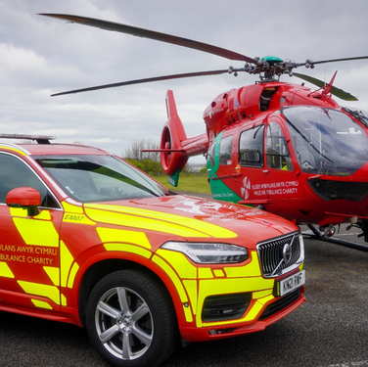

EMRTS Service Review
Where we are now...
We have looked at the facts, and have produced and made available online the following bilingual documents:
  Chief Ambulance Services Commissioner’s Report
  Chief Ambulance Services Commissioner’s Report - Plain Language version
  Phase 2 Frequently Asked Questions (FAQs)
To support these documents we have also developed:
  Supporting Document 1 - History of EMRTS
  Supporting Document 2 - Engagement - What We Did and What We Heard
  Supporting Document 3 - Picker Institute Report
  Supporting Document 4 - EMRTS Historical Data Information Pack
  Supporting Document 5 - Drive Time and Population Coverage
  Supporting Document 6 - Weather Data
  Supporting Document 7 - Optima Modelling
All of the documents are available on our website: https://easc.nhs.wales/engagement/sdp/
EMRTS Service Review
Engagement
Emergency Ambulance Services Committee

Slide 3

EMRTS Service Review
What happened in Phase 1
We explained how the EMRTS service works and the importance of the Charity
We explained why we were reviewing the service and why we need to make EMRTS better
We explained how you could ‘have your say’ in this process
This is further explained in Supporting Document 2 - Engagement What We Did and What We Heard and Supporting Document 3 - Picker Institute Report
Emergency Ambulance Services Committee

Slide 4
EMRTS Service Review
In Phase 1, I asked you...
  Have we thought about the right ways to make the EMRTS better?
  For comments on the proposed factors to help us evaluate options
  For comments on the weightings of the proposed factors
  For comments on the proposed model options that could be developed and
  For suggestions about other options that could be developed
I listened to all your comments, concerns, questions and suggestions
Emergency Ambulance Services Committee

Slide 5
EMRTS Service Review
In Phase 1, you said...
  You were concerned about the potential impact on responses
  You wanted clarity on the history of the service and unmet patient need
What I have done in response...
Historical information on response activity and time has been reviewed
This is further explained in Supporting Document 1 - History of EMRTS, Supporting Document 4 - EMRTS Historical Data Information Pack and Supporting Document 7 - Optima Modelling
Emergency Ambulance Services Committee

Slide 6
EMRTS Service Review
In Phase 1, you said...
  Use the most appropriate data for modelling
  Consider weather impacts
  Consider population variances
  Consider rural needs compared to urban needs
What I have done in response...
Used the most recent available data
Looked at new modelling that accounts for service developments, demand changes and weather
Produced a geographical and population review
This is further explained in Supporting Document 4 - EMRTS Historical Data Information Pack and Supporting Document 5 - Drive Time and Population Coverage
Emergency Ambulance Services Committee

Slide 7
EMRTS Service Review
In Phase 1, you said...
  Keep the proposed factors to help evaluate the options
  Adjust the proposed factor weightings for the options evaluation process
What I have done in response...
Kept the factors for the evaluation process and defined these in more detail
Increased the Clinical Skills and Sustainability factor weighting
Lowered the Value for Money factor weighting
This is further explained in Supporting Document 2 - Engagement -What We Did and What We Heard
Emergency Ambulance Services Committee

Slide 8
EMRTS Service Review
Factor Evaluation Reminder
Factor | Description | Proposed Weighting in Phase 1 | Agreed Weighting after Phase 1
Health Gain | To improve the quality of care and outcomes for patients in Wales | 25 | 25
Equity | To ensure that the whole population of Wales receive adequate and timely access to specialised pre-hospital critical care | 25 | 25
Clinical Skills and Sustainability | To retain and retrain our staff and enable them to utilise their skills to the top of their skill set and to attract and recruit the best people for our service | 15 | 20
Value for Money | To maximise efficiency…. Enabling the population to attain the highest possible level of health gain for the given level of expenditure* | 20 | 15
Affordability | To ensure the service delivered is able to operate effectively within the financial constraints of NHS Wales and Wales Air Ambulance Charity Trust | 15 | 15
Total | Total | 100 | 100
This is further explained in Supporting Document 2 - Engagement - What We Did and What We Heard
Emergency Ambulance Services Committee

Slide 9
EMRTS Service Review
In Phase 1, you said...
  Suggestions for other options to be developed
What I have done in response...
Modelled these suggested scenarios
This is further explained on page 37 of the Chief Ambulance Services Commissioner’s Report and in Supporting Document 7 - Optima Modelling
Emergency Ambulance Services Committee

Slide 10
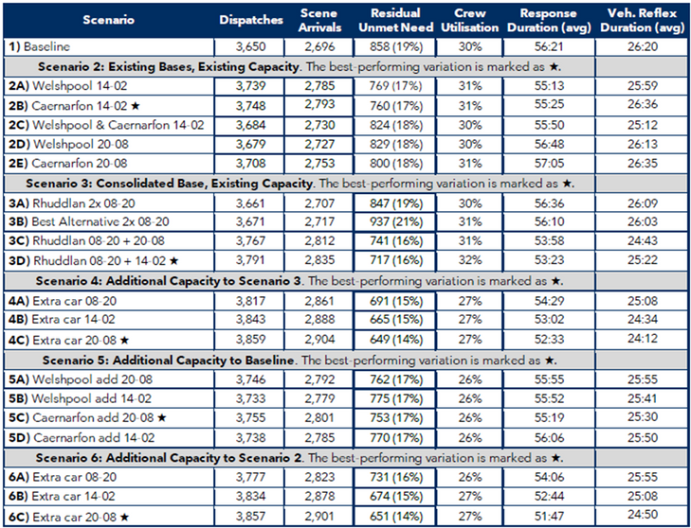
EMRTS Service Review
Modelled Results
The results show:
  Baseline
  Existing bases
  Having a new base in the centre of North Wales (by combining other bases)
  Additional ideas or scenarios informed by the engagement process
This is further explained on page 37 of the Chief Ambulance Services Commissioner’s Report and in Supporting Document 7 - Optima Modelling
Emergency Ambulance Services Committee

Slide 11
EMRTS Service Review
You also said...
  The importance of the Service and the high regard for the people who deliver it
  This is not just about numbers
  Risk of Charity losing money from donations
  Concern about broader Health and Care system issues
    Welsh Ambulance Services NHS Trust
    Primary and Secondary Care
    Health and Social Care
    Public Services
    Policy and Decision Makers
What I have done in response...
Shared this feedback at Committee Meetings and acknowledged it in the Chief Ambulance Services Commissioner’s Report
Emergency Ambulance Services Committee

Slide 12
EMRTS Service Review
In Phase 1, you said...
  Importance of transparent public engagement
What I have done in response...
Listened to your comments
Shared what we heard
Modelled suggested scenarios
Made information available
Emergency Ambulance Services Committee

Slide 13
EMRTS Service Review
It’s important that I now...
  Check what you told me
  Clarify any queries you may have
  Seek comments on Chief Ambulance Services Commissioner’s Report
Emergency Ambulance Services Committee

Slide 14
EMRTS Service Review
How to give your feedback...
As well as the meetings and drop-ins, you can share your comments by November 12, via:
Virtual/Online Public Meetings (details and links on website)
Post: ‘EMRTS Feedback’, EASC/NCCU, Unit 1, Charnwood Court,
Billingsley Road, Nantgarw, CF15 7QZ
E-mail: eascservicereviewqueries@wales.nhs.uk
Online Query Form: https://easc.nhs.wales/engagement/sdp/
Phone answer line: 01443 471520
You can read the full information in Welsh and English on the EASC website www.easc.nhs.wales
Request information in another language or printed, by e-mail or speaking to EASC team member
EMRTS Service Review
Engagement
Emergency Ambulance Services Committee

Slide 15
EMRTS Service Review
Next steps after Phase 2...
Then I will:
  Consider your feedback
  Evaluate the options using the factors
  Arrive at a recommendation and preferred option
  Make a recommendation to the Emergency Ambulance Services Committee (EASC)
  EASC will make a decision
Emergency Ambulance Services Committee

Slide 16
Chief Ambulance Services Commissioner’s Report
Emergency Medical Retrieval and Transfer Service
Service Review
Diolch / Thank you
Cwestiynau/Questions

