Slide 1


Emergency Ambulance Services Briefing
NWJCC
16 July 2024

Slide 2
Context 2023/24
423,365 calls to 999. Average of 35,000 a month
270,651 incidents received an attendance at scene. Average of 22,500 a month
53,898 Red Incidents. Average of 4,500 a month.
50.6% performance against the Red eight-minute target. 2,227 average a month.
179,832 incidents attended hospital via ambulance. Average of 15,000 a month
120,369 actual hours produced each month
8.59% sickness a month.
260,183 hours lost to handover. Average of 21,700 a month

Slide 3
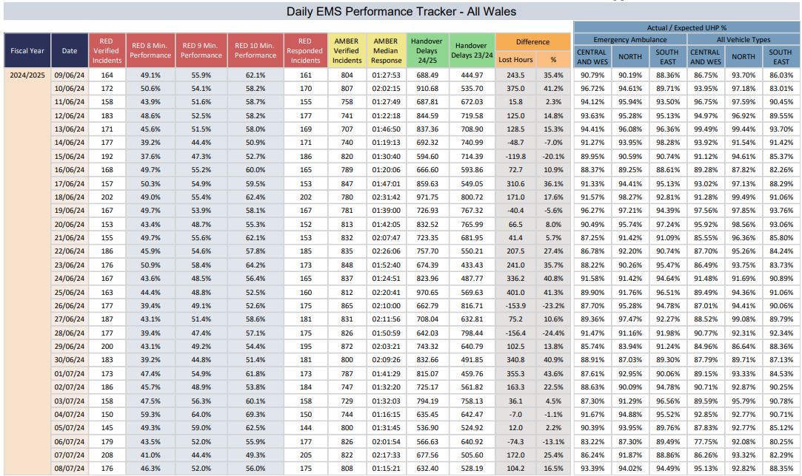
EMS Performance Tracker

Slide 5
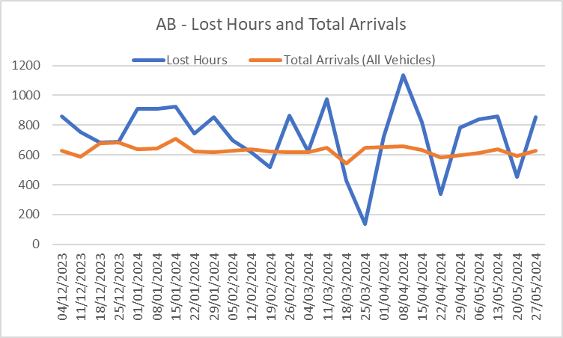
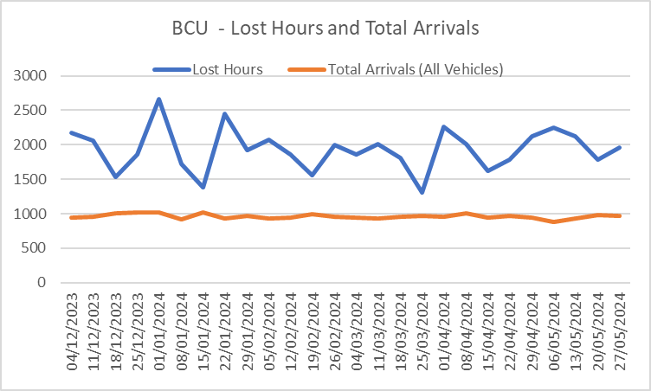
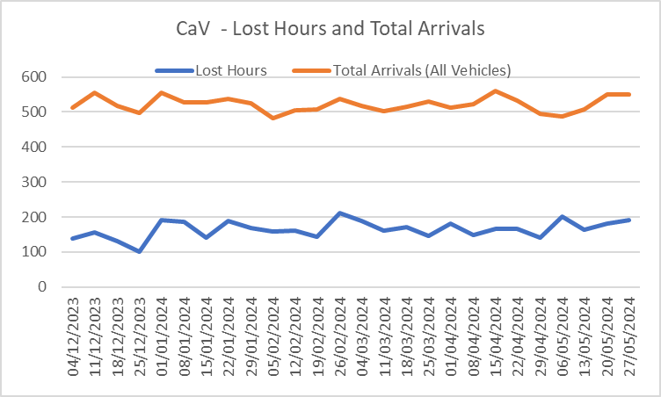
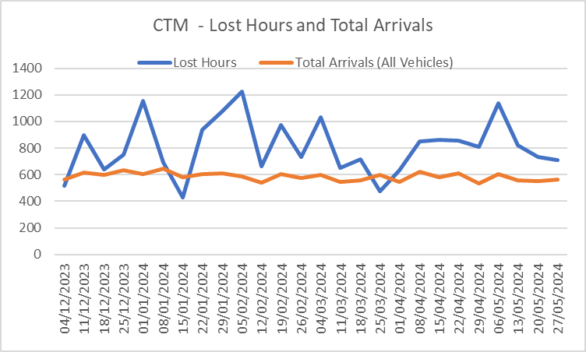
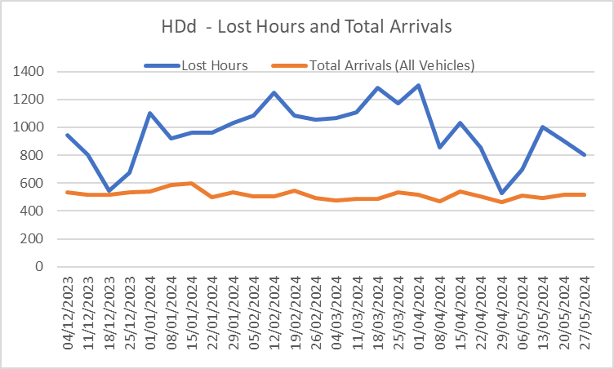
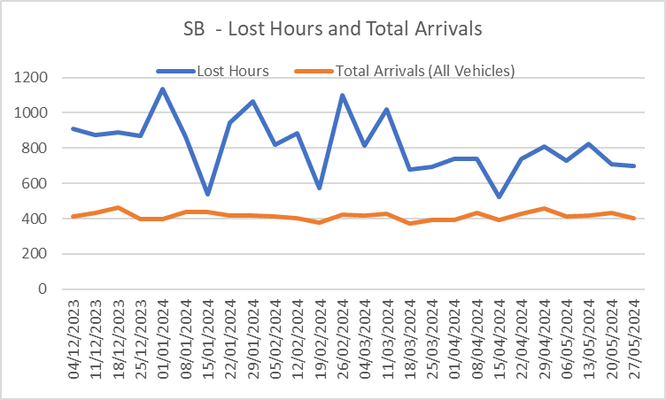
Lost Hours and Total Arrivals by Health Board

Slide 6
Top 10 conveyed by nature of condition
Condition | Incidents | Attended Scene | Conveyance | Conveyance Rate (attended/Conveyed)
BREATHING PROBLEMS | 48,036 | 37,696 | 26,103 | 69.2%
FALLS | 51,934 | 38,197 | 22,992 | 60.2%
UNKNOWN* | 37,919 | 32,209 | 21,605 | 67.1%
CHEST PAIN | 43,839 | 27,274 | 19,306 | 70.8%
HCP ADMISSION | 14,513 | 12,845 | 11,705 | 91.1%
SICK PERSON (SPECIFIC DIAGNOSIS) | 32,409 | 13,864 | 9,464 | 68.3%
UNCONSCIOUS/FAINTING (NEAR) | 23,554 | 14,592 | 9,191 | 63.0%
HAEMORRHAGE/LACERATIONS | 15,526 | 11,200 | 8,408 | 75.1%
CONVULSIONS/FITTING | 15,717 | 11,321 | 7,733 | 68.3%
STROKE (CVA/TIA) | 15,982 | 10,324 | 7,285 | 70.6%
*This relates to incidents reviewed by the clinical support desk as requiring a face to face ambulance assessment.

Slide 7
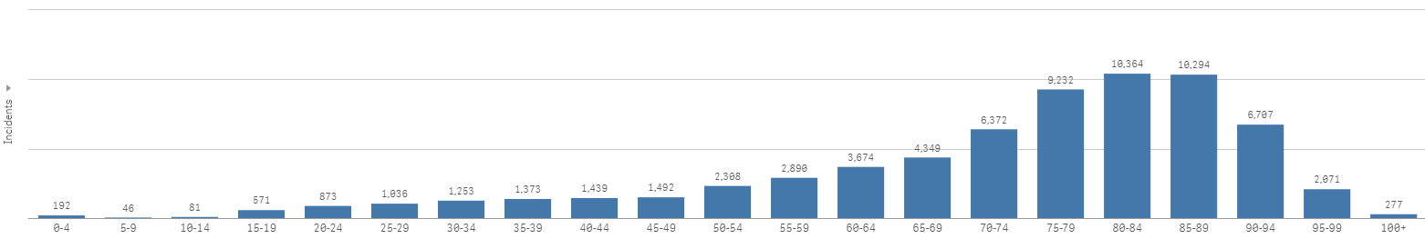
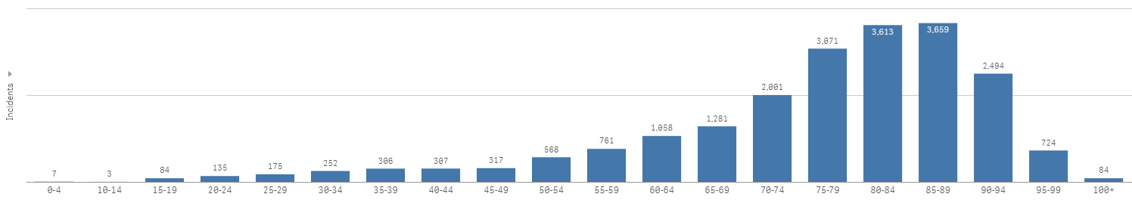
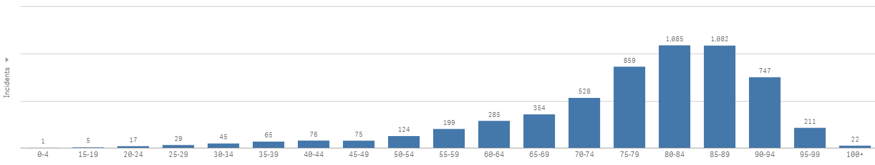
Lost Hours by Age Profile 2023
  Over 60 min
  Over 4 Hours
  Over 8 Hours

Slide 8
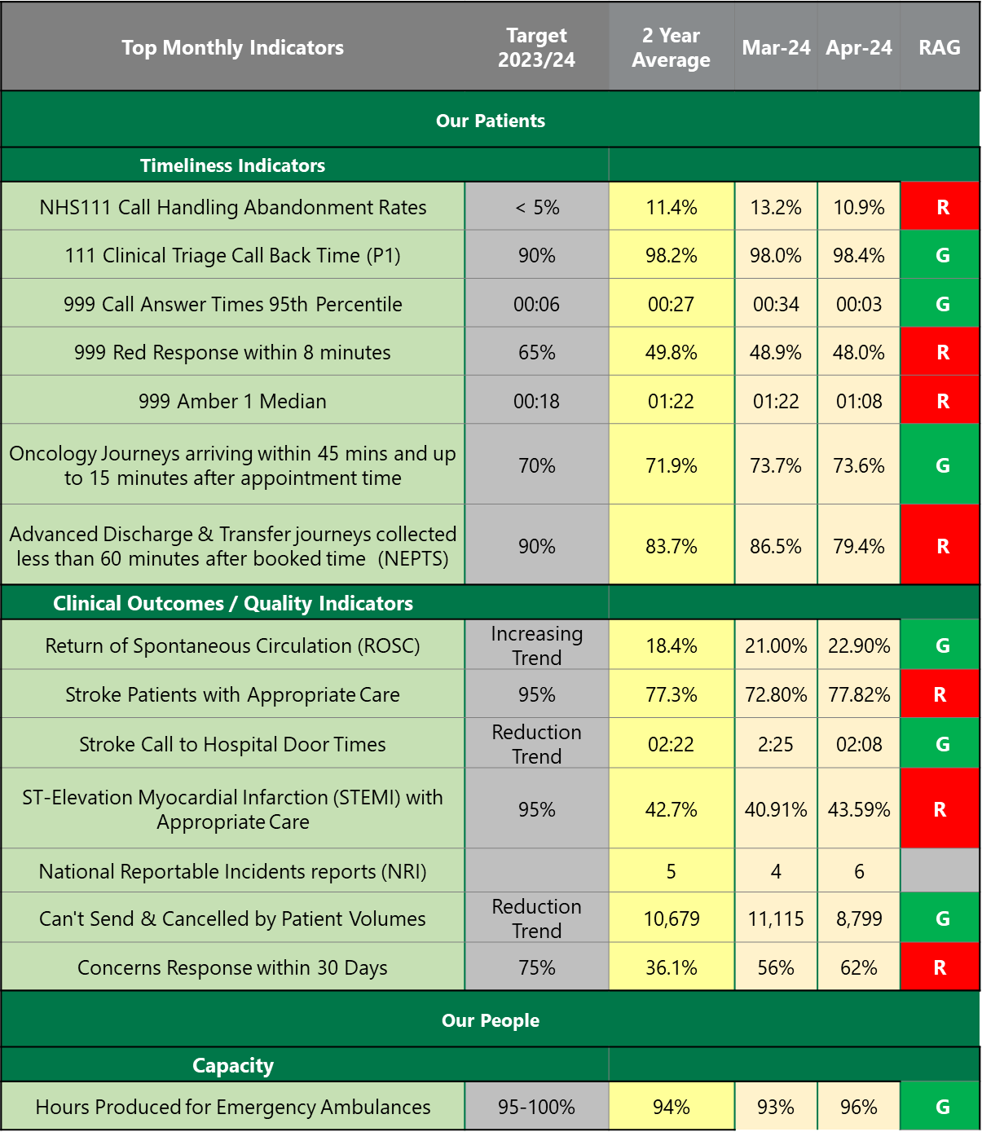
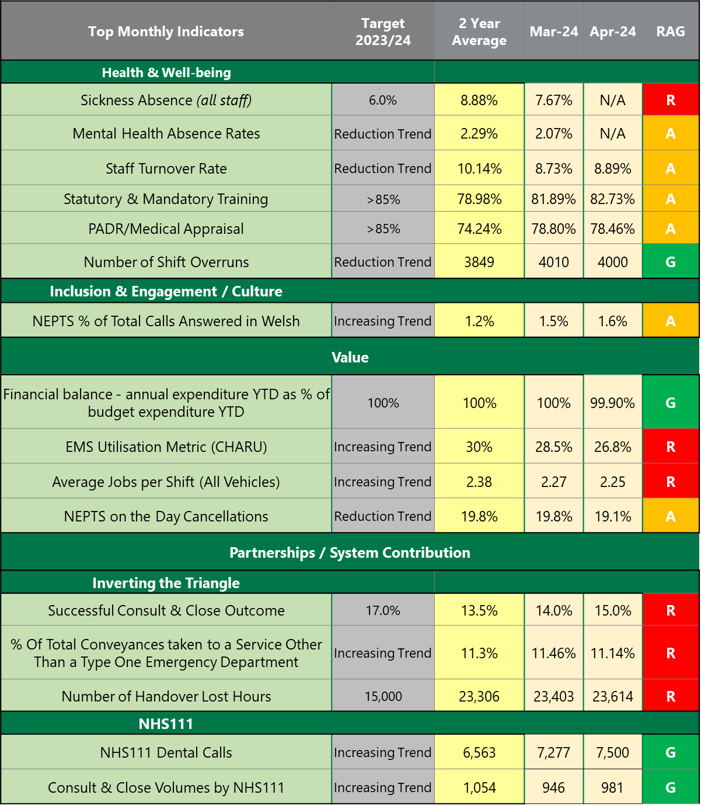

Section 1: Monthly Indicators / Top Indicator Dashboard
In-Month RAG Indicates =
Green: Performance is at or has exceeded the target (Indicates no action is required)
Amber: Performance is at or within 10% of target (Indicates some issues/risks to performance (monitoring is required))
Red: Performance is less than 10% of target (Indicates close monitoring or significant action is required)
TBD: Status cannot be calculated (To Be Determined)
Welsh Ambulance Services University NHS Trust

Slide 9
Performance Plan - Actions
The Trust provided a detailed report for the 20 Jun-24 Interim Ambulance Commissioning Group, which sets out actions taken to date and further planned actions for 2024/25.
As described in our IMTP, actions continue in relation to improving response times and reducing avoidable harm, including
  CHARU recruitment (currently at 73%) and effectiveness
  recruitment to commissioned levels and reduction in sickness absence
  focus on mobilisation times and time on scene.
However, modelling demonstrates that these will not be sufficient and therefore we are focused on rapid evolution of the clinical response model including
  rapid clinical screening;
  delivering appropriate pathways irrespective of access point (including a single DOS);
  Increased numbers of patients managed safely at home through remote clinical assessment, alternative face to face response capacity (APPs and mental health response) and
  improved health board referral pathways (ICAPs re-commencing)
Performance Plan
Welsh Ambulance Services University NHS Trust

Slide 10
Extract from IMTP 2024/27
For 2024/25, performance expectations will be introduced that are aligned to health board’s performance improvement levels. With ambulance handover delays being the single greatest factor in emergency ambulance performance, ambulance performance outcomes will be modelled and forecasted against ambulance handover delay levels.
This more sophisticated approach to the development of ambulance performance expectations, will provide the Committee with a clear understanding of the achievable ambulance performance outcomes against varied levels of ambulance handover delays.
Performance Expectations
Ambulance performance outcomes for 2024/25 will be based on the forecasting and modelling assumptions that:
Scenario 1
No reduction in ambulance handover delays handover
WAST to deliver within 2024/25 financial allocation as per WASTs 2024/25 IMTP.
Scenario 2
Reduction in handover as per the 2023/24 emergency ambulance services demand and capacity modelling
WAST to deliver within 2024/25 financial allocation as per WASTs 2024/25 IMTP.
Scenario 3
No ambulance handover delay waits over 1 hour
WAST to deliver within 2024/25 financial allocation as per WASTs 2024/25 IMTP

Slide 11
The Integrated Commissioning Actions Plans (ICAPs) are a mechanism for the development of collaborative actions between health boards and WAST, which will directly or indirectly impact on ambulance performance.
To reduce duplication and to ensure alignment of workstreams, the ICAPs have been aligned to the priorities of the Six Goals Programme for Urgent and Emergency Care.
The table below shows the number of actions being taken by each health board, aligned to the priorities of the Six Goals Programme.

Slide 12
Some Potential Questions / Issues
Important to look through the lens of Duty of Quality and Harm Reduction
Do we introduce greater scrutiny?
Are we measuring the right things?
Have we got the right balance between “core service delivery” and whole system transformation?
Do we focus on red?
Is it time to refresh the clinical model?
How do we benefit from 111 and 999 closer collaboration?
What will the impact of the governance review bring?

Slide 13
Further reference information

Slide 17
Commissioning Intention – CI4: Value
The Emergence Ambulance Service and its Commissioners will develop a value-based approach to service commissioning and delivery, which enables an equitable, sustainable and transparent use of resources to achieve better outcomes for patients.
Commissioning Statement
Value is created when we achieve the best possible healthcare outcomes for the Welsh population with the most efficient and effective use of available resources. We also recognise that value can be depleted and therefore the development of a value-based strategy will need to identify ways to effectively manage and mitigate the risks of value depletion in addition to identifying opportunities for value creation.
Aims
CI4-A1 | Value-Based Healthcare for the Welsh Ambulance Service Building on the engagement already undertaken, develop and embed a value-based approach for the Welsh Ambulance Service which enables better collective decision making across the whole urgent and emergency care system and accounts for WAST’s use of, and impact on, economic, social and environmental resources over the short, medium and long term. This will include: Development of WAST’s strategy and approach to Value-Based healthcare which links outcomes, patient experience and use of resources Implementation of a costing model for “5 step” pathway Improvement in ability to identify areas of unwarranted variation in service delivery across Wales
Products
CI4-P1 | Value-Based Strategy The Trust will develop a strategy to implement a value-based approach across the organisation and outline its role in delivering value across the wider UEC system. The value-based strategy will be integrated with and align to existing organisational strategies (e.g. clinical, quality, long term, digital, environmental etc) and the Commissioning Intentions outlined in this document in order to ensure goal congruence.
CI4-P2 | Value-Based Tools and Methods In order to monitor and measure value-based performance, the Trust will need to design, develop and implement a range of tools including, but not limited to, the following: Patient Level Costing Model Benchmarking Dashboard(s)
CI4-P3 | Value-Based Reporting WAST will enable a clear line of sight from commissioner allocation through to utilisation and the outcomes delivered by the services. WAST will holistically demonstrate through its reporting all separate revenue streams and associated costs of broader service provision (e.g. 111, NEPTS etc.). WAST receives a capital allocation directly from Welsh Government. The utilisation of the capital budget and the use of the ring-fenced depreciation allocation will need to be clearly identified in any report. As a result, WAST will be able to demonstrate how its capital allocation is being invested to deliver on the commissioning intentions.
Indicators
CI4-I1 | Value-Based Core Requirement to be agreed with Commissioner by the end of quarter 2: WAST Value Based Strategy Plan for Value Based Tools and Methods design, development and implementation Value Based Reports developed for revenue and capital Value-Based indicators developed in line with broader indicators outlined in CI1 to CI5 Connections to system-wide urgent and emergency care performance measures as identified in CI6 – Wider Health System

