Slide 1



Quality and Safety Dashboard
EASC Meeting 21 Dec 2023
Latest Data Loaded:
October 2023
HTTPS://EASC.NHS.WALES
CTM_CASC_EASC@WALES.NHS.UK

Slide 2
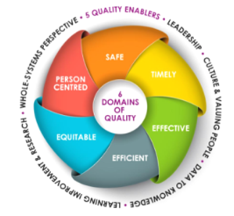
Purpose
The Duty of Quality
The Committee has a responsibility to support the delivery of Emergency Ambulance Services, and therefore must do so with a view to securing improvement in the quality of the services provided.
The Duty of Candour
The Committee has a responsibility to ensure Emergency Ambulance Services are identifying and learning from incidents that have caused harm and supporting the development of initiatives to stop similar incidents from happening again.
The purpose of this report is to ensure both requirements are addressed and to inform the Committee of progress in improving quality of Emergency Ambulance Services.
HTTPS://EASC.NHS.WALES
Quality Report
CTM_CASC_EASC@WALES.NHS.UK

Slide 3
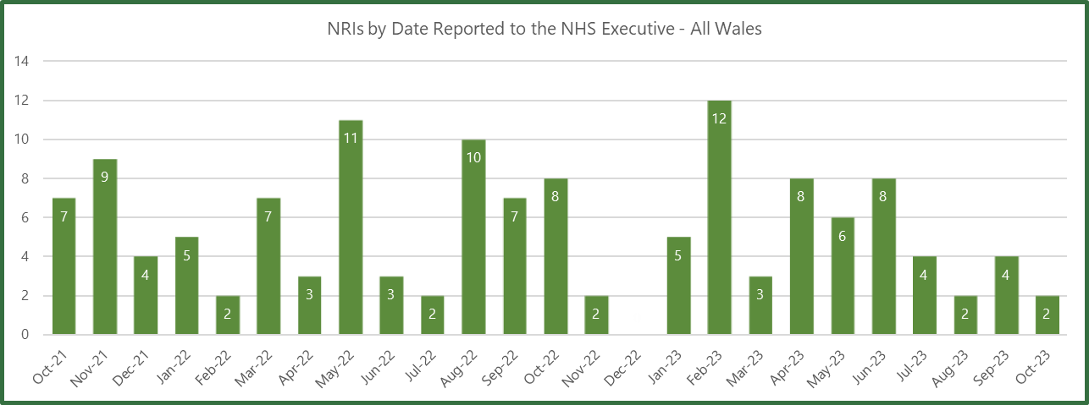
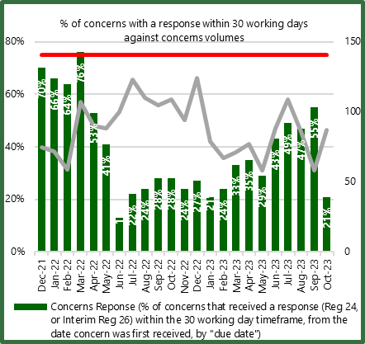
Safe Care
A system level focus on commissioning and ensuring sufficient levels of resource availability to provide safe services.
Themes: 'delayed community response' and 'call categorisation'.
Immediate improvement actions
Education of individual staff,
Updates to Standard Operating Procedures,
Circulation of bulletins
HTTPS://EASC.NHS.WALES
Quality Report
CTM_CASC_EASC@WALES.NHS.UK

Slide 4
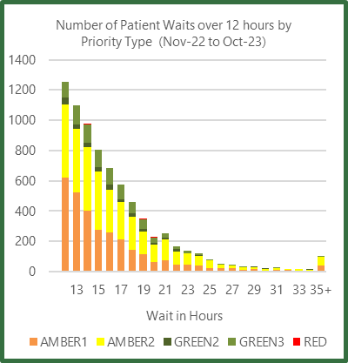
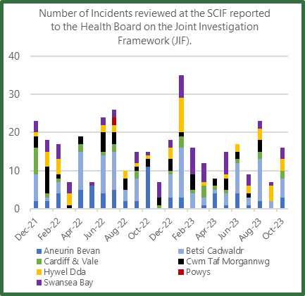
Safe Care
A system level focus on commissioning and ensuring sufficient levels of resource availability to provide safe services.
Joint Investigations
In October, WAST identified 16 Joint Investigations and there was one referral from a health board into WAST under the Joint Investigation Framework.
Themes
Delay in raising concern
Lack of clinical input
HTTPS://EASC.NHS.WALES
Quality Report
CTM_CASC_EASC@WALES.NHS.UK

Slide 5
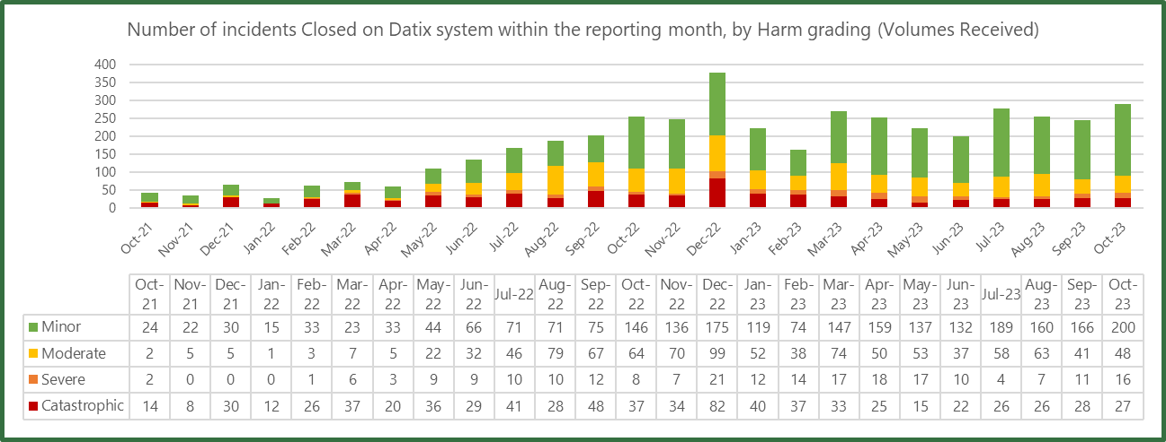
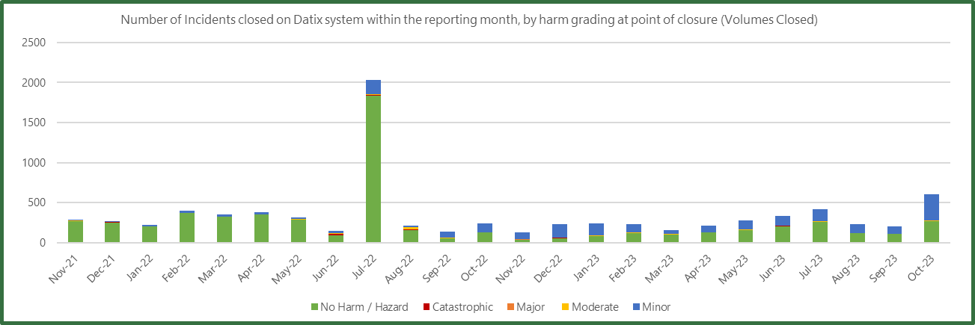
Safe Care
A system level focus on commissioning and ensuring sufficient levels of resource availability to provide safe services.
All patient safety incidents graded moderate or above will continue to be reviewed by the Patient Safety Team, who will consider the requirement to enact the Duty of Candour (2023) and contact patients and families.
HTTPS://EASC.NHS.WALES
Quality Report
CTM_CASC_EASC@WALES.NHS.UK

Slide 6
Safe Care
A system level focus on commissioning and ensuring sufficient levels of resource availability to provide safe services.
Coroners: The number of in month requests continues to be higher than pre-pandemic.
The pre-pandemic financial year saw 244 cases in 2019/2020.
Last financial year - 450 requests received.
HTTPS://EASC.NHS.WALES
Quality Report
CTM_CASC_EASC@WALES.NHS.UK

Slide 7



Timely Care
Commissioning services to provide a response within timescales that contribute to improving clinical outcomes and patient satisfaction
Red
There were 4,828 incidents categorised as Red, 2,277 arrived within 8 minutes
NEPTS
80% of calls were answered within 60 seconds,
3.8% of calls were abandoned before answering.
74% of core journeys arrived within 30 minutes of their appointment time.
79% of discharge & transfer patients were collected in less than 60 minutes after their booked ready time.
Amber (1&2)
There were 15,618 incidents categorised and responded as Amber.
Green (2&3)
There were 1,364 incidents categorised and responded as Green.
HTTPS://EASC.NHS.WALES
Quality Report
CTM_CASC_EASC@WALES.NHS.UK

Slide 8
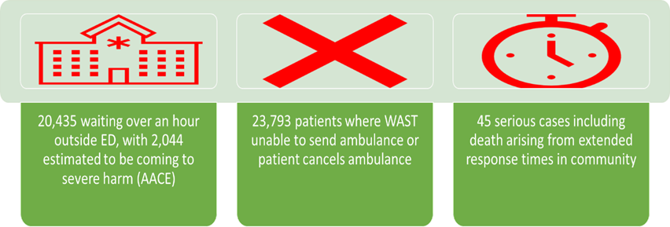
Timely Care
Commissioning services to provide a response within timescales that contribute to improving clinical outcomes and patient satisfaction
Extended waits in an ambulance outside hospital. AACE audit found 9% of patients waiting over 1 hour came to severe harm
Patients cancelling their ambulance or WAST unable to send at times of high escalation
Long response times in the community
Data period Apr-Jun 23
3,850
Ambulance
HTTPS://EASC.NHS.WALES
Quality Report
CTM_CASC_EASC@WALES.NHS.UK

Slide 9
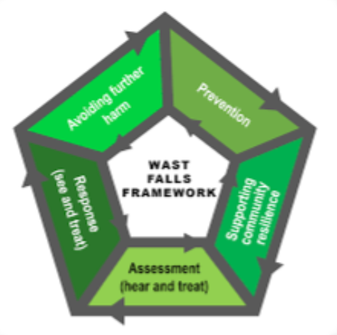
Effective Care
Commissioning services to do deliver care to the right call, at the right time, with the right response.
Falls - The biggest reason for a 999 call in October
287 patients were treated for a fractured hip.
204 patients received the appropriate care bundle
71.1% compliant
CVA (Stroke) and TIA (transient ischaemic attacks)
There were 415 patients identified as a potential CVA or TIA and 317 received the appropriate care bundle (76.4%)
Whilst this report details patients who have been treated for a fractured hip and stroke patients, future reports will explore other clinical outcomes.
Return of Spontaneous Circulation (ROSC)
In August
There were 4,828 incidents categorised as 'Red'.
Of these, 293 people had resuscitation attempts started on them
Of that 50 people arrived at hospital with a return of spontaneous circulation (50/293 = 17.1% ROSC).
HTTPS://EASC.NHS.WALES
Quality Report
CTM_CASC_EASC@WALES.NHS.UK

Slide 10
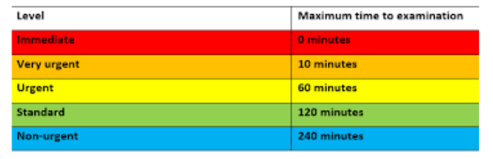
Efficient Care
Commissioning services to do deliver prudent, value based care
Patients who are triaged as Red (or category 1) are considered to be very unwell and are usually patients requiring resuscitation.
What makes a patient a Red / category 1?
Stridor
Airway Compromise
Shock
Inadequate breathing
Unresponsive
Drooling
Currently fitting
Exsanguinating haemorrhage
Chemical eye injury
Unresponsive child
Hypoglycaemia less than 3
Prolapsed umbilical cord
Presenting fetal parts
Acuity of patients arriving at ED
Manchester triage is a clinical risk assessment and management tool which is used to help identify the priority in which patients need to be seen.
In September, 314 patients self presented to type 1 ED's that were triaged as a Red/ Category 1. These patients required immediate medical attention and may have benefitted from ambulance intervention.
HTTPS://EASC.NHS.WALES
Quality Report
CTM_CASC_EASC@WALES.NHS.UK

Slide 11

Patient Centered Care
Commissioning services to do deliver care that is culturally embedded and supported by a common approach to assessing and managing peoples needs.
Opportunities for learning
Monitoring response to complaint times
Delayed community response – have all opportunities been explored?
Call categorisation – How will this be monitored?
End of Life- How are these patients identified?
Await outcome of review of Red incidents
How do we improve care for older people?
Analysis of patients conveyed by ambulance presenting at ED
Capture patients that were advised to attend ED by another service
Benefits and outcomes for patients that received a specialist response from either an Advanced Paramedic Practitioner or a Falls vehicle.
HTTPS://EASC.NHS.WALES
Quality Report
CTM_CASC_EASC@WALES.NHS.UK

Slide 12
Emergency Ambulance Services Committee
HTTPS://EASC.NHS.WALES
CTM_CASC_EASC@WALES.NHS.UK

