Slide 1

Welsh Ambulance Services NHS Trust
Demand and Capacity Review
Chris Polden
23 July 2019

Slide 2












Examples of ORH Global Experience

Slide 3
Context
Demand on ambulance services is changing. As the population ages demand rates are increasing but the type of patients responded to are also changing.
In October 2015 WAST introduced a new Clinical Response Model (CRM).
The CRM is being constrained by the current resource and staff skill mix, with only 72.5% of patients receiving an ideal response (an increase from 60% in 2015).
While the CRM was found to be valid and safe by an EASC review in 2018, some Amber patients are waiting too long for a response, with ambulance availability being highlighted as the overriding factor (Amber Review).
Demand is increasing and exhibits large seasonal variations, which current shifts do not account for.
Notes:
The aim of the COM is to move the focus of WAST from a service delivery model based on fast response to a large proportion of patients to a model that delivers the most appropriate response to each patient while still maintaining a quick response to life threatening conditions.

Slide 4
Review Aims
WAST and Commissioners require an independent consultant to work with them to:
  Forecast incident demand over the next 5 years.
  Agree the required level of quality and time performance for each type of patient.
  Model the resources needed to achieve these levels of time and quality assuming current operations.
  Identify WAST efficiencies and the impact these will have on the staffing required.
  Identify unscheduled care system efficiencies and the impact these will have on the staffing required.
  Model the impact of planned service changes and their impact on patient flows.
  Model the resources required for call handling clinical staff and dispatch in the clinical contact centres.

Slide 5
Review Overview: Response
Data Collection and Analysis
WAST data collected and checked.
Current service profile analysed.
Demand projections calculated.
Benchmarking to identify potential efficiencies.
Model Setup and Initial Baselining
Data analysed to create model inputs.
Simulation model set up and validated.
Initial baseline runs (impact of demand, planned service changes) carried out.
Efficiency Testing and ‘Optimum’ Position
Identified efficiencies tested individually and appraised.
Selected efficiencies modelled to create ‘efficient’ or ‘optimum’ baseline trajectories.
Bridging the Shortfall
Model options for bridging any remaining shortfall.
Additional resources, new locations, CPs, Defibs, CFRs.
Notes:
Four step process

Slide 6
Review Overview: CCC’s
Data Collection and Staff Interviews
Visit CCCs to observe and conduct staff interviews.
Recommendations for team configurations, balance of roles and control room structure.
Data Analysis
Data analysed to understand demand profile, call flows and call answering/making performance.
Call Taker and Triage Modelling
Set up the call taker and triage models, and validate.
Incorporate demand projections from operations stream, and identify call taker and triage desk requirements in future years.
Dispatch Desk Modelling
Incorporate resource numbers in future years from operations stream.
Create dispatch desk boundaries based on analyses of vehicle flow, patient flow and resource numbers per desk.
Notes:
Four step process

Slide 7
Data Collection and Analysis
Operational data analysis
  demand, resources and resource use, standards, operational parameters
  analysis outcomes used to build model
Call taking analysis
  call times/frequencies and call handler utilisation
  outcomes used to build models for call taking and triage
Benchmarking analysis
  for a range of operational inputs/outputs comparisons
  to inform WAST efficiency options for modelling future
Demand projections
  age/gender demand rates to 2025 population
  to then be used in future trajectory model runs

Slide 8
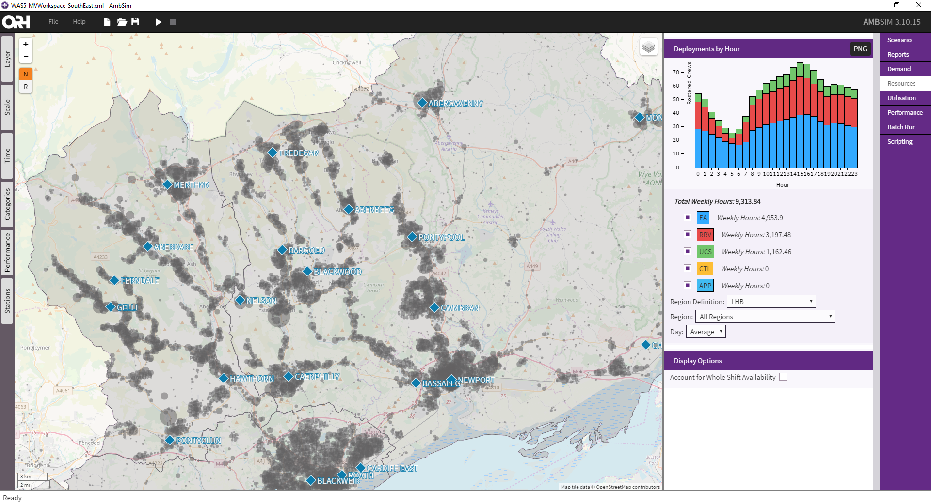
Model Set up and Initial Baselining
AmbSim is a Discrete Event Simulation model, which models the full incident life-cycle.
Notes:
What do we mean by a model…

Slide 9
Modelled Incident Life-cycle
AmbSim simulates the entire life-cycle of emergency incidents.
Incidents are generated within the model according to the times/locations analysed. Vehicles within the model respond based on proximity to the incident, availability and dispatch protocols.
Incident Generated
Closest Appropriate Response Determined
Response Sent and Arrives at Scene
Travel to Hospital
(Optional)
Vehicle Free
Returns home, or responds to another incident
Taking account of:
Geographical distribution of incidents
Frequency of calls by time of day
Separately by category of call
Taking account of:
Response protocols
Vehicle activation times
Travel times
Vehicle availability
Taking account of:
Average time on scene depending on vehicle and incident type
Probability that patient can be treated on scene, and not taken to hospital
Taking account of:
Travel times/Hospital locations
Patient clinical profile determines appropriate destination hospital
Turnaround times at hospital
Transfer profile
The above happens over and over again, until many years of ‘simulated time’ (and thousands of incidents) have been simulated.

Slide 10
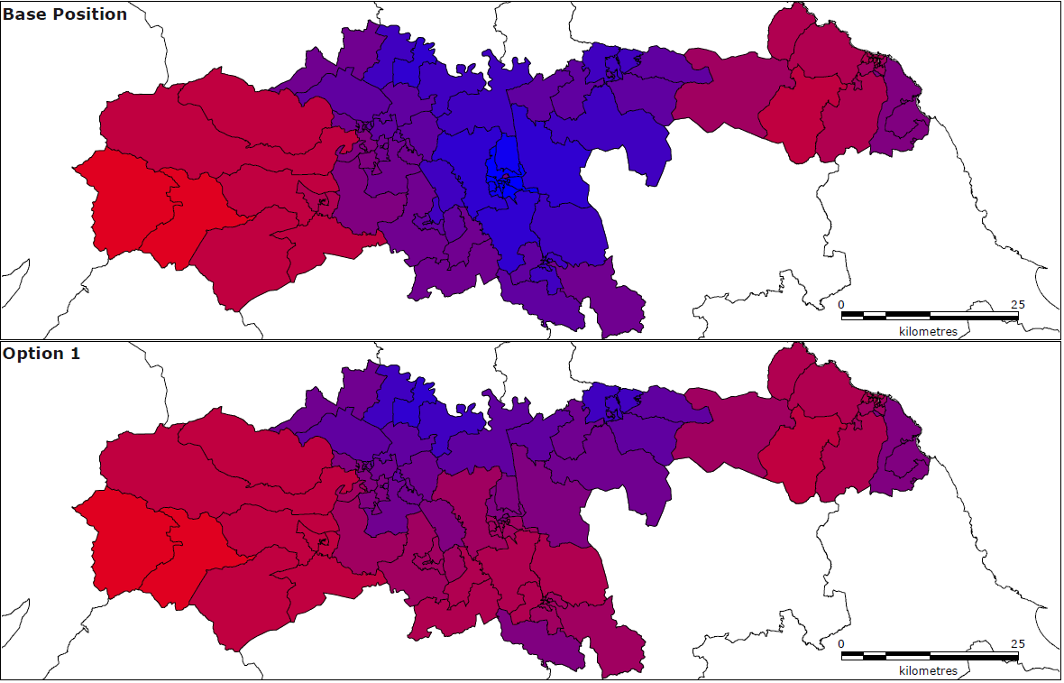
Strategic Configurations
Planned Service Changes Affecting Patient Flows

Slide 11
Performance Options
ORH to put forward options for difference response standards based on experience in the UK and overseas.
Where possible, to supply clinical evidence or context for these standards.
WAST to put forward options based on internal clinical input.
ORH to model high level resourcing requirements for each of the agreed options to compare the costs against patients benefits.

Slide 12
Efficiency Testing and Optimal Position
Identify potential efficiencies through benchmarking and consultation with Steering Group
Model efficiencies independently and report impacts to Steering Group
Agree efficiencies to be combined and incorporated

Slide 13
Bridging the Shortfall (example)

Slide 14
Project Team
Chris Polden
Project Manager
Jon Mobbs
Quality Assurance
Hannah Mayes
Project Consultant
Analysis
Andrew Greggan
Project Consultant
Modelling
James Batchelor
Project Consultant
Control
Gill Mason
Analytical Specialist
David Lundqvist
Analytical Consultant

Slide 15
Review Timetable
 | Week No | 1 | 2 | 3 | 4 | 5 | 6 | 7 | 8 | 9 | 10 | 11 | 12 | 13 | 14 | 15 | 16
 | Week Commencing | 17-Jun | 24-Jun | 01-Jul | 08-Jul | 15-Jul | 22-Jul | 29-Jul | 05-Aug | 12-Aug | 19-Aug | 26-Aug | 02-Sep | 09-Sep | 16-Sep | 23-Sep | 30-Sep
a) | Data Collection
b) | Data Analysis |  | Model Set-up and Current Service Profile
c) | Benchmarking
d) | Demand Projections
e) | Model Setup and Validation
f) | Operational Scenario Modelling
g) | Control Scenario Modelling
h) | Stakeholder Engagement
 | Reporting |  |  | Progress Report 1 |  |  | Progress Report 2 |  |  |  | Interim Report |  |  | Draft Results Report |  | Final Report

Slide 16
Discussion

Slide 17
Demand Projection Approach
Historic age/gender profile of historic incidents (2011-2019).
Combine
Population data
(2011 to 2019).
Calculate demand rate per head of population:
By year
By age/gender group
By LHB
Linear
Forecast
Forecast 2025 demand rates per head of population based on historical trends.
2025 Demand Forecasts by LHB.
Population projections for 2025.
Combine

