Slide 1

EASC Meeting July 2020

Slide 2
EMRTS Summary
Activity
COVID 19 period modifications / activity
24 Hour Service Expansion
Critical Care Transfer Service

Slide 3
ACTIVITY (Jan- June)
Sharp decline from normal activity - end March / April
Now recovered to higher than normal levels of activity
Increased road response and conveyance (twilight RRV and air restrictions)

Slide 4
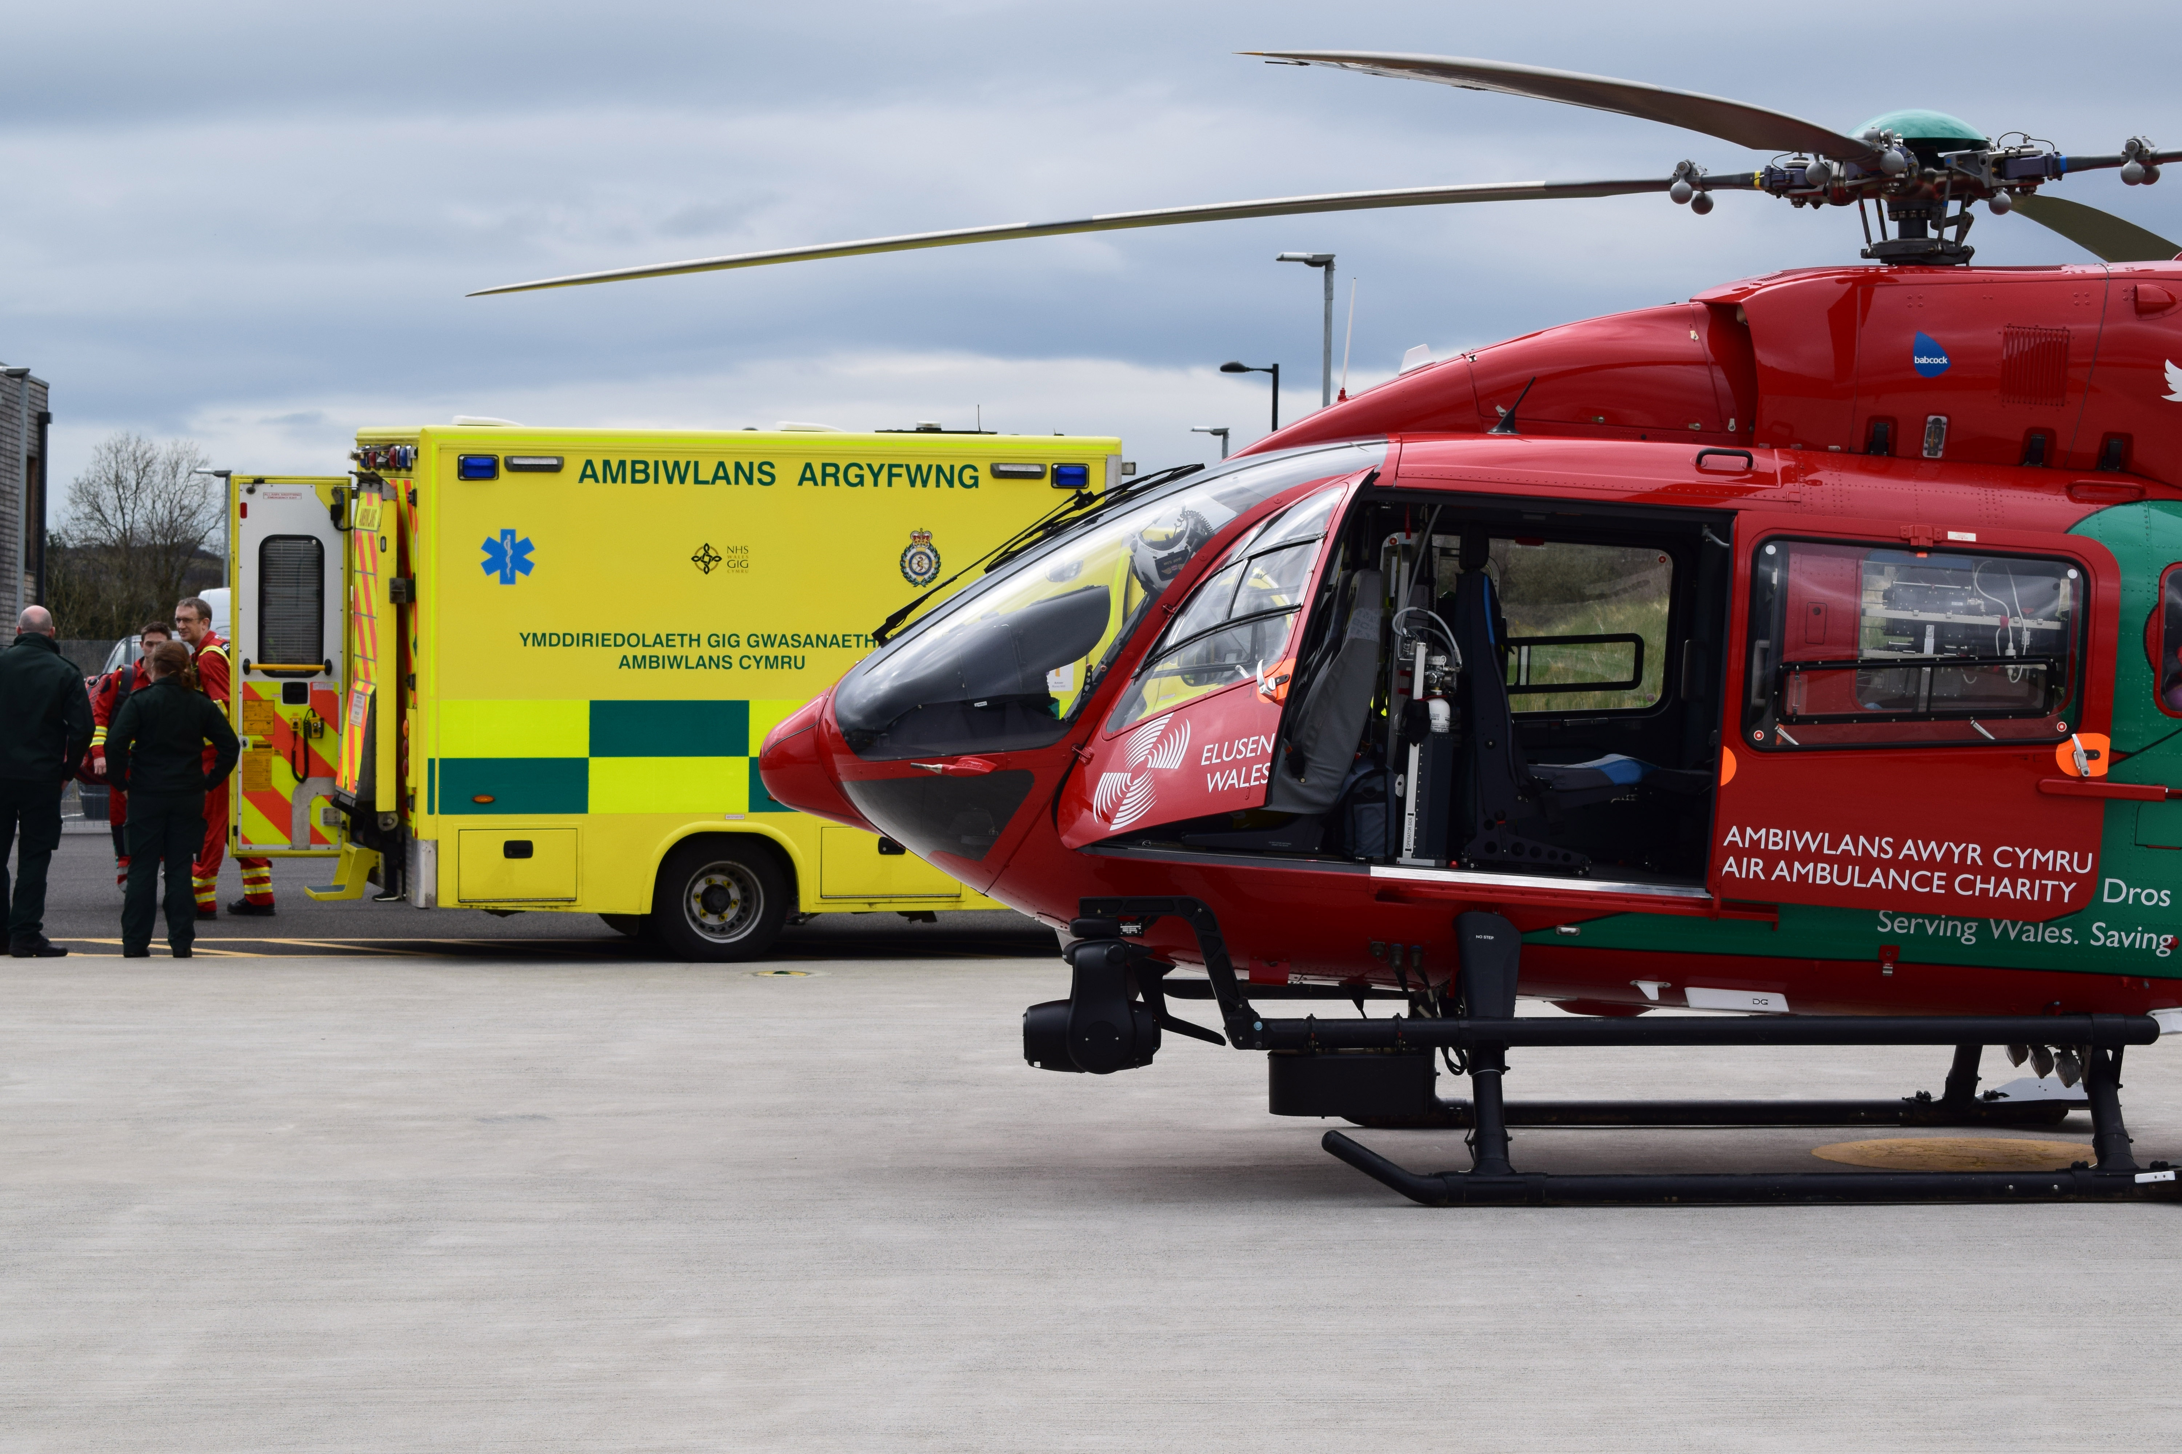
Activity
Response during period: 60% road: 40% air (usual 30% road: 70% air)
Missions - 93% primary : 7% secondary transfer
Trauma : Medical 50:50 split (normal)
63% of patients transported to hospital (73% with EMRTS escort)

Slide 5

COVID-19
COVID-19 escalation plan developed
Working practices / PPE / flying restrictions
Staff availability impacted by:
  staff illness,
  self-isolation and
  recall of EMRTS Consultants (particularly intensivists) to host HB
Remaining staff worked more or flexibly to fill gaps
All key aspects of commissioned EMRTS service maintained

Slide 6
Co-ordination for information / practice modification and mutual aid
Wales Critical Care Network
England Critical Care Network
Wales Trauma Network
National Trauma Networks Group
Air Ambulance National Group

Slide 7
Severe escalation plan (not required)
Service reduction
Assistance to overwhelmed hospitals with team to mobilise to hospital assist with stabilisation and ventilation of patients then transfer to less affected hospitals

Slide 8
Support to wider NHS Wales community:
    2 Air Support Desk staff released back to support WAST
    EMRTS CCPs and HTPs undertook further ITU training at Neville Hall and Morriston Hospitals to provide support in case of a surge in demand
    EMRTS Patient Liaison Nurse returning to support her previous department within AB UHB’s CCU

Slide 9
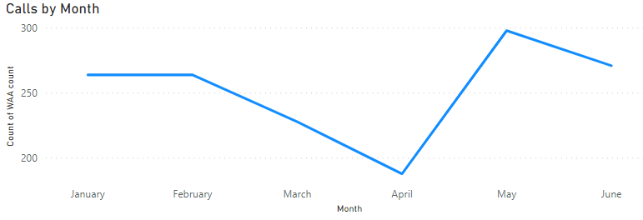
Activity reduced by 30-40% (in line with other UK AA services

Slide 10
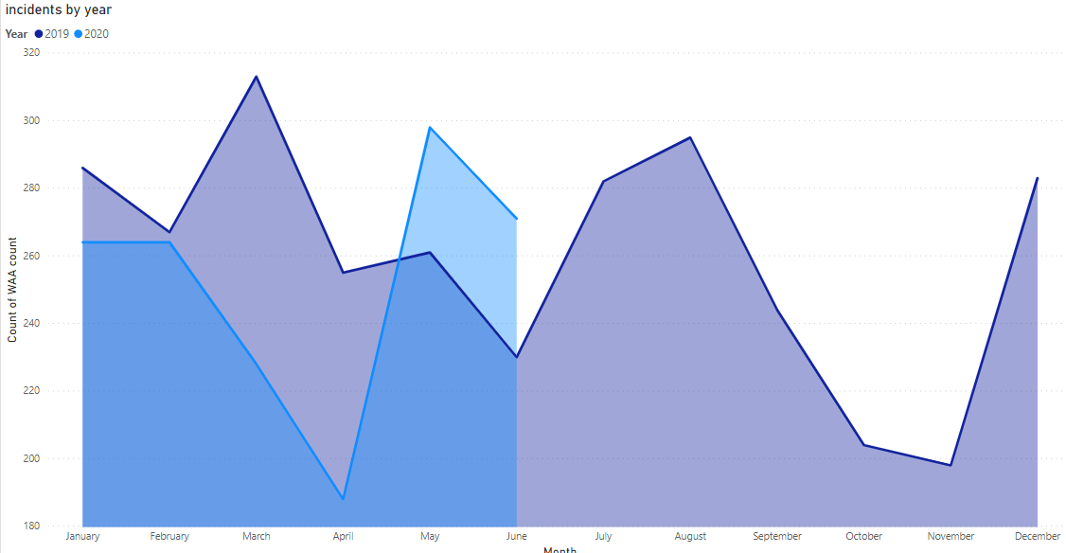
Comparison of annual activity

Slide 11
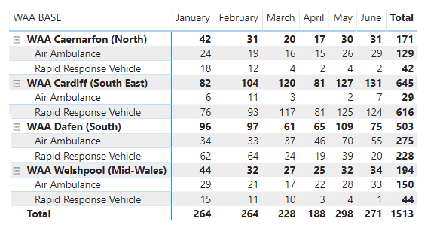
Monthly activity (base, response mode)

Slide 12
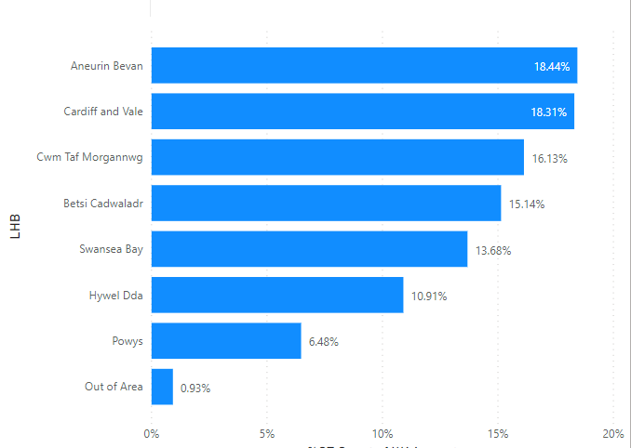
Incidents per HB

Slide 13
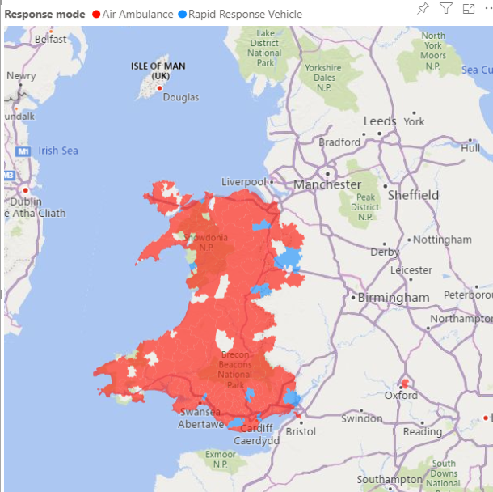
Activity map by post code

Slide 14

Twilight RRV
Winter pressure funding: December 2019 - March 2020, 14:00-02:00.
64 duty shifts, staffed by EMRTS Consultant / CCP
203 calls / Average 3.2 calls / shift
Cardiff & Vale most calls (85)
94% calls outside hospital (e.g. patient’s home / scene of RTC)
Only 13 calls (6%) required secondary transfer to another specialist facility
Air Support Desk staffed by Allocator or Clinician

Slide 15
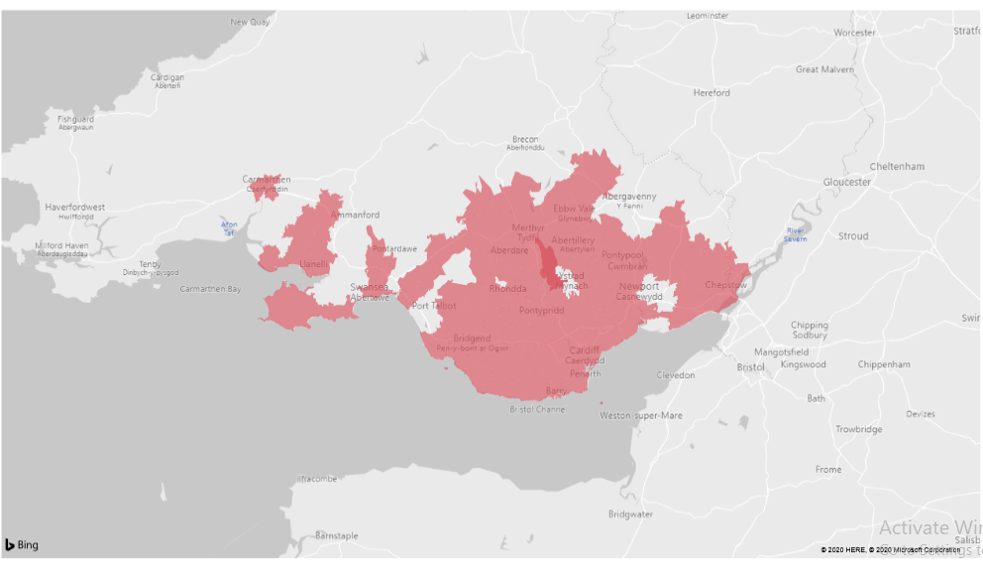
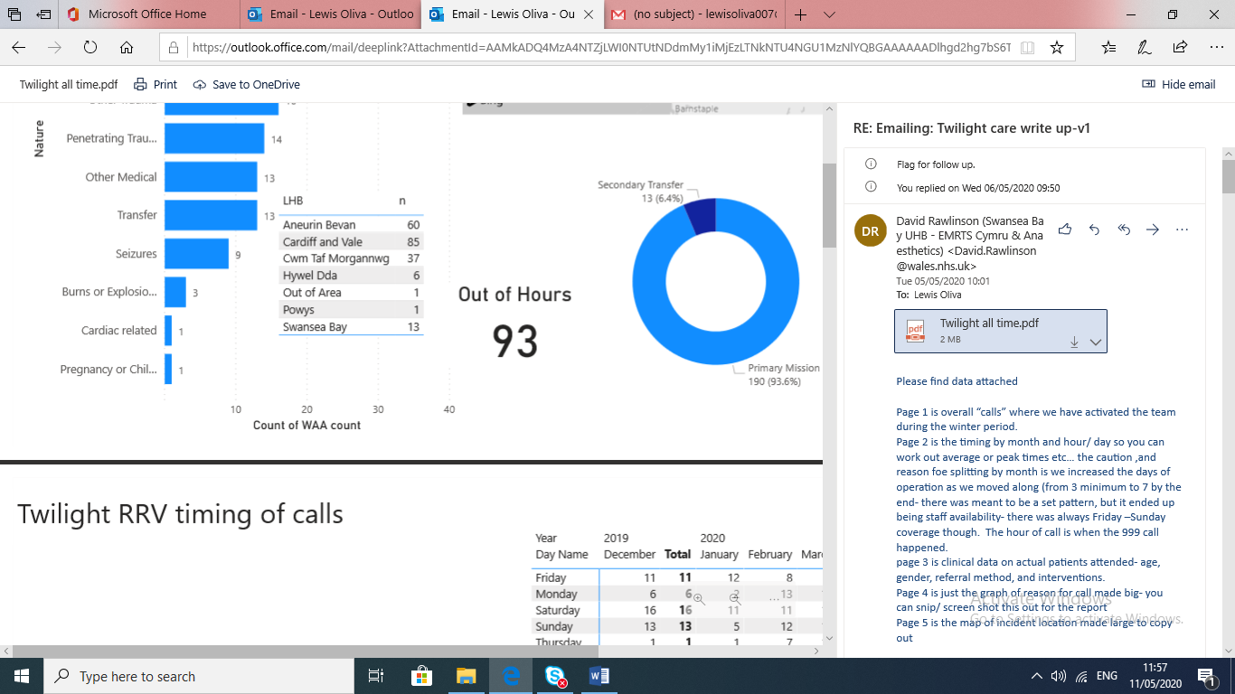
Twilight RRV
Indication of the areas covered by Twilight RRV and number of calls made by each Health Board:

Slide 16
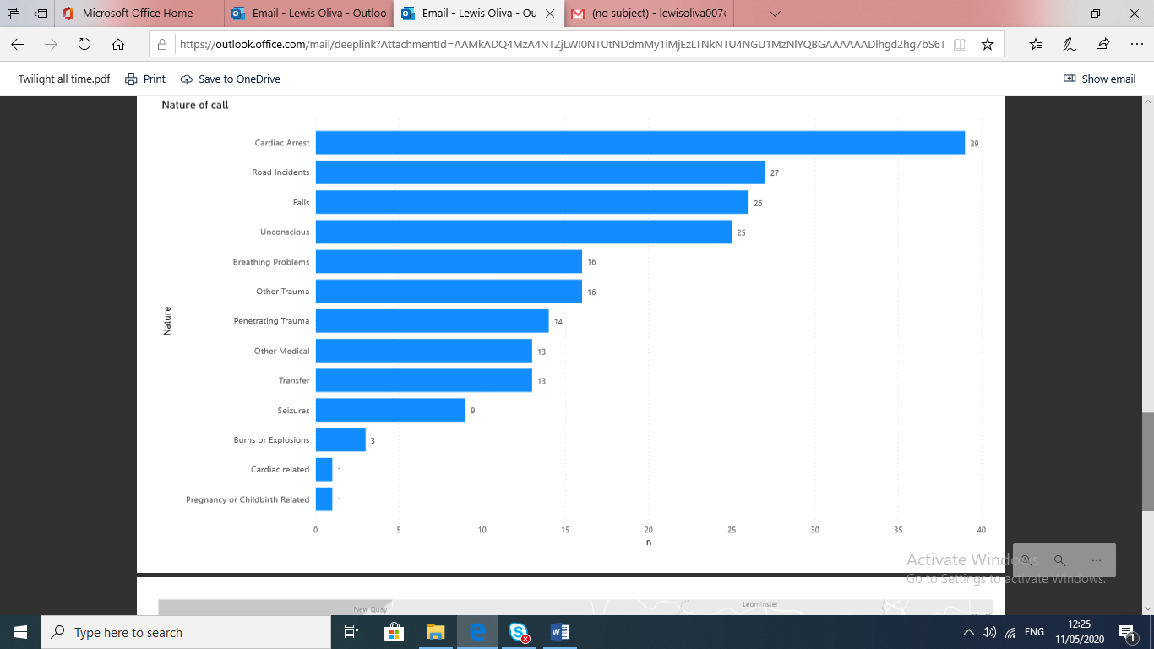
Twilight RRV – nature of call
Key categories
Cardiac arrest | 39
Road incident | 27
Falls | 26
Unconscious | 25
Breathing | 16
Other trauma | 16
Penetrating trauma | 14

Slide 17
Twilight RRV – Summary
Majority of calls: more densely populated areas of S Wales, (Cardiff and Vale (42%) Aneurin Bevan (30%) )
Busiest period: weekend (45%)
Median age 43 (range 1-90 years)
Male 64%, Female 36%
203 calls made, 128 patient attendances:
  38 (30%) required intubation
  28 (22%) required anaesthetics
  5 (4%) received blood products

Slide 18
24/7 Service Expansion
1st July - service commenced full night operations by car from Cardiff Heliport
Significant recruitment, induction and training programme
Discussions ongoing with WG capital colleagues re outstanding capital allocation
New service will be reported on via the recently developed EMRTS Quality & Delivery Framework

Slide 19
24 hour Service Development
Air support will follow asap (Charity working with aircraft operator to progress)
All Wales cover – partial with Cardiff aircraft
Phase II – North Wales based service
  Recruitment
  Workload
  Interhospital transfer at night

Slide 20
National Critical Care Transfer Service
Request from Crit Care WG to set up interhospital Crit Care Transfer Service as part of Crit Care improvement programme
Implementation plan for introduction of two ground based regional assets (one North one South Wales) submitted to WG Nov 2019
Establish service as division of EMRTS, ring-fenced funding, appropriate governance arrangements, collaborative commissioning framework with EASC
Included revenue and capital requirements to establish and implement the new service (partners EASC / WAST / SBUHB)

Slide 21
National Critical Care Transfer Service
12 month set-up period set out with key milestones ahead of service delivery
Recently shortlisted for key enabling posts - clinical lead and project manager to progress with scoping / engagement / set up

Slide 22
