Slide 1
Ambulance
4-hour Improvement Trajectory

Slide 2
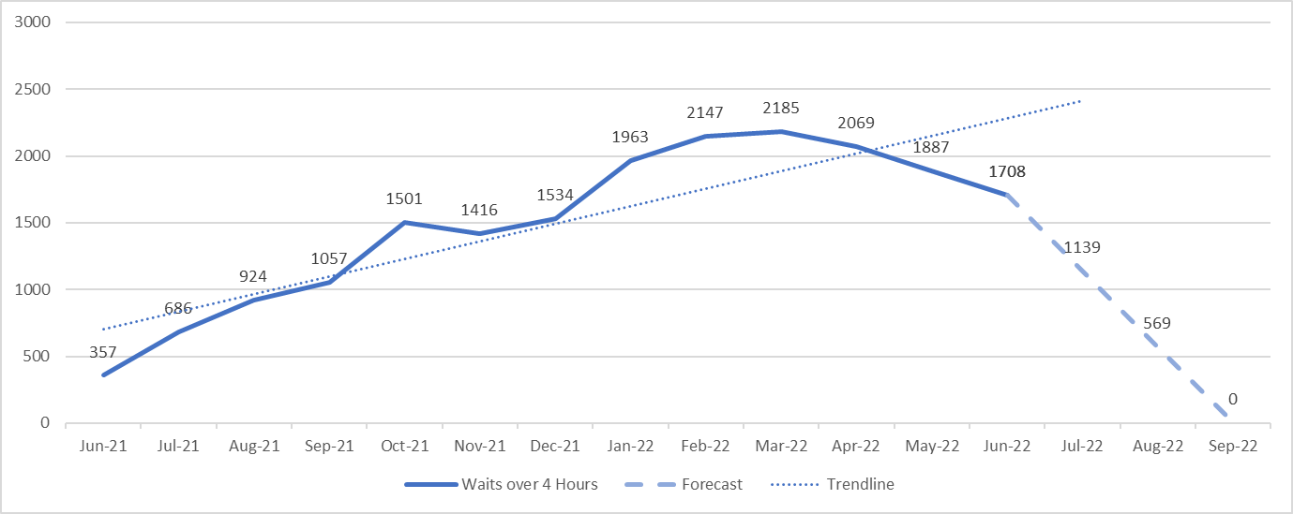
Ambulance Arrival
4-hour Improvement Trajectory
NHS Wales
The graph left shows the current level of ambulance waiting outside and Emergency Department over 4-hours.
Based on the previous data from June 2021 the current trendline is showing an upwards trend.
Reducing this level to 0 ambulance waits over 4-hours by September 2022 is shown as a dashed line.
Reduction Scale: 1,708
June – July 2022: 66.7% (1,139)
July – August 2022: 50.0% (569)
August – September 2022: 100% (0)
The data contained in the graph is based lost hours based on ambulance arrival to handover

Slide 3
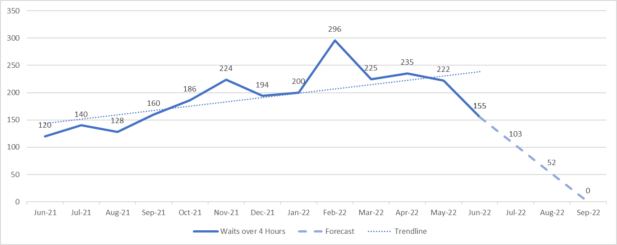
Ambulance Arrival
4-hour Improvement Trajectory
Aneurin Bevan University Health Board
The graph left shows the current level of ambulance waiting outside and Emergency Department over 4-hours.
Based on the previous data from June 2021 the current trendline is showing an upwards trend.
Reducing this level to 0 ambulance waits over 4-hours by September 2022 is shown as a dashed line.
Reduction Scale: 155
June – July 2022: 66.5% (103)
July – August 2022: 50.5% (52)
August – September 2022: 100% (0)
The data contained in the graph is based lost hours based on ambulance arrival to handover

Slide 4
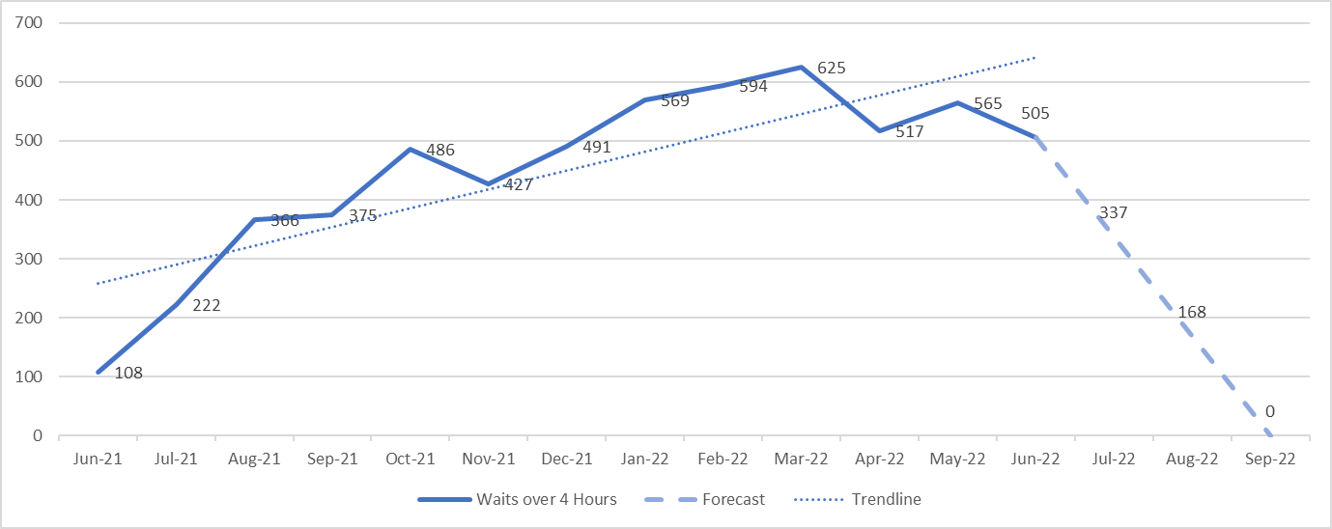
Ambulance Arrival
4-hour Improvement Trajectory
Betsi Cadwaladr University Health Board
The graph left shows the current level of ambulance waiting outside and Emergency Department over 4-hours.
Based on the previous data from June 2021 the current trendline is showing an upwards trend.
Reducing this level to 0 ambulance waits over 4-hours by September 2022 is shown as a dashed line.
Reduction Scale: 505
June – July 2022: 66.7% (337)
July – August 2022: 49.9% (168)
August – September 2022: 100% (0)
The data contained in the graph is based lost hours based on ambulance arrival to handover

Slide 5
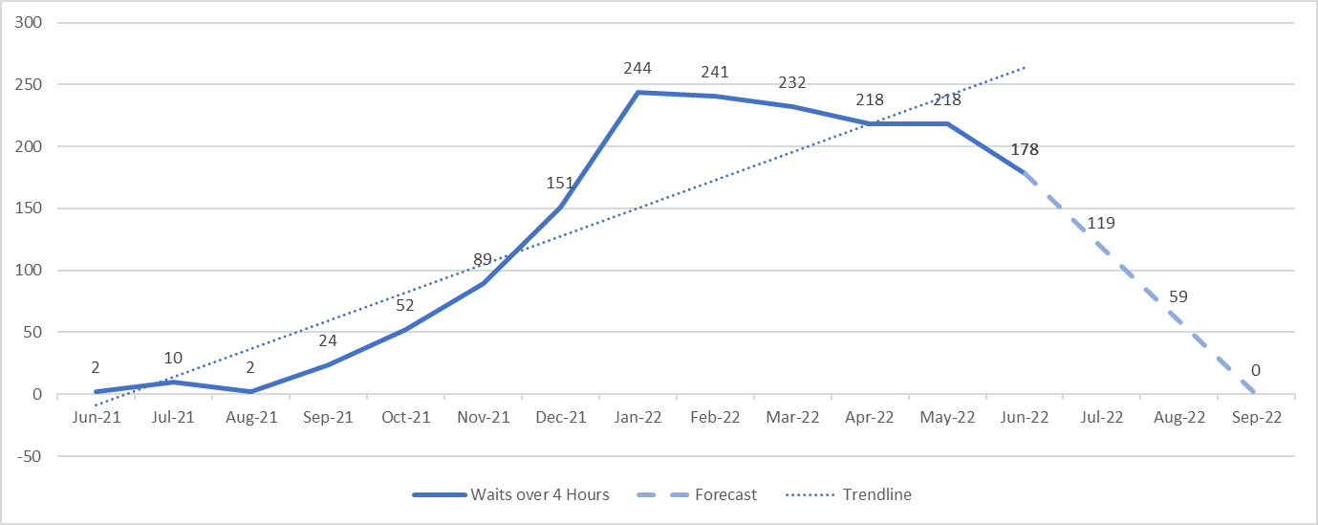
Ambulance Arrival
4-hour Improvement Trajectory
Cardiff and Vale University Health Board
The graph left shows the current level of ambulance waiting outside and Emergency Department over 4-hours.
Based on the previous data from June 2021 the current trendline is showing an upwards trend.
Reducing this level to 0 ambulance waits over 4-hours by September 2022 is shown as a dashed line.
Reduction Scale: 178
June – July 2022: 66.9% (119)
July – August 2022: 49.6% (59)
August – September 2022: 100% (0)
The data contained in the graph is based lost hours based on ambulance arrival to handover

Slide 6
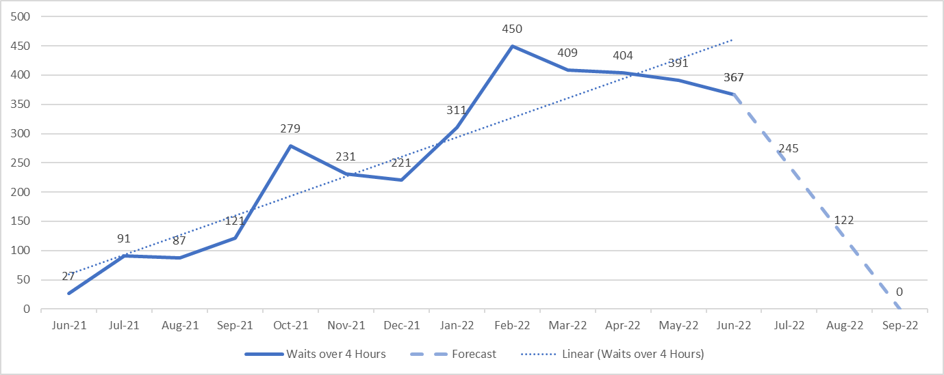
Ambulance Arrival
4-hour Improvement Trajectory
Cwm Taf Morgannwg University Health Board
The graph left shows the current level of ambulance waiting outside and Emergency Department over 4-hours.
Based on the previous data from June 2021 the current trendline is showing an upwards trend.
Reducing this level to 0 ambulance waits over 4-hours by September 2022 is shown as a dashed line.
Reduction Scale: 367
June – July 2022: 66.8% (245)
July – August 2022: 49.8% (122)
August – September 2022: 100% (0)
The data contained in the graph is based lost hours based on ambulance arrival to handover

Slide 7
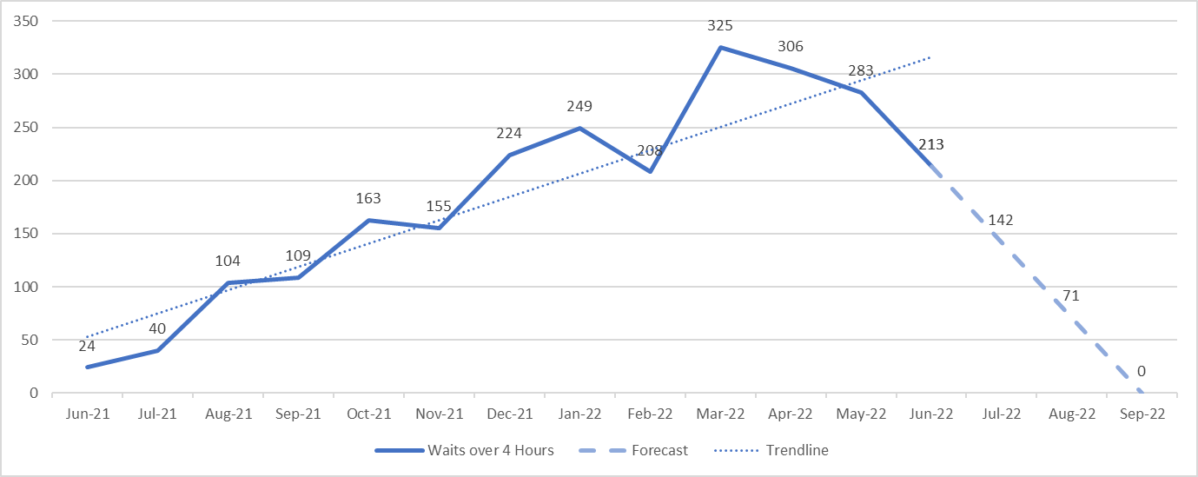
Ambulance Arrival
4-hour Improvement Trajectory
Hywel Dda University Health Board
The graph left shows the current level of ambulance waiting outside and Emergency Department over 4-hours.
Based on the previous data from June 2021 the current trendline is showing an upwards trend.
Reducing this level to 0 ambulance waits over 4-hours by September 2022 is shown as a dashed line.
Reduction Scale: 213
June – July 2022: 66.7% (142)
July – August 2022: 50.0% (71)
August – September 2022: 100% (0)
The data contained in the graph is based lost hours based on ambulance arrival to handover

Slide 8
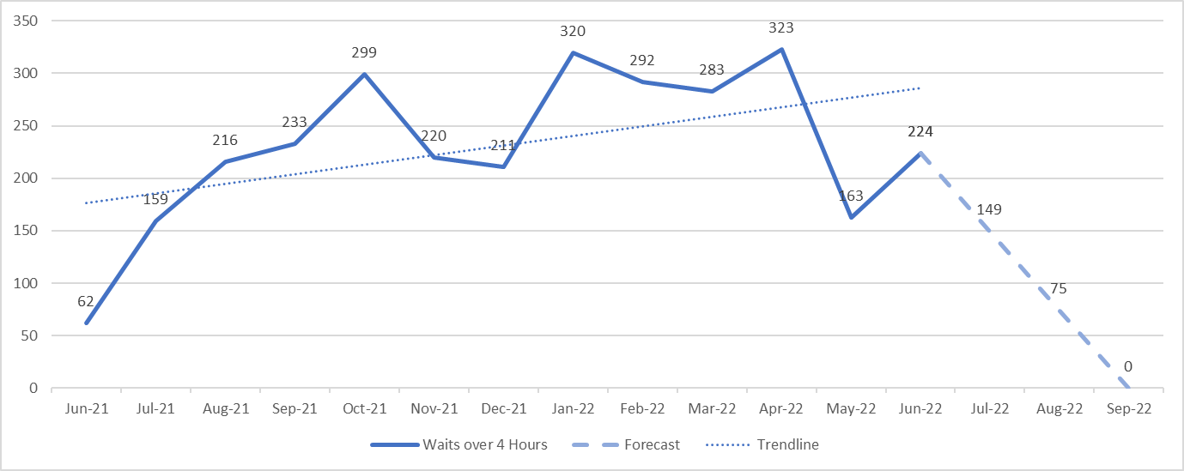
Ambulance Arrival
4-hour Improvement Trajectory
Swansea Bay University Health Board
The graph left shows the current level of ambulance waiting outside and Emergency Department over 4-hours.
Based on the previous data from June 2021 the current trendline is showing an upwards trend.
Reducing this level to 0 ambulance waits over 4-hours by September 2022 is shown as a dashed line.
Reduction Scale: 224
June – July 2022: 66.5% (149)
July – August 2022: 50.3% (74)
August – September 2022: 100% (0)
The data contained in the graph is based lost hours based on ambulance arrival to handover

