Slide 1




WAST IMTP
EASC Committee meeting
14th March 2023
Welsh Ambulance Services NHS Trust

Slide 2

  Developing our Plan for 2023/24
A Healthier Wales
Six Goals Programme
Commissioning Intentions
WAST’s IMTP 2023/24
Ministerial Priorities
There are a range of external influences and drivers which we take account of in our plan.
Welsh Ambulance Services NHS Trust
Notes:
Including financial allocation

Slide 3

  Developing our Plan for 2023/24
  Commissioning Intentions - EASC
At a national level, formal commissioning intentions broadly in line with 2022/23, with same direction of travel
Range of performance targets put forward for both Health Boards and WAST
ICAPS
Integrated Commissioning Action Plans
Local plans to be agreed in each health board area
Opportunity to focus on local solutions, transformation and inverting the triangle
Welsh Ambulance Services NHS Trust

Slide 4
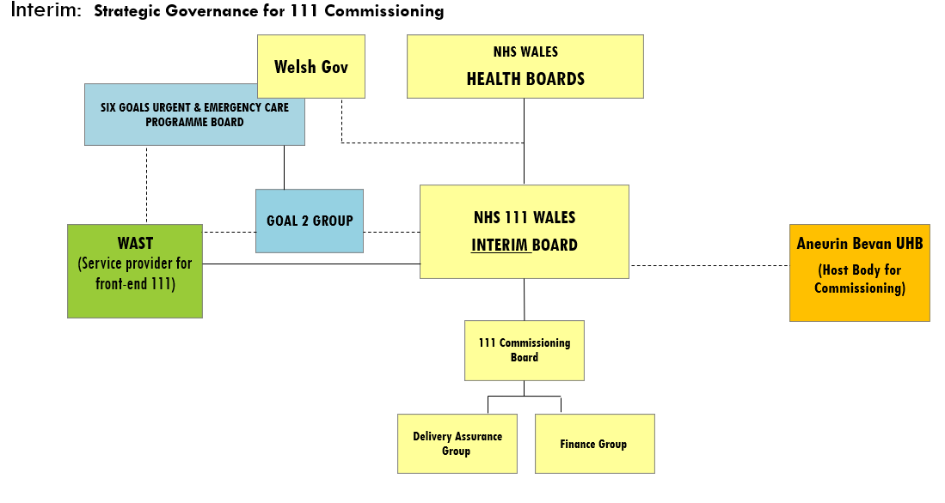
  Developing our Plan for 2023/24
  Commissioning Intentions - 111
Formal commissioning structure set up under the NHS 111 Wales Board
Commissioning Framework to be developed collaboratively
Range of initial priorities put forward by commissioners, in line with our own thinking
Welsh Ambulance Services NHS Trust
Notes:
Review of the all wales commissioning structures by WG

Slide 5


  Developing our Plan for 2023/24
Surveys / work of PECI team
Patient stories
Complaints
Incidents / NRIs
We also listen to the voices of our patients and our people.
Staff stories
Roadshows
WAST live
Opportunities during IA
Welsh Ambulance Services NHS Trust

Slide 6
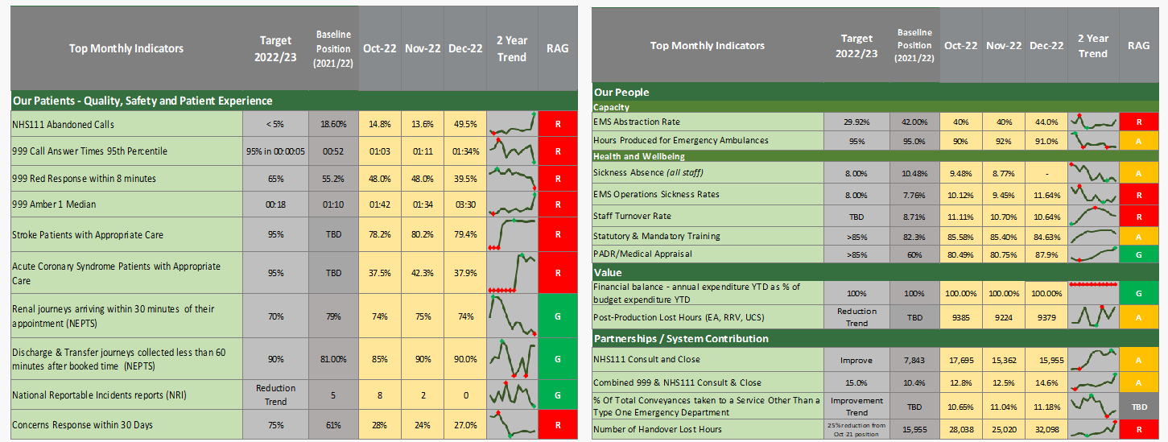
  Developing our Plan for 2023/24
We constantly monitor and analyse key metrics relating to quality, our people, finance / value and system contribution
Welsh Ambulance Services NHS Trust
Notes:
Three main areas of harm, staff experience shown in high turnover rates, high sickness etc, some of the staff survey outcomes etc

Slide 7
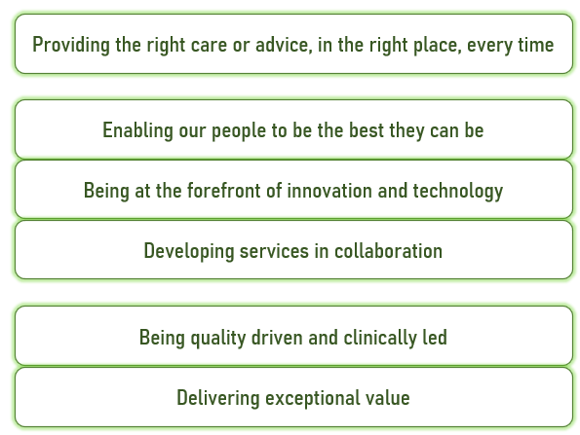
  Developing our Plan for 2023/24
We seek to work towards and continue to develop our longer term strategy and ambition, building on our sense of purpose
Ambition
Enablers
Fundamentals
Welsh Ambulance Services NHS Trust

Slide 8

  Three areas of focus for next year
  Underpinned by how we work with the system
Enabling our people to be their best
Improving employee experience
Value and Sustainability
Financial Sustainability Programme
111 service
ABC of core needs at work
999 service
Ambulance Care
Right care, right place, every time
Digital First
Partnerships and wider system – engagement, innovation, population health
Welsh Ambulance Services NHS Trust

Slide 9

Our Patients.
The right advice or care, in the right place, first time - 111
What will change?
More patients’ needs met digitally
Expanded service for more people
Call answering and ring back times improved
More patients’ needs met without need for referral onwards
Recruiting and retaining the right numbers of call handlers and clinicians and deploying them to better meet demand patterns
Continuing to work with others on developing remote clinical assessment as a speciality
Embedding and developing the clinical leadership of the service
Implement new pathways for callers with urgent dental or palliative care needs
Review the service and workforce model
Implement SALUS
Continue to make improvements in ‘digital first’
Welsh Ambulance Services NHS Trust

Slide 10
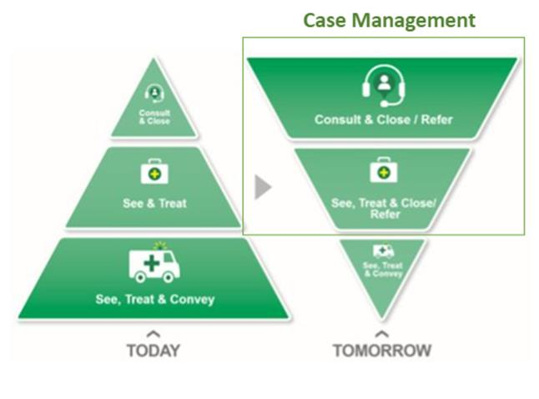


Our Patients.
Provide the right advice or care, in the right place, first time - 999
What will change?
Reduced patient harm
Reduced response times
Better clinical outcomes
More patients needs met remotely
More treated on scene
Fewer conveyed to Emergency Departments
Welsh Ambulance Services NHS Trust

Slide 11
Our Patients.
Provide the right advice or care, in the right place, first time - 999
Case management approach through enhanced remote clinical teams
  Amber virtual ward
  Maximise use of technology
  Use ePCR data to identify best response
Develop variety of on scene capabilities and response e.g. Advanced Practice
Improve access to alternative pathways
Protect resource for most urgent calls
  Expand CHARUs
  Manage red demand differently
  Recurrent funding for +100
Welsh Ambulance Services NHS Trust

Slide 12
Our Patients.
Provide the right advice or care, in the right place, first time - 999
Continuing a focus on transformation
  Case for change independent review
  Stakeholder engagement process
  Revised Demand and Capacity modelling
  ‘Perfect day’ tests
  Using the ICAPS to develop local solutions
Welsh Ambulance Services NHS Trust

Slide 13


Our Patients. The right advice or care, in the right place, first time – Ambulance Care
What will change?
Improved patient experience
Better performance on drop off and pick up times
Improved support to hospitals and system flow
Re rostering in NEPTS
Focussing on patients that are eligible for NEPTS
Understand the impact of, and opportunities presented by, the move of UCS to Ambulance Care
Development of transfer and discharge services for Wales
Welsh Ambulance Services NHS Trust

Slide 14
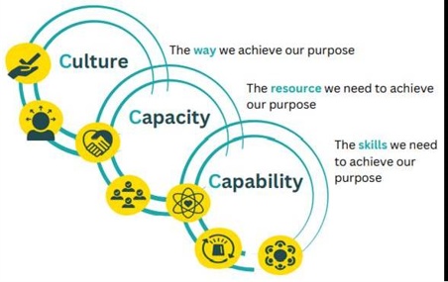

Our People.
Enable our people to be the best that they can be
Priorities on work place experience
Flexible working
Overruns
Digital solutions
Welsh Ambulance Services NHS Trust

Slide 15
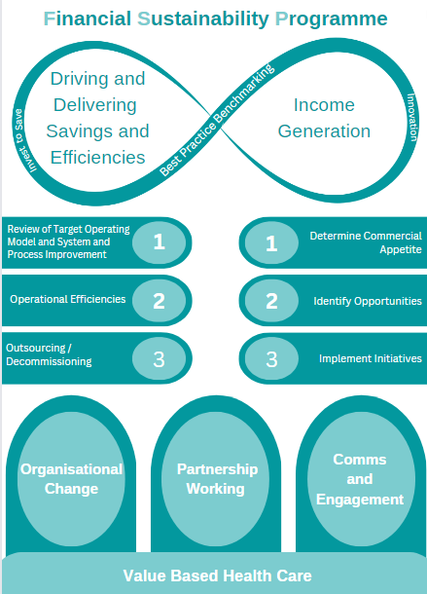
Value and sustainability
The financial sustainability programme will be a major part of the work of the organisation through 2023/24 with an emphasis on both securing additional income and delivering savings and efficiencies.
Welsh Ambulance Services NHS Trust

Slide 16
Financial Plan
  AO letter sent on 28th February setting out detailed position
  Significant cost pressures, in line with others across Wales
  Assumption that recurrent funding received for 100 staff recruited this year
  Will need a significant step up in savings delivery – up to c£6m (2.5%)
  Financial Sustainability Programme:
    Achieving efficiencies
    Income generation
  Potential then to submit a plan that assumes delivery of financial balance by end of March 2024
  Below the line, opportunities to recruit further to support remote clinical assessment, APPs, expansion of sitting service (national /ICAPs)
Welsh Ambulance Services NHS Trust

Slide 17
Performance Delivery
  CASC has set out a number of proposed trajectories in terms of performance, with modelling currently being finalised to determine feasibility based on current assumptions
Target | Comment
UHP 95-100% | Achievable
Sickness 5.5% | Trajectory from last year to deliver 6% by Mar 24
Consult and close 17% | Achievable – more possible with additional resource
Clinical review of all red calls | Not achievable without additional resource
Red 65% by Oct | Being modelled
Amber median 45 mins Q2 | Being modelled
Reduction in no sends | Being modelled
Welsh Ambulance Services NHS Trust

Slide 18
Risks
Ability to develop a balanced financial plan
Capacity to deliver on priorities within the plan
  Time available to devote to priorities
  Resources (revenue / capital) curtailed
Tension between maintaining progress on strategic ambition with focus on the short term
Ongoing disruption through Industrial Action
Ongoing wider system pressures impacting on our services
Commissioning landscape may change
Welsh Ambulance Services NHS Trust
Notes:
1545pm

