Slide 1
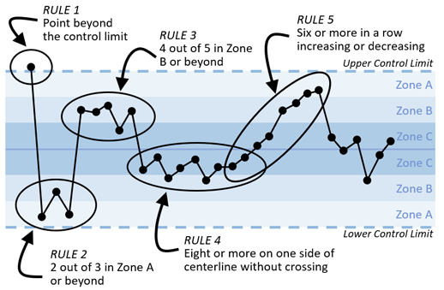
Statistical Process Control
A brief introduction to statistical process control charts (SPC) SPC charts are used as an analytical technique to understand data (performance) over time. Using statistical science to underpin data, and using visual representation to understand variation, areas that require appropriate action are simply highlighted. This method is widely used within the NHS to assess whether change has resulted in improvement.
SPC charts provide an excellent view of trends, highlighting areas of improvement, or concern over a significant time period (e.g. common or special cause variation). The graphs also contain a mean (average) value, and two process control limits UCL & LCL (expected maximum & minimum performance).
Types of Process Variation
There are two types of process variation:
Common cause variation is inherent to the system. This variation can be changed only by improving the equipment or changing the work procedures; the operator has little influence over it.
Assignable cause variation comes from sources outside of the system. This variation can occur because of operator error, use of improper tooling, equipment malfunction, raw material problems, or any other abnormal disruptive inputs.
The goal of SPC is to understand the difference between these two types of process variation—and to react only to assignable cause variation. Processes that show primarily common cause variation are, by definition, in control and running as well as possible.
Out of Control
A process is usually judged to be out of control based on five commonly used control chart rules. These rules signal a change in either the process average or the variation.
Points are beyond control limits.
Eight or more consecutive points are either above or below the centerline.
Four out of five consecutive points are in or beyond the 2-sigma zone (referred to as zone B in the graphic).
Six points or more point in a row are steadily increasing or decreasing.
Two out of three consecutive points are in the 3-sigma region (referred to as zone A in the graphic).

Slide 2
