Slide 1



Emergency Ambulance Services Committee
IMTP Tracker
HTTPS://EASC.NHS.WALES
CTM_CASC_EASC@WALES.NHS.UK

Slide 2
Introduction
  The 2023-26 EASC IMTP set out a number of performance improvement ambitions and performance enablers for Emergency Ambulance Services
  This slide deck sets out the progress to date against each of the commitments.
HTTPS://EASC.NHS.WALES
EASC IMTP 23/26 Tracker
CTM_CASC_EASC@WALES.NHS.UK

Slide 3
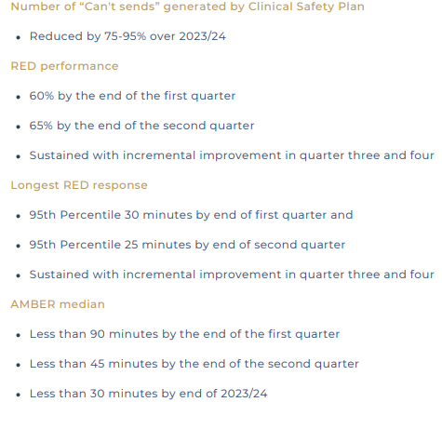
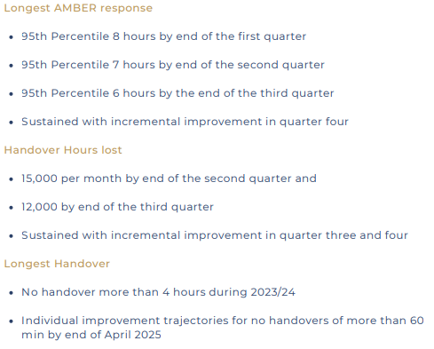
Summary – Performance Improvement
HTTPS://EASC.NHS.WALES
EASC IMTP 23/26 Tracker
CTM_CASC_EASC@WALES.NHS.UK

Slide 4
“Cant Sends” - Reduced by 75-95% over 2023/24
The level of cant sends have remained significantly lower in each month this year compared to last.
However, each incident is a patient that did not get a response, further work is required to minimise these incidents.
*CSP Can’t sends only
HTTPS://EASC.NHS.WALES
EASC IMTP 23/26 Tracker
CTM_CASC_EASC@WALES.NHS.UK

Slide 5
Red Performance – 60% by end of Q1
EASC committed to achieve 65% by end of Q2 with sustained incremental improvement in Q3/4
Further substantial improvements to system flow and ambulance availability are required to address this commitment.
HTTPS://EASC.NHS.WALES
EASC IMTP 23/26 Tracker
CTM_CASC_EASC@WALES.NHS.UK

Slide 6
Longest Red – 95th Percentile 30 min by end of Q1
Initial improvements from Q1 have not been sustained.
In July 2023 EASC agreed to update their Q2 ambition– to be less than 18 min
Further substantial improvements to system flow and ambulance availability are required to address this commitment.
HTTPS://EASC.NHS.WALES
EASC IMTP 23/26 Tracker
CTM_CASC_EASC@WALES.NHS.UK

Slide 7
Amber Median - < 90 min by end of Q1
EASC committed to achieve 45 min by end of Q2 with less than 30 min by the end of 2023/24.
Further substantial improvements to system flow and ambulance availability are required to address this commitment.
HTTPS://EASC.NHS.WALES
EASC IMTP 23/26 Tracker
CTM_CASC_EASC@WALES.NHS.UK

Slide 8
Longest Amber – 95th Percentile 8 hours by end Q1
At the July 2023 meeting, EASC agreed to revise the improvement ambitions to Quarter 2 less than 4.5 hours and Quarter 3 less than 3.5 hours with sustained incremental improvement by in Q4
Further substantial improvements to system flow and ambulance availability are required to address this commitment
HTTPS://EASC.NHS.WALES
EASC IMTP 23/26 Tracker
CTM_CASC_EASC@WALES.NHS.UK

Slide 9
Handover Hours – 15,000 Lost per month by end of Q2
EASC committed to achieve 12,000 hours per month by end of Q3 with sustained and incremental improvement in Q4
Further substantial improvements to system flow and ambulance availability are required to address this commitment
HTTPS://EASC.NHS.WALES
EASC IMTP 23/26 Tracker
CTM_CASC_EASC@WALES.NHS.UK

Slide 10
Longest Handover – No Handover >4 Hours in 2023/24
Requirement for all sites to eradicate waits over 1 hour by end of April 2025
Further substantial improvements to system flow are required to address this commitment
HTTPS://EASC.NHS.WALES
EASC IMTP 23/26 Tracker
CTM_CASC_EASC@WALES.NHS.UK

Slide 11
Longest Handover – No Handover >1 Hours by April 2025
Requirement for all sites to eradicate waits over 1 hour by end of April 2025
Welsh Government requested HB forecast to end of March 2024.
Further substantial improvements to system flow are required to return to the trajectory
HTTPS://EASC.NHS.WALES
EASC IMTP 23/26 Tracker
CTM_CASC_EASC@WALES.NHS.UK

Slide 12
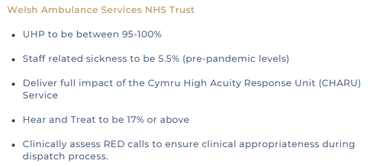
Summary – Performance Enablers – WAST
Progress
Units of hours produced (UHP) has averaged 92.6% between April and December 2023, with a range of 86.5% - 96.8%
Sickness absence was 9.54% in December
Hear and Treat has averaged 11% between April and December 2023
Clinical assessment of red calls in place
HTTPS://EASC.NHS.WALES
EASC IMTP 23/26 Tracker
CTM_CASC_EASC@WALES.NHS.UK

Slide 13
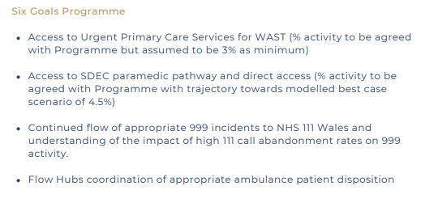
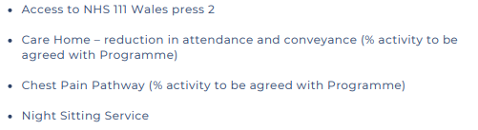
Summary – Performance Enablers – Six Goals
Progress
Urgent Primary Care - Work ongoing to understand referral rates
Same Day Emergency Care (SDEC) – Limited progress in increasing SDEC direct access activity.
111- Work ongoing to understand how abandonment rates impact 999
Connected Support Cymru – extended to end of 2023/24
HTTPS://EASC.NHS.WALES
EASC IMTP 23/26 Tracker
CTM_CASC_EASC@WALES.NHS.UK

Slide 14
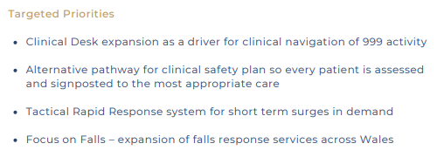
Summary – Performance Enablers – Targeted
Progress
Review of clinical desk completed by EASC, recommendations delivery plan being developed.
HTTPS://EASC.NHS.WALES
EASC IMTP 23/26 Tracker
CTM_CASC_EASC@WALES.NHS.UK

