Slide 1


Welsh Ambulance Services NHS Trust
IMTP 2024-27
EASC 19th March 2024
______________________________
IMTP 2024-27
Version 1.0
Released: March 2024
______________________________
by Rachel Marsh

Slide 2
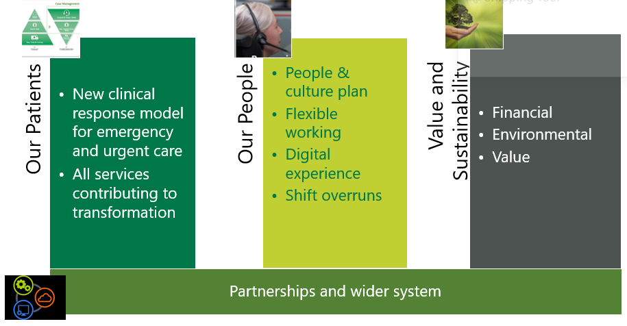

Plan Headlines
Balanced financial plan, with £6.4m (2.2%) saving requirement
Longer term financial sustainability programme to include both efficiencies and income generation
Developing our plan for 2024/25
Available resources directed to clinical front-line posts
    Supporting core, emergency service
    Supporting shift left
Sufficient critical mass to move to new clinical response model
Welsh Ambulance Services NHS Trust

Slide 3


What will good look like for 999 callers in 2027?
What will be different?
All patients receive an appropriate and timely response.
Patients in life threatening or emergency situations consistently receive an immediate or rapid response.
Patients who need to go to hospital are conveyed and handed over quickly.
More patients’ needs are met closer to home.
Patients experience an exceptional service with the best possible health outcomes.
Achieve 65% red target.
Reduce unmet demand by half.
Double the numbers of patients safely managed at home or in the community.
Increase ROSC rates to between 25-30%
Right care and advice, right place, every time
Welsh Ambulance Services NHS Trust

Slide 4


Improving our core, emergency response
Restructure the EMS Coordination function
Introduce a rapid clinical screening and clinically led dispatch and streaming service.
Fully staff the CHARU service and increase utilisation
Maintain commissioned levels of front-line staffing, including 100 WTE recruited last year
Specific priorities EMS
999 call
Red/Amber/
Green
Rapid Clinical Screening
Immediate or planned dispatch
Remote Clinical Assessment
Face to face assessment
Emergency Ambulance / CHARU / Falls
Welsh Ambulance Services NHS Trust
Notes:
New clinical response model predicated on better sophisticated patient information, including linked data to inform pathways

Slide 5



Growing our 24/7 urgent care response
Remote Clinical Assessment
Grow remote clinical capacity by 23 WTE
Embed Connected Support Cymru service including deployment of 600 Community Welfare Responders and 50 Luscii ‘Ambulance in a Box’ solutions
Work with Health Boards to agree new pathways.
On scene urgent community response
Training and deploying more Advanced Paramedic Practitioners (APP) to support WAST and the wider health care system
16 additional staff to increase see and treat – resource type to be determined
Piloting and evaluating the mental health response vehicle in AB
Specific priorities EMS
Welsh Ambulance Services NHS Trust

Slide 6
What will good look like for 111 patients in 2027?
What will be different?
Patients know how to access the 111 service and choose it as their preferred gateway to care.
Patients are confident that the service steers them safely through the complex health and care system.
Patients are happy to comply with the information and advice that they are given.
Patients receive timely, high quality remote clinical assessments with no further intervention needed for many.
Where needed, patients are booked directly and seamlessly into the right service.
Consistently timely – less than 5% abandonment
Improved patient reported satisfaction.
Increased proportion of consultations closed with no further follow up needed.
Increased proportion of next steps seamlessly booked.
Right care and advice, right place, every time
Welsh Ambulance Services NHS Trust

Slide 7

Creating the ‘Gateway to Care’
Co-create a ‘digital first’ vision for urgent and emergency care
Build on our digital platforms, delivering the new CAS system
Maintain commissioned numbers of staff, undertake a demand and capacity review and re-roster
Work with Six Goals programme on new and improved pathways including dental care, palliative care, UPCC, medicines management
Develop attractive career pathways and opportunities that attract and retain colleagues, specifically for clinicians seeking portfolio-based careers.
Bring together expertise and capacity from 111 and 999 clinical teams to provide an integrated urgent response service, whichever access point is used
Specific priorities 111

Slide 8
Creating the ‘Gateway to Urgent Care’
999 call
Rapid Clinical Screening
Immediate or planned dispatch
Remote Clinical Assessment
Close / refer / face to face
Specific priorities 111
Nonclinical triage
111 call

Slide 9
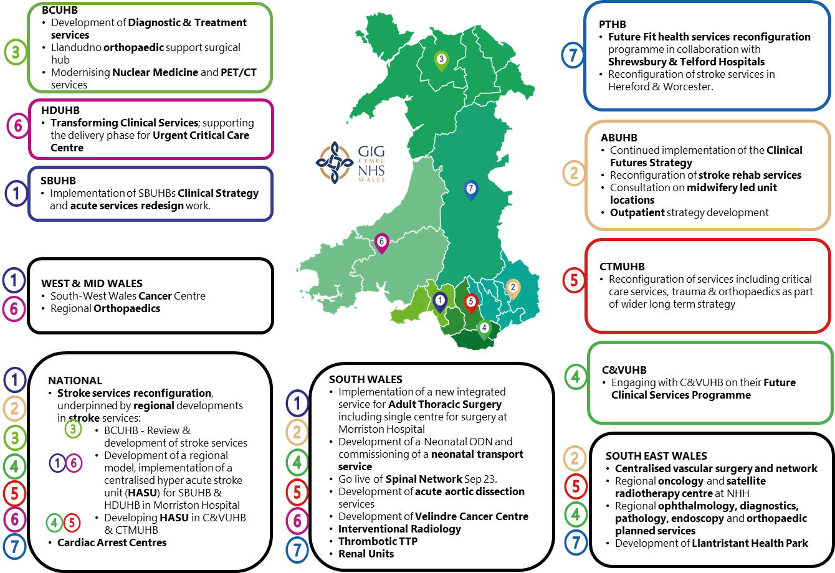
Building dedicated inter-hospital transfer
Engaging on nationally modelled options for Inter-hospital transfer services is key given the scale of change within health boards and the need to outcomes for patients and flow across the system
Developing services in collaboration

Slide 10
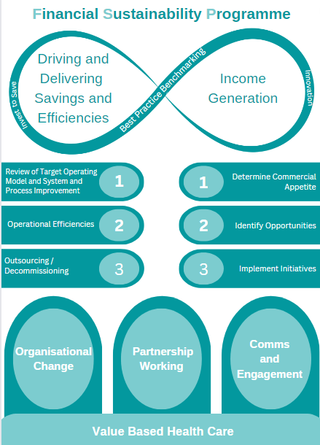
Creating a sustainable future
The Financial Sustainability Programme will continue to be a major part of the work of the organisation through 2024/25.
Focus on efficiency in all areas of the organisation:
  Managing attendance
  E Timesheets
  Job cycle times / utilisation
  Implementing admin review recommendations
  Digital investment including Robotic Process Automation
  Service Review (leading to further opportunities for efficiency
  Financial savings (2.2%)
Delivering Exceptional Value

Slide 11
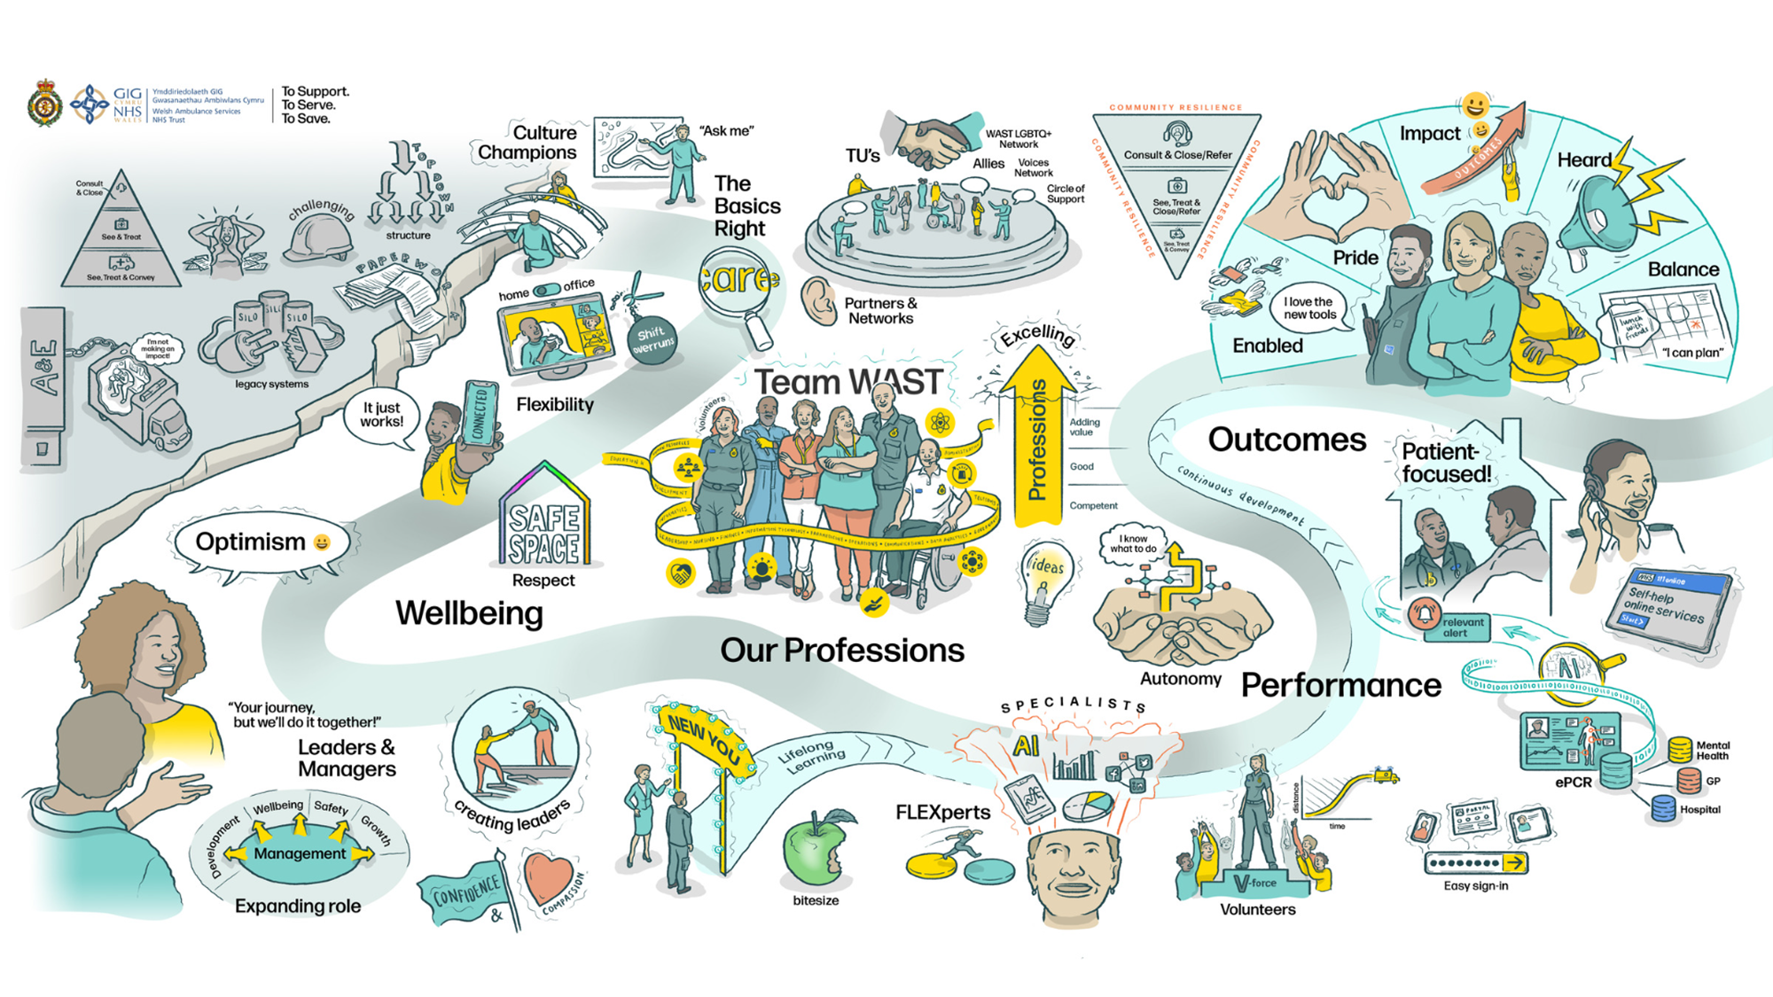
Enabling our people
Enabling our people to be the best they can be
Welsh Ambulance Services NHS Trust

