Slide 1

Emergency Ambulance Services Committee
System Pressures - planning and securing sufficient ambulance services for the population this winter

Slide 2
Introduction
Statutory requirement for planning and securing sufficient ambulance services for Wales
System pressures challenge the ability of the Committee to meet this requirement
Welsh Ambulance Services NHS Trust (WAST) modelling forecasts an inability to respond to patients this winter

Slide 3
What has happened?

Slide 4
What has happened?
COVID has increased response time for Red (personal protective equipment (PPE) requirement)
Overall incidents, attendances, conveyances are down
Overall emergency department (ED) attendances are down
Investment for Demand and Capacity Review (136WTE)
Operational Delivery Unit established
Doubling of handover delays since August
WAST Demand Management Plan Level 6 enacted on more than one occasion

Slide 5
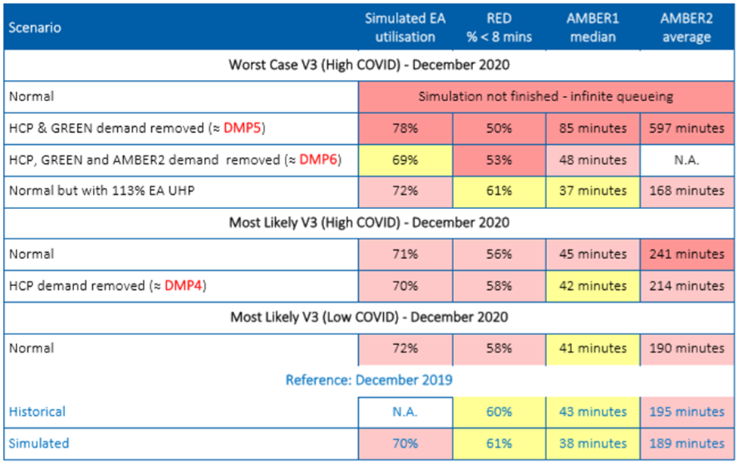
Modelling

Slide 6
What Now?
What is our collective position / actions to deliver our statutory requirements this winter?
            Efficiencies
            Investment
            Additionality
            Operational Delivery Unit
            Handover

