Slide 1
Demand and Capacity Update.

Slide 2
Background
Multiple Demand and Capacity Reviews have been undertaken since 2009.
2019 ORH Demand and Capacity Review first to be jointly commissioned between WAST and EASC
Provided a forward view of demand and capacity needs up to December 2024
Implementation of the recommendations have been progressing since 2019.
Environment has changed substantially:
  Increased Red
  Increased Handover Delays
  Grange University Hospital
Need to update the findings in light of this

Slide 3
2019 Assumptions and Findings
The 2019 Review used the following assumptions:
    Demand based on December 2018
    Demand to grow by 2.3% per annum
    Handover Delays at December 2018 levels
And identified that:
    A ‘relief gap’ of 262.5 WTE existed
    Rosters did not match demand
    RRVs should reduce and EA’s increase
    Hear and Treat and APP’s could provide additional efficiencies
    Extra ~500 WTE would be needed by December 2024

Slide 4
What has been delivered?
EASC has provided the funding to close the relief gap
  2020/21 – Non-recurrent £1.8m followed by £4.9m Recurrent for Phase 1
  2021/22 – Non-recurrent £2.0m, with forecast of £5.6m Recurrent for Phase 2.
WAST are on track to complete this recruitment by the end of 2021/22
Revised rosters are being designed
Hear and Treat Rates are increasing and the clinical desk is expanding.
Additional APPs are operational

Slide 5
Updated Demand and Capacity Modelling
Updated assumptions within the updated modelling:
  Revised demand data including uplift in Red demand since May 2019
  Handover delays at December 2019 levels (>8000 hours extra)
  Additional hear and treat activity
  Grange University Hospital now in model
  Options around RRV usage

Slide 6




Next Steps in WAST’s Transformation Journey
EASC Focus on session
9th November 2021
Welsh Ambulance Services NHS Trust

Slide 7

Areas of focus
Our transformation journey to date
  Demand and Capacity Review
  Progress
What’s changed?
Our response for 2022/23 to maintain safety and start the transition to a sustainable future
Welsh Ambulance Services NHS Trust

Slide 8
Journey started with the Demand and Capacity Review
Additional Capacity:
Additional 500 WTE
Improved Efficiency:
Realign rosters with demand
Reduce sickness levels to 5.99%
Reduce hospital lost hours to 2018/19 levels
Demand Management:
Increase hear and treat rate to 10.2%
Increase see and treat rate by adding APPs
Now
Current funded staffing levels and performance
Increasing demand yearly by 2.3%
Five years time
65% red performance in every health board
18 minutes average response for Amber 1
Welsh Ambulance Services NHS Trust

Slide 9
Progress to date
 | Expected | Actual
Capacity | Additional 500 WTE |  | On track 263 this year
Demand Management | Increase hear and treat rate to 10.2% |  | Achieved
 | Increase see and treat rate by adding APPs |  | Not planned till later years
Improved Efficiency | Realign rosters with demand |  | Work commenced, on pause while next year investment considered
 | Reduce sickness levels to 5.99% |  | COVID pressures have meant these (and other health organisations) have increased
 | Reduce hospital lost hours to 2018/19 levels |  | System pressures related to COVID/recovery
Welsh Ambulance Services NHS Trust

Slide 10
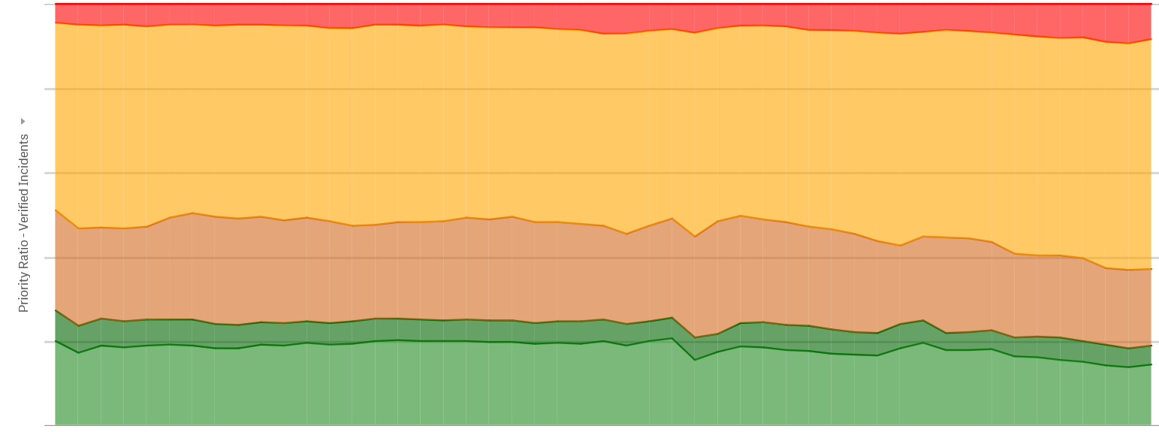
What’s changed?
Significant uplift in number and proportion of red calls
Proportions of Incident Demand
Welsh Ambulance Services NHS Trust

Slide 11
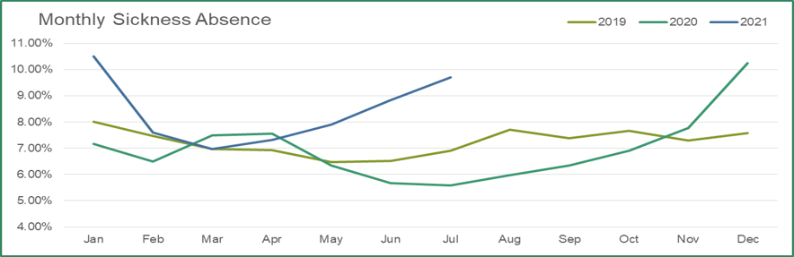
What’s changed?
Sickness levels and abstractions have increased
Welsh Ambulance Services NHS Trust

Slide 12
What’s changed?
Handover lost hours have increased
Welsh Ambulance Services NHS Trust

Slide 13
Response times continue to deteriorate rather than improve, leading to significant patient harm
Welsh Ambulance Services NHS Trust

Slide 14



Short term actions across this winter
Ongoing actions across the service, but significant mitigating actions include:
    Additional Capacity
    St John Ambulance
    Military Support – till end March at most
    Fire and Rescue Support
    Demand Management
    Additional 36 clinicians funded to increase Clinical Support Desk (and hear and treat)
    Additional mental health monies being used to put MHPs into CSD
    Increased Efficiency
    Work accelerated with TU partners to look at modernisation in key areas
Welsh Ambulance Services NHS Trust

Slide 15
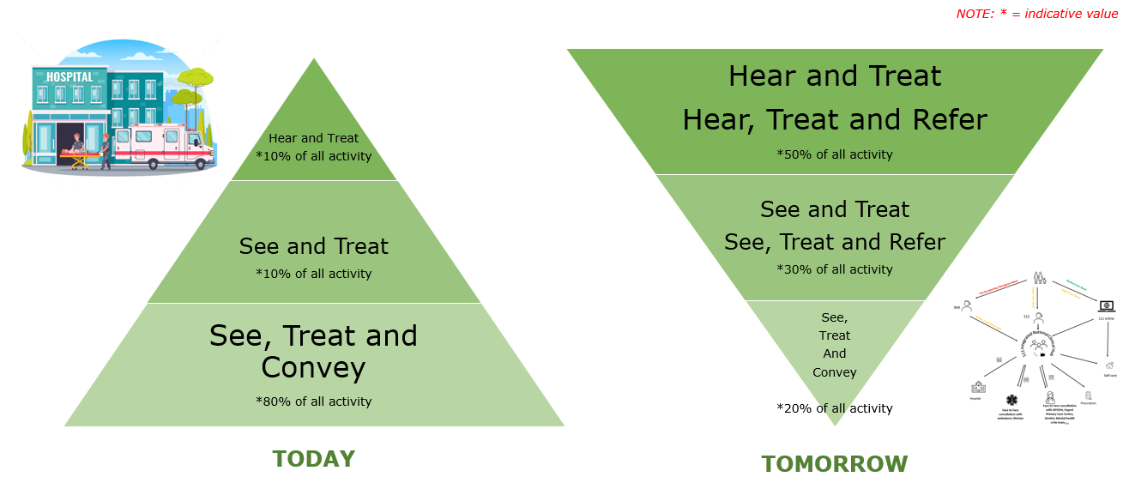
So what does this mean for next year?
We want to accelerate the move to our new transformed service model
But we still need to also mitigate impact and patient harm of ongoing handover lost hours and sickness absence
Welsh Ambulance Services NHS Trust

Slide 16
Modelling scenarios for 2022/23
Assumptions
Demand:
Acuity profile re-set
Hear and treat increasing to 15%
See and treat increases through 50 more APPs
Efficiency
Roster reviews completed
Sickness levels remain high at 10%
Handover lost hours stay high
Safer outcomes for patients
Red 65% in each health board
Amber 1 at 30 mins average
Required
283 additional front line staff
50 APPs
System and Patient Benefits
Reduced patient harm
Reduction of 120 conveyances a week
Welsh Ambulance Services NHS Trust

Slide 17
Next Steps
Ambitious Strategic Outcome Case to be developed by early December to start to realise the strategic ambition for the transformation of our services, whilst mitigating impact of system pressure risks, and will include:
Potential trajectory set out over 3 years as strategic ambition realised and handover / sickness levels decrease
Recruitment deliverability
Fleet impact – additional vehicles required
Estate impact – additional hubs required
Capital and revenue implications – likely to be significant
Benefits – to patients, health boards and staff
Risks
Range of options will be included which will balance deliverability, patient outcomes and risk
Welsh Ambulance Services NHS Trust

Slide 18
Questions
What is the general level of support for this proposed way forward for improving services and reducing harm?
Where is this next further discussed?
Welsh Ambulance Services NHS Trust

