Slide 1


Welsh Ambulance Services NHS Trust
EASC 21st November 2023
IMTP Ambitions / Strategy
Rachel Marsh (Executive Director of Strategy, Planning & Performance)

Slide 2
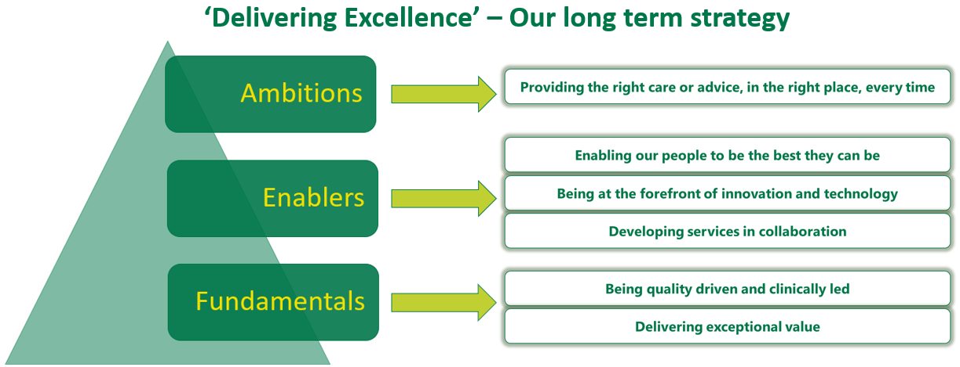


Our Strategic Objectives
Strategic Objectives
Welsh Ambulance Services NHS Trust

Slide 3
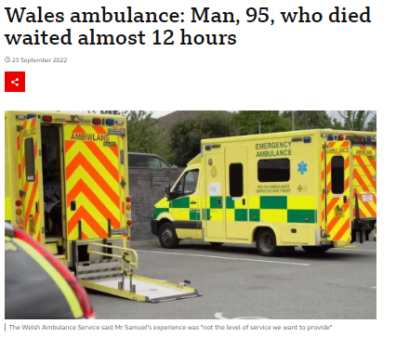
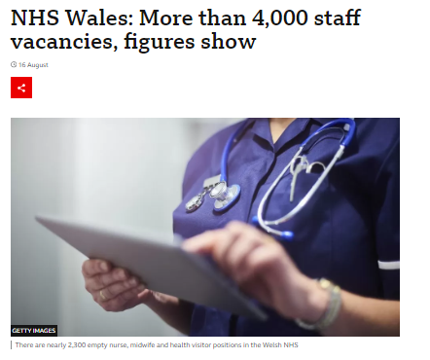
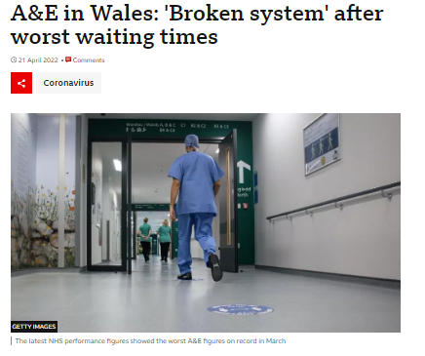
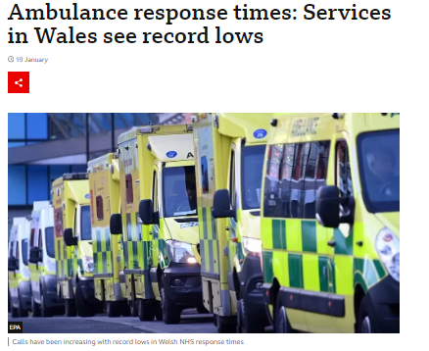
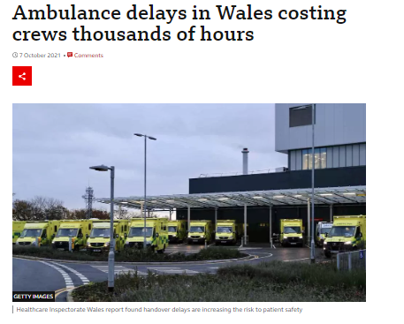
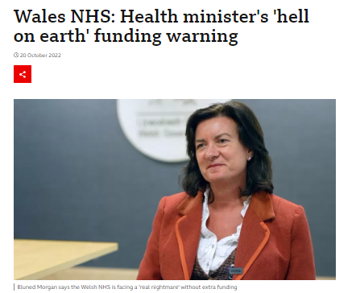
Well understood system pressures drive need for change
System Pressures
Our Drivers for Change
Notes:
The current pressures facing our service and the wider system here in Wales are becoming more challenging, driving the need for fundamental changes in our role and how we provide our service

Slide 4
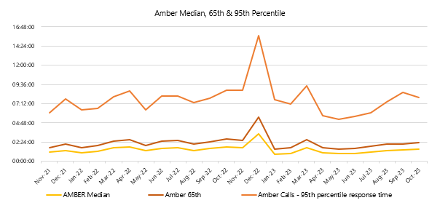
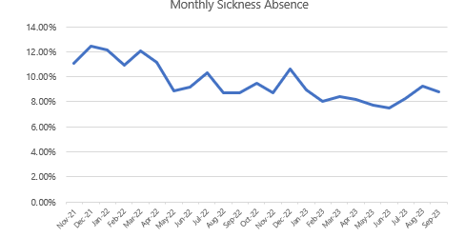
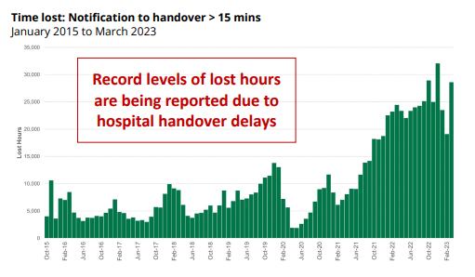
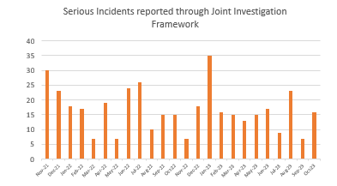
Pressures impact on patient and staff safety
System Pressures
Notes:
As a result of the pressures we face, we know that response times are suffering, with patients coming to avoidable harm

Slide 5

What can WAST offer the system, health boards and patients?
Unique position as a national (all Wales) service, providing care 24/7, 365 days a year.
Ability to deliver a consistent national model of care and / or respond to local variations.
Critical infrastructure already in place across Wales.
Interact with thousands of patients every day across our core services EMS, NHS11 & NEPTS.
WAST’s activity influences patient flow across the wider health system everyday.
Strong recruitment, low vacancies, with staff looking to be utilised more creatively to support patients
Transforming Care
Welsh Ambulance Services NHS Trust
Notes:
We’re talking to our commissioners about the benefits of WAST transforming its services and becoming more than a clinical logistics organisation and becoming a trusted partner in delivering quality healthcare solution
We think thar our national all wales perspective and existing critical infrastructure provides the opportunity to support an urgent and emergency care service that is crying out for better 24/7 support, reduce unwanted variation, and maximise the benefit of the 1000s of interactions we have with pateints and their families every day

Slide 6
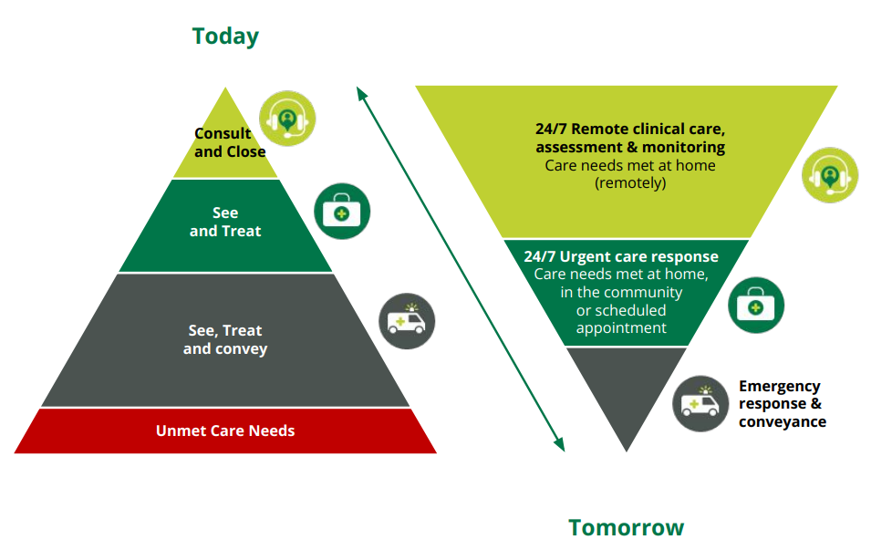
Transforming our Clinical Service Model
How do we improve our model?
Patients
Partnerships
NHS 111 Wales
Digital
NEPTS
Transforming Care
Welsh Ambulance Services NHS Trust
Notes:
Our ITT concept sets out our emerging ambitions to transform our clinical service offer for EMS, founded on the principles to…
Protect our precious emergency resources so we always have an ambulance available to quickly respond to those most in need
Enhancing our clinical offer to best meet the changing health needs of our patients. With a focus on managing patients differently for those with an urgent care need (digital opportunities, remote clinical management and monitoring and an enhanced face to face response to resolve care at home)
Manage & resolve more patients at home / in the community through WAST led interventions without destabilising the wider system.
Hospital conveyance is only for patients whose needs cannot be safely met in another setting.
We are continuing to ‘evolve’ out thinking and whilst the fundamental concept of ‘ITT’ remains at the heart of our thinking, we recognise that there is an opportunity to develop a more ‘holistic’ and ‘integrated’ service offer that includes our wider ‘Digital’, ‘NHS 111’ and ‘NEPTs’ ambitions.
We want the future service model to articulate the full ‘value’ we can add along the patient pathway and across the wider health and care system through an integrated and whole systems approach.

Slide 7













Alignment with the National 6 Goals Programme
Digital First 111
NHS 111 Wales
Remote clinical assessment and monitoring service
Opportunities
24/7 urgent care service
999 emergency response
Inter - hospital transfer service
Discharge service
Wearable technology monitoring
Making every contact count
Data sharing
Welsh Ambulance Services NHS Trust

Slide 8
Alignment with the National 6 Goals Programme
Digital First 111
Modern Interactive website
Linked to NHS Wales App
Symptom checkers
Directory of Services
Automatic transfer to next step if required
Inter-hospital transfer service
National service
Plurality model
Dedicated to support transfers
Provided jointly with health boards
Opportunities
National 111 Wales
24/7 Gateway to all urgent care
Access to range of pathways
999 emergency response
Ambulance resources protected to respond to critically ill patients
CHARU service
Variation in model to meet geographical differences
Remote clinical care, assessment and monitoring
Once for Wales
Integrated 111 and 999
Integrated WAST / Health Board clinicians
Majority of callers receive a remote clinical assessment (CSD first)
Assessment supported by information from volunteers / technology (connected Support Cymru)
24/7 urgent care service
Integrated part of health board community service offer
Range of clinical responses to meet patient need, based on remote clinical assessment
Advanced practitioners / prescribers
Enhanced practitioners
Joint service responses e.g. mental health / falls
Scheduled responses
Welsh Ambulance Services NHS Trust

Slide 9


Impact of the changes we could make together
Immediate remote clinician review reduces cancellations
Integrated remote clinical assessment service linked to clinical diagnostics gathered on scene or through technology increases closure of more calls and meets needs closer to home
24/7 urgent community response service, with advanced, enhanced and wider range of skills means more patients treated at home or referred to community services
Emergency response resource protected to get critically ill patients to hospital quickly
Staff in WAST and across health boards have better work experience, reducing pressure and sickness
Patients receive a more timely and appropriate service to meet their needs, reducing harm
2022
2027
150,000
Cancelled
What will be different?
54,000
Remote clinical assessment
48,000
Treat or refer on scene
20,000
150,000
Conveyed to ED
28,000
Welsh Ambulance Services NHS Trust

Slide 10
What do we need from the system to enable change?
Endorsement and overt support from commissioners and senior decision makers
Pump-priming or transition fund support to increase the pace of change
Explicit enablement of the integration of WAST services with community services
Acknowledgement of once for Wales potential in many instances
Through, for example:
Inclusion of specific deliverables in the 6 goals programme for 2024/25
Support from HEIW to increase APP training places
Explicit agreement to referral pathways
What are our next steps?
Welsh Ambulance Services NHS Trust

