Slide 1

Welsh Ambulance Services NHS Trust
Demand and Capacity Review
Chris Polden and James Batchelor
29 August 2019

Slide 2
Contents
Project Update
Updated Ops Analysis
Ops Relief Requirement
APP Potential
Dispatch Analysis
CCC Relief Requirement
CTA Potential
CCC Modelling Assumptions
CCC Modelling
Ops Modelling Assumptions
Ops Modelling
Optimal Location Modelling
Next Steps

Slide 3

Project Update

Slide 4
Project Update
Final analysis items have been undertaken.
Operational simulation models have been set up and validated.
Operational models have been used to show the impact of achieving planned rosters and of increased demand.
Initial location optimisation modelling has been undertaken.
Ops and CCC modelling assumptions have been confirmed.
CCC model set-up progressing.

Slide 5
Review Timetable
 | Week No | 1 | 2 | 3 | 4 | 5 | 6 | 7 | 8 | 9 | 10 | 11 | 12 | 13 | 14 | 15 | 16
 | Week Commencing | 17-Jun | 24-Jun | 01-Jul | 08-Jul | 15-Jul | 22-Jul | 29-Jul | 05-Aug | 12-Aug | 19-Aug | 26-Aug | 02-Sep | 09-Sep | 16-Sep | 23-Sep | 30-Sep
a) | Data Collection
b) | Data Analysis |  | Model Set-up and Current Service Profile
c) | Benchmarking
d) | Demand Projections
e) | Model Setup and Validation
f) | Operational Scenario Modelling
g) | Control Scenario Modelling
h) | Stakeholder Engagement
 | Reporting |  |  | Progress Report 1 |  |  | Progress Report 2 |  |  |  | Interim Report |  |  | Draft Results Report |  | Final Report

Slide 6
Updated
Ops Analysis

Slide 7
Utilisation by LHB
Emergency Ambulance |  |  |  |  | RRV
Local Health Board | Weekly Vehicle Hours | Avg Weekly Occupied Time | Utilisation |  |  | Weekly Vehicle Hours | Avg Weekly Occupied Time | Utilisation
Aneurin Bevan | 2,240.8 | 1,635.7 | 73.0% |  | Aneurin Bevan | 1,565.3 | 582.8 | 37.2%
Cardiff & Vale | 1,461.6 | 1,086.9 | 74.4% |  | Cardiff & Vale | 822.6 | 283.7 | 34.5%
Cwm Taf | 1,204.2 | 727.8 | 60.4% |  | Cwm Taf | 816.6 | 243.7 | 29.8%
Betsi Cadwaladr | 4,283.5 | 2,579.9 | 60.2% |  | Betsi Cadwaladr | 1,081.1 | 378.1 | 35.0%
Abertawe Bro Morgannwg | 2,288.5 | 1,519.9 | 66.4% |  | Abertawe Bro Morgannwg | 991.8 | 397.1 | 40.0%
Hywel Dda | 3,010.9 | 1,374.3 | 45.6% |  | Hywel Dda | 442.3 | 166.0 | 37.5%
Powys | 1,549.3 | 576.7 | 37.2% |  | Powys | 315.7 | 60.8 | 19.3%
Trust Wide | 16,038.7 | 9,501.1 | 59.2% |  | Trust Wide | 6,035.5 | 2,112.2 | 35.0%
UCS |  |  |  |  | APP
Local Health Board | Weekly Vehicle Hours | Avg Weekly Occupied Time | Utilisation |  | Local Health Board | Weekly Vehicle Hours | Avg Weekly Occupied Time | Utilisation
Aneurin Bevan | 442.6 | 301.9 | 68.2% |  | Aneurin Bevan | 25.1 | 18.3 | 73.0%
Cardiff & Vale | 420.9 | 222.2 | 52.8% |  | Cardiff & Vale | - | 0.4 | -
Cwm Taf | 409.7 | 226.2 | 55.2% |  | Cwm Taf | 14.0 | 9.7 | 69.1%
Betsi Cadwaladr | 635.4 | 389.1 | 61.2% |  | Betsi Cadwaladr | 94.1 | 55.1 | 58.6%
Abertawe Bro Morgannwg | 442.5 | 271.4 | 61.3% |  | Abertawe Bro Morgannwg | 67.2 | 42.7 | 63.6%
Hywel Dda | 354.3 | 192.4 | 54.3% |  | Hywel Dda | 44.5 | 15.4 | 34.5%
Powys | 202.7 | 82.9 | 40.9% |  | Powys | 10.3 | 1.4 | 13.4%
Trust Wide | 2,908.2 | 1,686.0 | 58.0% |  | Trust Wide | 255.2 | 143.0 | 56.0%
Note: 84 APP weekly hours per control have been removed from the actual vehicle hours in this analysis to represent the APPs planned to work in the control room. This has been proportioned to LHB level.

Slide 8
Red 8 by Contributing Vehicle
Vehicle Type Description | LHB |  |  |  |  |  |  | Overall
 | Aneurin Bevan LHB | Betsi Cadwaladr University LHB | Cardiff & Vale University LHB | Cwm Taf LHB | Abertawe Bro Morgannwg University LHB | Hywel Dda LHB | Powys LHB
Emergency Ambulance | 33.9% | 44.4% | 44.6% | 37.6% | 39.9% | 45.5% | 38.9% | 40.9%
Rapid Response Vehicle | 30.0% | 16.9% | 28.9% | 25.6% | 27.2% | 10.7% | 12.2% | 23.2%
UCS/St John UCS | 2.6% | 3.0% | 3.3% | 4.7% | 1.7% | 2.3% | 3.3% | 2.8%
Advanced Paramedic Practitioner | 0.5% | 1.2% | 0.0% | 0.4% | 1.7% | 0.6% | 0.1% | 0.8%
DEFIB(MEDIC) | 4.0% | 4.2% | 2.8% | 3.5% | 3.8% | 3.7% | 4.8% | 3.7%
Community First Responder | 1.7% | 1.8% | 0.9% | 0.4% | 1.0% | 1.1% | 2.3% | 1.3%
All other vehicles | 0.3% | 0.8% | 0.8% | 0.3% | 1.2% | 1.6% | 4.3% | 1.0%
Overall | 73.0% | 72.4% | 81.3% | 72.5% | 76.4% | 65.6% | 65.9% | 73.7%
Core Vehicles | 67.1% | 65.5% | 76.9% | 68.4% | 70.4% | 59.1% | 54.5% | 67.7%
Other Vehicles | 5.9% | 6.9% | 4.4% | 4.2% | 6.0% | 6.5% | 11.3% | 6.0%

Slide 9
Dropped Shifts
Actual - sample period
Model Area | EA | RRV | UCS | APP | Overall
Central & West | 6,849 | 1,750 | 1,000 | 204 | 9,802
North | 4,284 | 1,081 | 635 | 178 | 6,178
South East | 4,852 | 3,204 | 1,273 | 123 | 9,453
Overall | 15,984 | 6,036 | 2,908 | 505 | 25,433
Planned
Model Area | EA | RRV | UCS | APP | Overall
Central & West | 7,144 | 1,954 | 998 | 288 | 10,383
North | 4,758 | 1,373 | 652 | 168 | 6,950
South East | 5,395 | 3,998 | 1,233 | 229 | 10,855
Overall | 17,296 | 7,324 | 2,882 | 685 | 28,187
Difference
Model Area | EA | RRV | UCS | APP | Overall
Central & West | -295 | -204 | 2 | -84 | -581
North | -474 | -291 | -16 | 10 | -771
South East | -543 | -793 | 40 | -106 | -1,402
Overall | -1,312 | -1,288 | 26 | -180 | -2,754
Dropped Shift Rate
Model Area | EA | RRV | UCS | APP | Overall
Central & West | 4.1% | 10.4% | -0.2% | 29.3% | 5.6%
North | 10.0% | 21.2% | 2.5% | -6.0% | 11.1%
South East | 10.1% | 19.8% | -3.3% | 46.3% | 12.9%
Overall | 7.6% | 17.6% | -0.9% | 26.3% | 9.8%

Slide 10
Ops Relief
Requirement

Slide 11
Deriving an Abstraction Rate
ORH analysed WAST abstraction rates for the financial year 2018/19.
Current abstraction rates are some of the highest ORH has analysed in any UK ambulance service.
WAST has put forward a suggestion for new abstraction rates based on industry best practices, to be achieved through internal efficiencies.

Slide 12
Abstraction Rate Calculation
WAST proposed abstraction rates are:
Abstraction Reason | Rate
Annual Leave | 12.66%
Bank Holidays | 3.07%
Sickness | 5.99%
Alternative Duties | 3.00%
Training | 3.00%
Maternity | 1.20%
Other | 1.00%
Total | 29.91%
This gives a relief rate requirement of 42.67%. ORH has benchmarked this against other services in the UK:
Trust | Frontline Relief Rate
A | 37.0%
B | 38.5%
C | 38.9%
WAST | 42.7%
D | 43.3%
E | 46.2%
F | 47.4%

Slide 13
Planned Vehicle Hours
Current planned rosters across frontline resourcing in WAST provide (when fully staffed) the following weekly vehicle hours:
This is equivalent to the following weekly staff hours:
Vehicle Type | BCU | ABM | HD | CT | CV | AB | Powys | Total
EA | 4,758 | 2,450 | 3,033 | 1,292 | 1,528 | 2,576 | 1,660 | 17,296
RRV | 869 | 680 | 268 | 650 | 578 | 1,618 | 97 | 4,759
UCS | 652 | 438 | 332 | 421 | 301 | 512 | 305 | 2,959
Total | 6,278 | 3,568 | 3,634 | 2,363 | 2,406 | 4,705 | 2,062 | 25,015
Vehicle Type | BCU | ABM | HD | CT | CV | AB | Powys | Total
EA | 9,515 | 4,901 | 6,067 | 2,584 | 3,055 | 5,152 | 3,320 | 34,593
RRV | 869 | 680 | 268 | 650 | 578 | 1,618 | 97 | 4,759
UCS | 1,303 | 876 | 665 | 842 | 601 | 1,023 | 609 | 5,919
Total | 11,687 | 6,456 | 6,999 | 4,076 | 4,234 | 7,793 | 4,026 | 45,270

Slide 14
Required Staff
Taking account of the 30 minute unpaid break per shift and assuming a 36.5 hour working week, the following staff are required (excluding relief) to run the roster:
Adding in the 42.67% relief rate gives a requirement of:
Vehicle Type | BCU | ABM | HD | CT | CV | AB | Powys | Total
EA | 249.6 | 128.6 | 159.2 | 67.7 | 79.9 | 135.0 | 86.9 | 907.0
RRV | 22.7 | 17.3 | 6.8 | 17.0 | 15.1 | 42.4 | 2.2 | 123.5
UCS | 33.6 | 22.9 | 17.3 | 22.1 | 15.7 | 26.8 | 15.8 | 154.3
Total | 306.0 | 168.9 | 183.3 | 106.8 | 110.6 | 204.2 | 105.0 | 1,184.8
Vehicle Type | BCU | ABM | HD | CT | CV | AB | Powys | Total
EA | 356.1 | 183.5 | 227.1 | 96.6 | 113.9 | 192.7 | 124.0 | 1,294.0
RRV | 32.4 | 24.7 | 9.7 | 24.3 | 21.5 | 60.4 | 3.2 | 176.1
UCS | 48.0 | 32.7 | 24.7 | 31.5 | 22.4 | 38.2 | 22.6 | 220.1
Total | 436.5 | 240.9 | 261.6 | 152.4 | 157.8 | 291.3 | 149.8 | 1,690.3

Slide 15
Required Staff by Grade
The staff are then converted from vehicles to staff by grade by assuming the following staffing on a vehicle:
EA: Para and Tech
RRV: Para
UCS: UCA and UCA
A 55/45 split between Para and Tech has been assumed on the EA roster to reduce the likelihood of double technician crews.
Staff Grade | BCU | ABM | HD | CT | CV | AB | Powys | Total
Para | 228.3 | 125.6 | 134.7 | 77.4 | 84.2 | 166.4 | 71.4 | 887.8
Tech | 160.3 | 82.6 | 102.2 | 43.5 | 51.3 | 86.7 | 55.8 | 582.3
UCA | 48.0 | 32.7 | 24.7 | 31.5 | 22.4 | 38.2 | 22.6 | 220.1
Total | 436.5 | 240.9 | 261.6 | 152.4 | 157.8 | 291.3 | 149.8 | 1,690.3

Slide 16
Funded Staffing and Requirement
WAST is currently funded for the following staff by grade:
This gives the following shortfall compared to the requirement:
Staff Grade | BCU | ABM | HD | CT | CV | AB | Powys | Total
Para | 195.4 | 129.3 | 138.0 | 69.0 | 84.5 | 139.0 | 60.5 | 815.7
Tech | 118.8 | 51.0 | 61.0 | 26.0 | 45.9 | 67.0 | 44.5 | 414.2
UCA | 49.0 | 33.0 | 23.0 | 29.0 | 18.9 | 31.0 | 14.0 | 198.0
Total | 363.2 | 213.3 | 222.0 | 124.0 | 149.3 | 237.0 | 119.0 | ,1427.8
Vehicle Type | BCU | ABM | HD | CT | CV | AB | Powys | Total
Para | -32.8 | 3.7 | 3.3 | -8.4 | 0.4 | -27.4 | -10.9 | -72.1
Tech | -41.5 | -31.6 | -41.2 | -17.5 | -5.4 | -19.7 | -11.3 | -168.2
UCA | 1.0 | 0.3 | -1.7 | -2.5 | -3.5 | -7.2 | -8.6 | -22.2
Total | -73.3 | -27.6 | -39.6 | -28.4 | -8.5 | -54.3 | -30.8 | -262.5

Slide 17
APP Potential

Slide 18
APP Potential
An APP suitable code set has been taken from the pre determined attendance list from the DCR table.
Responded Demand per day (2018/19)
LHB | All | APP Suitable |  |  |  | % APP Suitable
 |  | APP Only | APP and/or Other | Total |  | APP Only | APP and/or Other | Total
Abertawe Bro Morgannwg Uni. | 157.2 | 5.2 | 21.0 | 26.2 |  | 3.3% | 13.4% | 16.6%
Aneurin Bevan | 171.7 | 5.6 | 22.8 | 28.4 |  | 3.3% | 13.3% | 16.5%
Betsi Cadwaladr University | 255.4 | 10.2 | 39.1 | 49.3 |  | 4.0% | 15.3% | 19.3%
Cardiff & Vale University | 130.2 | 3.7 | 16.6 | 20.3 |  | 2.8% | 12.7% | 15.6%
Cwm Taf | 95.2 | 3.6 | 13.5 | 17.1 |  | 3.8% | 14.2% | 18.0%
Hywel Dda | 131.7 | 5.0 | 18.4 | 23.4 |  | 3.8% | 14.0% | 17.7%
Powys | 46.4 | 1.7 | 6.2 | 8.0 |  | 3.7% | 13.5% | 17.2%
Out of Area | 0.7 | 0.0 | 0.0 | 0.0 |  | 0.0% | 1.7% | 1.7%
Trust-wide | 988.4 | 34.9 | 137.6 | 172.5 |  | 3.5% | 13.9% | 17.5%
Notes:
APP Codeset suggests 60% suitable.

Slide 19
APP Potential
Potential to increase APP workload to 172.5 incidents per day, or 17.5% of total incident volumes.
In 2018/19 APPs responded to 14.3 incidents per day, only 4 of which were considered APP suitable.
To those suitable incidents, APPs had an average conveyance rate of 25.5%, compared to 59.1% if an APP didn’t attend.
Pilots have suggested that as the APP codeset is expanded, an average conveyance rate of 33% is achievable.

Slide 20
Dispatch
Analysis

Slide 21
Dispatch
Use vehicle deployments required to meet targets in 2025 to appraise the dispatch desk areas.
Agree preferred dispatch desk structure.
Identify dispatch desk boundaries that:
  Minimise variation in the number of vehicles per desk
  Minimise variation in workload (assignments) per desk
  Respect the patient-hospital vehicle flows as much as possible
Potential for merging some desks during the night.

Slide 22
Dispatch Desk Workload (2018/19)
Vehicle Workload
Dispatch Desk | Average Planned Vehicles
 | Day (07:00-19:00) | Evening (19:00-02:00) | Night (02:00-07:00)
Anglesey & Gwynedd | 15.4 | 15.4 | 10.5
Conwy & Denbighshire | 13.2 | 10.8 | 9.0
Flintshire & Wrexham | 13.2 | 12.3 | 8.3
Carmarthenshire & Pembrokeshire | 16.8 | 16.0 | 13.5
Neath Port Talbot & Bridgend | 14.1 | 14.2 | 9.7
Powys & Ceredigion | 20.4 | 18.2 | 12.9
Swansea | 9.4 | 9.9 | 7.5
Cardiff & Vale | 15.8 | 17.9 | 10.3
North & West Aneurin Bevan | 17.5 | 17.8 | 11.9
Rhondda Cynon Taf | 16.5 | 15.9 | 8.3
South Aneurin Bevan | 13.5 | 13.3 | 7.8
HCP North | 8.5 | - | -
HCP Central & West | 9.4 | - | -
HCP South East | 9.2 | - | -
APP North | 2.0 | 2.0 | -
APP Central & West | 1.8 | 1.4 | 1.0
APP South East | 1.7 | 1.4 | 1.1

Slide 23
Dispatch Desk Workload (2018/19)
Incident Workload (Assignments)
Dispatch Desk | Average Hourly Incidents
 | Day (07:00-19:00) | Evening (19:00-02:00) | Night (02:00-07:00)
Anglesey & Gwynedd | 3.3 | 2.8 | 1.5
Conwy & Denbighshire | 3.9 | 3.3 | 2.1
Flintshire & Wrexham | 4.2 | 3.6 | 2.1
Carmarthenshire & Pembrokeshire | 4.9 | 4.2 | 2.3
Neath Port Talbot & Bridgend | 3.6 | 3.4 | 1.9
Powys & Ceredigion | 3.2 | 2.6 | 1.4
Swansea | 3.0 | 3.0 | 1.7
Cardiff & Vale | 5.2 | 5.1 | 2.7
North & West Aneurin Bevan | 3.8 | 3.5 | 1.9
Rhondda Cynon Taf | 4.1 | 3.7 | 2.0
South Aneurin Bevan | 3.6 | 3.2 | 1.8
HCP North | 3.1 | - | -
HCP Central & West | 3.4 | - | -
HCP South East | 4.3 | - | -
APP North | 0.6 | 0.3 | -
APP Central & West | 0.4 | 0.3 | 0.1
APP South East | 0.2 | 0.1 | 0.0

Slide 24
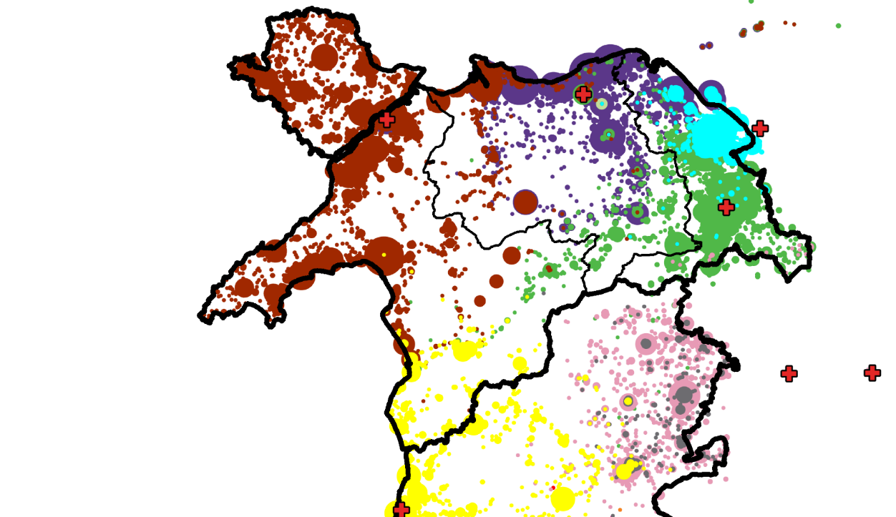
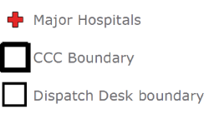
Hospital Flows
Patient flows to major hospitals across Wales are mapped.
Notes:
Yellow = Bronglais General Hospital Aberystwyth

Slide 25
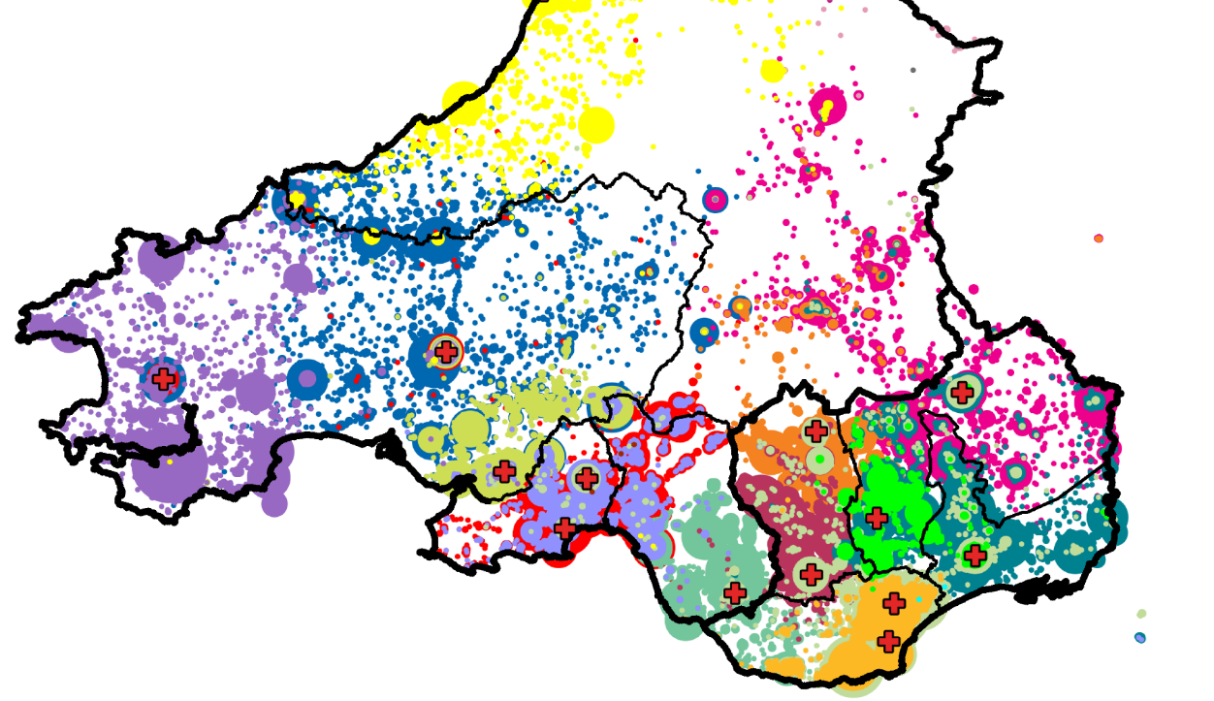
Hospital Flows
Patient flows to major hospitals across Wales are mapped.
Notes:
Yellow = Bronglais General Hospital Aberystwyth

Slide 26
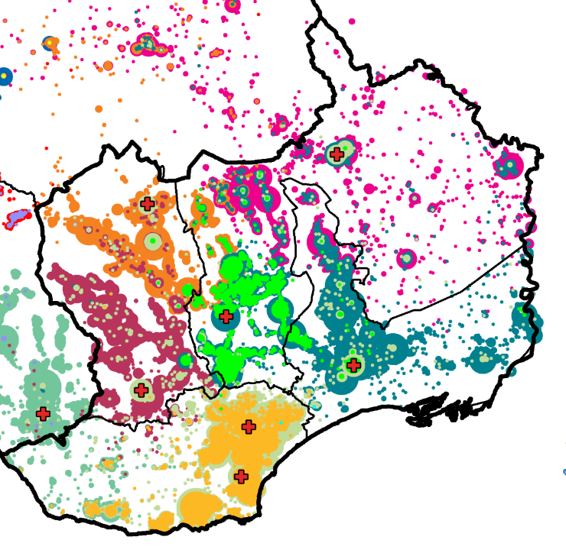
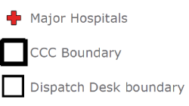
Hospital Flows
Patient flows to major hospitals across Wales are mapped.
Notes:
Yellow = Bronglais General Hospital Aberystwyth

Slide 27
CCC Relief
Requirement

Slide 28
Relief Rate
WAST have identified abstraction efficiencies to be made.
Absence Reason | 2018/19 | WAST Proposed | Difference
Annual Leave* | 14.0% | 15.7% | 1.8%
Sickness | 9.7% | 6.0% | -3.7%
Alternative Duties | 2.2% | 3.0% | 0.8%
Training | 5.4% | 3.0% | -2.4%
Maternity | 2.2% | 2.0% | -0.2%
Other | 1.5% | 1.0% | -0.5%
Abstraction Rate | 35.1% | 30.7% | -4.3%
Relief Rate | 54.0% | 44.3% | -9.6%
Trust | CCC Relief Rate
J | 37.8%
K | 43.7%
L | 44.1%
WAST | 44.3%
M | 47.7%
*Based on maximum 33 days and 8 bank holidays.

Slide 29
Planned Staff Hours - CCCs
Current planned rosters across CCC resourcing in WAST provide (when fully staffed) the following weekly staff hours:
Position | CCC |  |  | Total
 | North | Central & West | South East
Allocator | 554 | 736 | 840 | 2,130
Call Handler | 793 | 982 | 1,103 | 2,879
Clinician | - | - | - | 656
DCM | 168 | 168 | 168 | 504
Dispatcher | 336 | 672 | 840 | 1,848
DSM | - | - | - | 119
Senior Clinician | - | - | - | 169
Supervisor | 154 | 168 | 168 | 490
Total | 2,005 | 2,727 | 3,119 | 8,796
Note: Plan as of July 2019. Allocator includes the HCP desk.

Slide 30
Required Staff (excluding Relief)
Taking account of the 30 minute unpaid break per shift and assuming a 37.5 hour working week, the following staff are required (excluding relief) to run the roster:
Position | CCC |  |  | Total
 | North | Central & West | South East
Allocator | 14.1 | 18.8 | 21.5 | 54.4
Call Handler | 20.2 | 25.0 | 28.1 | 73.3
Clinician | - | - | - | 16.7
DCM | 4.3 | 4.3 | 4.3 | 12.9
Dispatcher | 8.6 | 17.2 | 21.5 | 47.2
DSM | - | - | - | 3.0
Senior Clinician | - | - | - | 4.3
Supervisor | 3.9 | 4.3 | 4.3 | 12.5
Total | 51.1 | 69.6 | 79.6 | 224.4

Slide 31
Required Staff (including Relief)
Adding in the 44.34% relief rate increases the staff requirement to:
Position | CCC |  |  | Total
 | North | Central & West | South East
Allocator | 20.4 | 27.1 | 31.0 | 78.6
Call Handler | 29.1 | 36.1 | 40.5 | 105.7
Clinician | - | - | - | 24.2
DCM | 6.2 | 6.2 | 6.2 | 18.6
Dispatcher | 12.4 | 24.8 | 31.0 | 68.2
DSM | - | - | - | 4.3
Senior Clinician | - | - | - | 6.3
Supervisor | 5.7 | 6.2 | 6.2 | 18.1
Total | 73.8 | 100.4 | 114.9 | 323.8

Slide 32
Funded Staffing
WAST is currently funded for the following staff across the three CCCs:
Position | CCC |  |  | Total
 | North | Central & West | South East
Allocator | 20.0 | 26.0 | 30.0 | 76.0
Call Handler | 30.1 | 28.6 | 38.2 | 96.9
Clinician | - | - | - | 41.0
DCM | 6.0 | 6.0 | 6.0 | 18.0
Dispatcher | 12.6 | 24.2 | 30.0 | 66.8
DSM | - | - | - | 3.0
Senior Clinician | - | - | - | 7.0
Supervisor | 1.0 | 1.0 | 1.0 | 3.0
Total | 69.8 | 85.7 | 105.2 | 311.6
Note: Funded establishment as on 24th June 2019.

Slide 33
Staffing Shortfall (Relief Rate Gap)
Comparing the staffing requirement (including relief) with the funded staffing gives the following shortfall:
Position | CCC |  |  | Total
 | North | Central & West | South East
Allocator | -0.4 | -1.1 | -1.0 | -2.6
Call Handler | 1.0 | -7.5 | -2.4 | -8.9
Clinician | - | - | - | 16.8
DCM | -0.2 | -0.2 | -0.2 | -0.6
Dispatcher | 0.2 | -0.6 | -1.0 | -1.4
DSM | - | - | - | -1.3
Senior Clinician | - | - | - | 0.7
Supervisor | -4.7 | -5.2 | -5.2 | -15.1
Total | -4.1 | -14.7 | -9.7 | -12.2

Slide 34
Clinical Triage
Assessment (CTA) Potential

Slide 35
CSD Suitable Calls
Three quarters of Hear & Treat not coming from CSD codeset.
Triage not attempted on 38% of CSD suitable calls.
Average Daily Calls
CSD Outcome | Hear & Treat Reason | CSD Suitable |  | Total | % Verified Calls
 |  | Yes | No
Hear & Treat | Alternative Transport | 5.0 | 14.4 | 19.4 | 1.5%
 | Hear and Treat Discharge | 4.5 | 11.2 | 15.7 | 1.2%
 | Taxi Suitable | 3.7 | 11.7 | 15.3 | 1.2%
 | Hear and Treat Referral | 2.9 | 6.9 | 9.8 | 0.8%
 | Hear & Treat Total | 16.1 | 44.2 | 60.3 | 4.8%
Upgrade |  | 11.7 | 63.5 | 75.2 | 5.9%
CSD Aborted/Unable to Complete |  | 13.8 | 24.3 | 38.1 | 3.0%
Response Appropriate (No Change) |  | 8.2 | 27.0 | 35.2 | 2.8%
Downgrade |  | 0.1 | 2.9 | 3.0 | 0.2%
Other |  | 0.7 | 0.7 | 1.4 | 0.1%
CSD Total |  | 50.7 | 162.5 | 213.2 | 16.8%
Not Dealt with by CSD |  | 31.2 | - | - | 2.5%

Slide 36
CTA Potential (Current Codeset)
In 2018/19 WAST had a Hear & Treat rate of 7.9%
  4.8% CSD (1.3% from CSD codeset)
  3.1% NHSD
Maximising the current CSD and NHSD codesets would give a total Hear & Treat rate of 8.0%.
  2.1% CSD
  5.9% NHSD
Assumes current CSD and NHSD “success” rates.
Assumes no contribution from non-CSD suitable calls.

Slide 37
CTA Potential (Expanded Codeset)
WAST’s CSD codeset benchmarked against three UK Trusts.
Average Daily CSD Suitable Calls
Initial Category | WAST Codeset |  |  |  | Trust A Codeset |  | Trust B Codeset |  | Trust C Codeset
 | NHSD | CSD | Total |  |  |  |  |  | Clinician | Pharm | MH | Total
RED | 0.1 | 0.1 | 0.2 |  | 0.1 |  | 0.1 |  | 0.2 | 0.1 | 0.2 | 0.5
AMBER1 | 0.1 | 0.0 | 0.1 |  | 2.2 |  | 2.2 |  | 2.2 | 0.1 | 0.0 | 2.2
AMBER2 | 0.0 | 29.7 | 29.7 |  | 7.0 |  | 13.6 |  | 51.1 | 0.0 | 50.0 | 101.1
GREEN2 | 0.0 | 42.1 | 42.1 |  | 20.6 |  | 21.4 |  | 36.7 | 2.2 | 4.4 | 43.3
GREEN3 | 133.4 | 10.1 | 143.5 |  | 125.8 |  | 111.2 |  | 108.7 | 23.8 | 7.3 | 139.9
GREEN(HCP) | 0.1 | 0.0 | 0.1 |  | 0.1 |  | 0.1 |  | 0.1 | 0.0 | 0.0 | 0.1
ROUTINE | 0.0 | 0.0 | 0.0 |  | 0.0 |  | 0.0 |  | 0.0 | 0.0 | 0.0 | 0.0
Total | 133.7 | 81.9 | 215.6 |  | 155.8 |  | 148.7 |  | 199.0 | 26.1 | 62.0 | 287.1
% of Calls | 10.5% | 6.5% | 17.0% |  | 12.3% |  | 11.7% |  | 15.7% | 2.1% | 4.9% | 22.6%
WAST compare favourably when CSD and NHSD codesets are combined.

Slide 38
CTA Potential (Expanded Codeset)
CSD potential when combined with WAST’s codeset.
CSD Suitable Calls | WAST Codeset |  |  |  | WAST + Trust C Codeset
 | NHSD | CSD | Total |  | Clinician | Pharm | MH | Total
Average Daily Calls | 133.7 | 81.9 | 215.6 |  | 282.5 | 216.1 | 237.4 | 304.8
% of Verified Calls | 10.5% | 6.5% | 17.0% |  | 22.3% | 17.0% | 18.7% | 24.0%
Potential to increase the volume of CSD suitable calls from 17% to 24% of calls, with assistance from MH professionals.
Note: Codeset changes are subject to clinical governance processes, so are used for modelling purposes only at this stage.

Slide 39
CTA Potential (Expanded Codeset)
Potential to more than double the CSD codeset (excluding NHSD) from 81.9 to 171.1 calls per day.
Almost a quarter (24%) of all calls would be passed to the CSD desk or NHSD.
Maximising an expanded CSD codeset, and current NHSD codeset, would give a total Hear & Treat rate of 10.2%, assuming current “success” rates.

Slide 40
CCC Modelling
Assumptions

Slide 41
Duplicate Calls
999 call volumes have increased at a faster rate than CAD calls, due in part to duplicate/repeat calls.
Expectation that volumes will fall as response times improve.
WAST to target 11% duplicates, a level seen in the more stable period of summer 2017.
Notes:
Currently around 19%.

Slide 42
Calls by Line
Use of 0845 lines varies between CCCs. No change in 19/20.
Average Daily Calls Offered (December 18 to March 19)
Line Type | Line Area |  |  | Total
 | North | Central & West | South East
Emergency Services (0845) | 45.6 | 6.2 | 95.1 | 146.9
Routine (0845) | 44.3 | 3.8 | 10.7 | 58.8
Primary 999 | 329.3 | 437.9 | 570.7 | 1,337.9
Urgent (0845) | 38.9 | 77.5 | 129.5 | 245.9
Total | 458.0 | 525.4 | 806.0 | 1,789.5
WAST have identified 70 calls day per which Central & West receive from Police, Fire and Coastguard on direct DDIs.
Assume 76 calls per day on C&W Emergency Services line, if used correctly. No change to Routine lines.

Slide 43
Calls by Position
Call logging data only shows the current staff position, taking no account of overtime and promotions.
Many calls with unknown answerer (suspected ICCS).
Calls Answered (2018/19)
Line Type | Call Taker | Supervisor | Dispatcher | Allocator | Unknown
Emergency Services (0845) | 52,146 | 1,921 | 1,408 | 515 | 4,213
HCP Urgent (0845) | 71,875 | 3,667 | 2,020 | 791 | 7,663
Primary 999 | 435,039 | 19,655 | 16,870 | 4,531 | 9,328
Routine (0845) | 18,271 | 243 | 1,310 | 332 | 13,838
Inbound-Other | 6,994 | 381 | 231 | 316 | 2,660,953
Total | 584,325 | 25,867 | 21,839 | 6,485 | 2,695,995
Assume 999 and 0845 calls are only ever answered by a Call Taker. Exclude all inbound other/ICCS calls.
Notes:
ICCS: Integrated communication control system which is the combined radio and telephone system on the dispatchers desks

Slide 44
Calls by Area
WAST operates a virtual call handling model across the three CCCs, bringing with it benefits of increased efficiency and resilience by utilising capacity WAST-wide.
The proportion of 999 calls answered by the home CCC has reduced slightly over the past year.
CCC | % Calls Answered Within Home CCC |  |  |  |  | Total
 | Q1 18/19 | Q2 18/19 | Q3 18/19 | Q4 18/19 | Q1 19/20
Central & West | 63% | 65% | 68% | 60% | 61% | 63%
North | 77% | 73% | 73% | 78% | 73% | 75%
South East | 71% | 66% | 63% | 63% | 62% | 65%
Overall | 70% | 68% | 67% | 66% | 64% | 67%

Slide 45
Calls by Area
There is no perceivable benefit to call handling times of a call being answered by the home CCC.
Average Call Duration (Primary 999, 2018/19)
Line Area | CCC Answered
 | North | Central & West | South East
North | 05:42 | 05:42 | 05:39
Central & West | 05:51 | 06:01 | 05:55
South East | 05:48 | 05:52 | 05:53
For BCP purposes, WAST to target 85% of calls being answered by the home CCC.

Slide 46
Call Durations
Call durations have increased significantly since October 2018.
Trust | 999 Average Call Duration
O | 04:16
Q | 04:59
WAST 2018 | 05:11
R | 05:12
S | 05:27
T | 05:30
WAST 2019 | 06:40

Slide 47
Call Durations
It is felt that call durations will naturally reduce as response times improve, through:
  less use of demand management scripts
  less staying on the line until the ambulance arrives
WAST to target a return to 2018 handling times.
Variation between CCCs to remain for modelling.
Average 999 Call Duration
CCC Answered | 2018 | 2019 | Efficiency
Central & West | 05:29 | 06:44 | 01:15
North | 05:19 | 06:07 | 00:48
South East | 04:52 | 07:10 | 02:18
Overall | 05:11 | 06:40 | 01:29
Notes:
Less use call taker demand management scripts.
Staying on the line less.

Slide 48
Time to Answer
Non-999 are answered more slowly that 999 calls not only due to call prioritisation, but primarily due to IVR delays.
It is assumed that this behaviour will continue.
Notes:
Welcome messages. IVR: Interactive Voice Response.

Slide 49
Clinical Triage Assessment (CTA)
CSD
Average call duration: 26m 31s
Hear & Treat “success” rate: 31.8%
No Hear & Treat contribution from non-CSD suitable calls.
Not modelling other CSD tasks.
NHSD
Average call duration: 23m 24s
Hear & Treat “success” rate: 56.0%
Notes:
Welcome messages

Slide 50
Other Assumptions
Targets
Call Handing: 95% in 5 seconds call answer target.
CSD Triage: 90% in 30 minutes call back target.
Targets to be met in busiest month (i.e December).
General
2.8% annual demand growth.
Current rest break policy.
Minimum shift 6 hours, maximum 12 hours.
Earliest start time 06:00, latest finish time 02:00.
Notes:
Welcome messages

Slide 51
CCC Modelling

Slide 52
CCC Modelling Plan
Simulation models are being set up. Modelling will look at:
Call Handling
Realign rosters to demand with current demand levels
Performance trajectory to 2025 with no additional staffing
Call taker requirement to meet call answer targets
Clinical Triage Assessment (CTA)
CSD staff requirement to maximise WAST codeset
NHSD staff requirement to maximise WAST codeset
CSD requirement to maximise expanded codeset (inc. Trusts C)

Slide 53
Ops Modelling
Assumptions

Slide 54
Response Times
Standard | Pan Wales | By LHB | Period | Comments
Red 8 Minute | 70% | 65% | Monthly | With expectation of continuous improvement. Parameters are minimum.
Red 90th | 15 mins | - | Monthly | As per English ARP. See what pan-Wales means at HB level. Improve distribution curve.
Amber 1 (first on scene) | 18 mins | - | Monthly | As per English ARP. To mirror ARP this is a hybrid: 18 minutes if not conveyed, 18 minutes for conveying resource if conveyance required. Model first on scene as per EASC AQIs.
Amber 1 90th (first on scene) | 40 mins | - | Monthly | As per English ARP. See what pan-Wales means at HB level. Improve distribution curve. Hybrid as above. Model first on scene as per EASC AQIs.
Longest Waits | - | - | - | Provide a table that shows predicted waits by hour, as per separate table attached. Review this, based on other changes proposed.
95% of Amber first responses to be modelled as ideal.

Slide 55
Operations Rosters
Roster review should conform to the following parameters:
Shift lengths between 8 and 12 hours
No shift to start before 06:00 or after 23:00 – if 23:00 start – maximum shift length to be 9 hours
No shift to finish after 2am?
Model assuming current meal break policy

Slide 56
Job Cycle Times
WAST components of JCT benchmarked favourably to other Trusts, therefore no change in JCT.
Arrival to handover times to be based on sample period – no change.
Utilisation to be seen as an output of the review, not an input.

Slide 57
Ops Modelling

Slide 58
Model Inputs
Model Parameter | Degree of Adjustability
Demand | By time, location, call category and clinical specialism (cardiac, stroke, etc)
Activation time (time of call or clock start to time assign) | By category and time
Mobilisation time | By time of day and vehicle type
Travel times | Fixed during calibration/setup but are varied by time, location, vehicle type and response priority
Time at scene | By category, vehicle type and time of week
Hear and Treat rates | By category, area and time of week, affecting responded demand levels
Conveyance rates | By time of week and type of call - can be altered by vehicle type
Hospitals | Location, opening hours and specialism accepted
Time spent at hospital | By time of day and type of patient
Response locations | Location, capacity, type (station, deployment point, etc)
Vehicle deployment | Shift times, locations, on duty vs on call variations, vehicle types and availability
Staff skill levels | Adjust staff skill be shift and input the impact by skill type on conveyance or 'See and Treat' rates
Meal breaks | Meal break length based on shift length, meal break locations and policy on interrupts
Dispatch rules | Type, number and distance of vehicles to send to each type of call. End of Shift behaviour
Reporting options | Geographical areas over which to aggregate results, response and transport time standards
Notes:
This provides a list of all of the parameters included in ORH’s ambulance simulation model, AmbSim, and the degree to which they can be adjusted.

Slide 59
Model Outputs
Response performance against KPIs
  By category: % within X minutes, mean response time, response time percentiles
  Also presented by area, day and hour
Vehicle utilisation
  By type, day, hour and location
Multiple attendance rate and vehicle workload
  By category, showing influence of dispatch rules
Hospital profiles – journeys by specialty
In the first instance, these outputs are used to validate the model against analysed performance

Slide 60
Validated Performance
Local Health Board | Red | Red | Amber 1 | Amber 2 | Red | Amber 1 | Amber 2
 | 8 | Mean |  |  | 90th Percentile
Abertawe Bro Morgannwg University LHB | 76.4% | 05:37 | 48:22 | 101:45 | 10:59 | 114:14 | 262:34
Aneurin Bevan LHB | 73.0% | 06:07 | 49:52 | 104:37 | 12:07 | 110:45 | 258:18
Betsi Cadwaladr University LHB | 72.4% | 06:14 | 31:32 | 66:53 | 13:26 | 67:22 | 159:19
Cardiff & Vale University LHB | 81.3% | 05:18 | 43:15 | 113:07 | 09:44 | 95:33 | 281:28
Cwm Taf LHB | 72.5% | 06:06 | 38:19 | 70:08 | 11:49 | 82:58 | 163:59
Hywel Dda LHB | 65.6% | 06:45 | 32:01 | 54:51 | 15:08 | 70:19 | 124:52
Powys LHB | 65.9% | 07:08 | 30:39 | 48:39 | 17:30 | 65:31 | 109:49
Wales-wide | 73.7% | 06:01 | 39:41 | 81:02 | 12:19 | 88:03 | 197:21
Red performance based on first response. Amber based on hybrid response measure.

Slide 61
Modelling Scenarios
With the model validated, the following scenarios have been run:
Moving to planned shifts (assumes full shift coverage)
Moving to projected December 2024 demand (highest month in final modelled year)

Slide 62
Planned Shifts – Current Demand
Planned Shifts
Local Health Board | Red | Red | Amber 1 | Amber 2 | Red | Amber 1 | Amber 2
 | 8 | Mean |  |  | 90th Percentile
Abertawe Bro Morgannwg University LHB | 81.0% | 04:58 | 40:44 | 79:24 | 09:49 | 94:28 | 194:49
Aneurin Bevan LHB | 83.9% | 04:46 | 29:59 | 54:47 | 09:28 | 61:48 | 109:07
Betsi Cadwaladr University LHB | 77.4% | 05:15 | 23:23 | 40:39 | 10:20 | 50:12 | 84:29
Cardiff & Vale University LHB | 83.7% | 05:08 | 26:24 | 61:45 | 09:10 | 53:01 | 126:28
Cwm Taf LHB | 77.6% | 05:29 | 23:14 | 36:27 | 10:26 | 45:52 | 67:56
Hywel Dda LHB | 66.3% | 06:37 | 28:38 | 46:07 | 14:53 | 63:19 | 101:34
Powys LHB | 67.9% | 06:32 | 27:09 | 40:32 | 15:57 | 58:11 | 87:17
Wales-wide | 78.7% | 05:19 | 28:35 | 51:22 | 10:38 | 61:24 | 110:19
Difference from Actual Resourcing
Local Health Board | Red | Red | Amber 1 | Amber 2 | Red | Amber 1 | Amber 2
 | 8 | Mean |  |  | 90th Percentile
Abertawe Bro Morgannwg University LHB | 4.6% | - 00:39 | - 07:38 | - 22:21 | - 01:10 | - 19:45 | - 67:44
Aneurin Bevan LHB | 10.9% | - 01:21 | - 19:53 | - 49:50 | - 02:39 | - 48:57 | - 149:11
Betsi Cadwaladr University LHB | 5.0% | - 00:59 | - 08:09 | - 26:14 | - 03:06 | - 17:10 | - 74:50
Cardiff & Vale University LHB | 2.4% | - 00:10 | - 16:51 | - 51:22 | - 00:34 | - 42:32 | - 154:59
Cwm Taf LHB | 5.1% | - 00:37 | - 15:05 | - 33:41 | - 01:23 | - 37:06 | - 96:03
Hywel Dda LHB | 0.7% | - 00:08 | - 03:23 | - 08:44 | - 00:15 | - 07:00 | - 23:18
Powys LHB | 2.0% | - 00:36 | - 03:30 | - 08:07 | - 01:33 | - 07:20 | - 22:32
Wales-wide | 5.0% | - 00:42 | - 11:06 | - 29:40 | - 01:40 | - 26:38 | - 87:02

Slide 63
Impact of December 2024 Demand
Planned Shifts - December 2024 Demand
Local Health Board | Red | Red | Amber 1 | Amber 2 | Red | Amber 1 | Amber 2
 | 8 | Mean |  |  | 90th Percentile
Abertawe Bro Morgannwg University LHB | 68.5% | 08:27 | 282:36 | 427:36 | 15:11 | 450:20
Aneurin Bevan LHB | 78.5% | 05:35 | 129:40 | 284:28 | 10:53 | 404:27
Betsi Cadwaladr University LHB | 72.2% | 06:17 | 61:49 | 199:59 | 13:22 | 150:40
Cardiff & Vale University LHB | 75.0% | 06:17 | 133:09 | 313:07 | 12:02 | 392:51
Cwm Taf LHB | 71.1% | 06:24 | 115:53 | 251:37 | 12:01 | 382:34
Hywel Dda LHB | 55.9% | 10:11 | 270:14 | 401:26 | 21:32 | 396:01
Powys LHB | 60.2% | 09:23 | 261:18 | 404:33 | 21:18 | 392:31
Wales-wide | 70.5% | 07:12 | 161:13 | 305:22 | 14:14 | 339:57 | >12 hours
Difference from Current Demand
Local Health Board | Red | Red | Amber 1 | Amber 2 | Red | Amber 1 | Amber 2
 | 8 | Mean |  |  | 90th Percentile
Abertawe Bro Morgannwg University LHB | -12.5% | 03:29 | 241:52 | 348:12 | 05:22 | 355:51
Aneurin Bevan LHB | -5.4% | 00:49 | 99:41 | 229:42 | 01:25 | 342:39
Betsi Cadwaladr University LHB | -5.1% | 01:03 | 38:26 | 159:20 | 03:02 | 100:28
Cardiff & Vale University LHB | -8.7% | 01:09 | 106:46 | 251:22 | 02:52 | 339:50
Cwm Taf LHB | -6.6% | 00:55 | 92:38 | 215:10 | 01:35 | 336:42
Hywel Dda LHB | -10.4% | 03:34 | 241:36 | 355:19 | 06:39 | 332:42
Powys LHB | -7.6% | 02:51 | 234:09 | 364:00 | 05:21 | 334:20
Wales-wide | -8.2% | 01:53 | 132:38 | 254:01 | 03:36 | 278:33

Slide 64
Ops Modelling Plan
The next modelling steps are:
Add staff to meet targets with current demand
Add staff to meet targets with December 2024 demand
Model efficiencies through increased:
  Hear and treat
  APP usage
  Locations
Model trajectory from 2019/20 to 2024/25

Slide 65
Optimal Location
Modelling

Slide 66
Location Optimisation
Applied ‘blank canvas’ location optimisation to assess current estates configuration.
  Blank canvas modelling uses optimisation techniques to identify ideal locations with no account of current locations or other constraints.
Majority of existing stations are aligned with optimal locations.
However, there may be some opportunities to improve coverage.

Slide 67
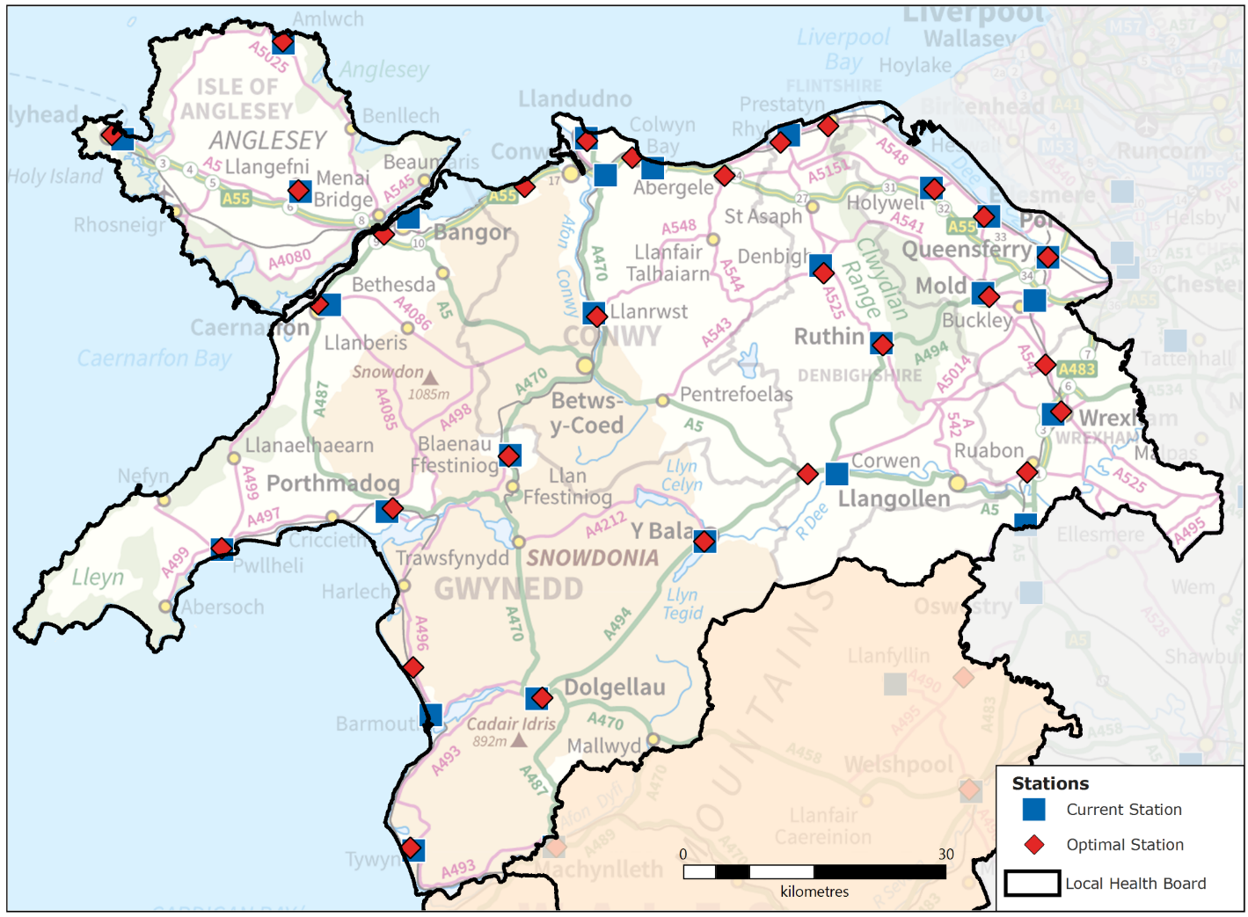
North

Slide 68
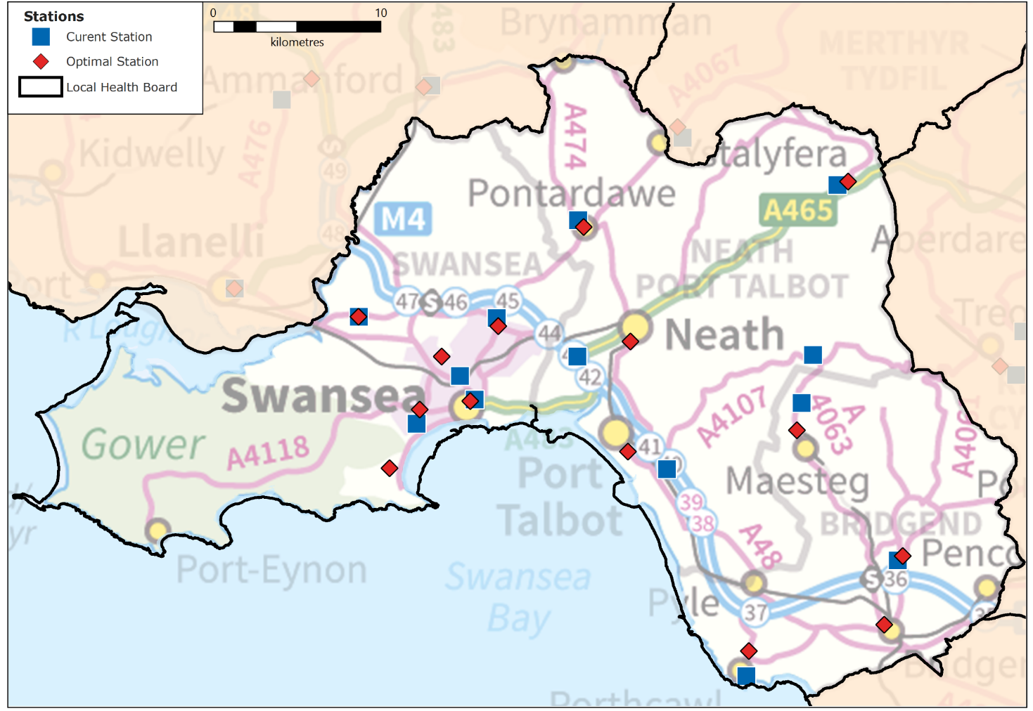
Central & West:
Abertawe Bro Morgannwg

Slide 69
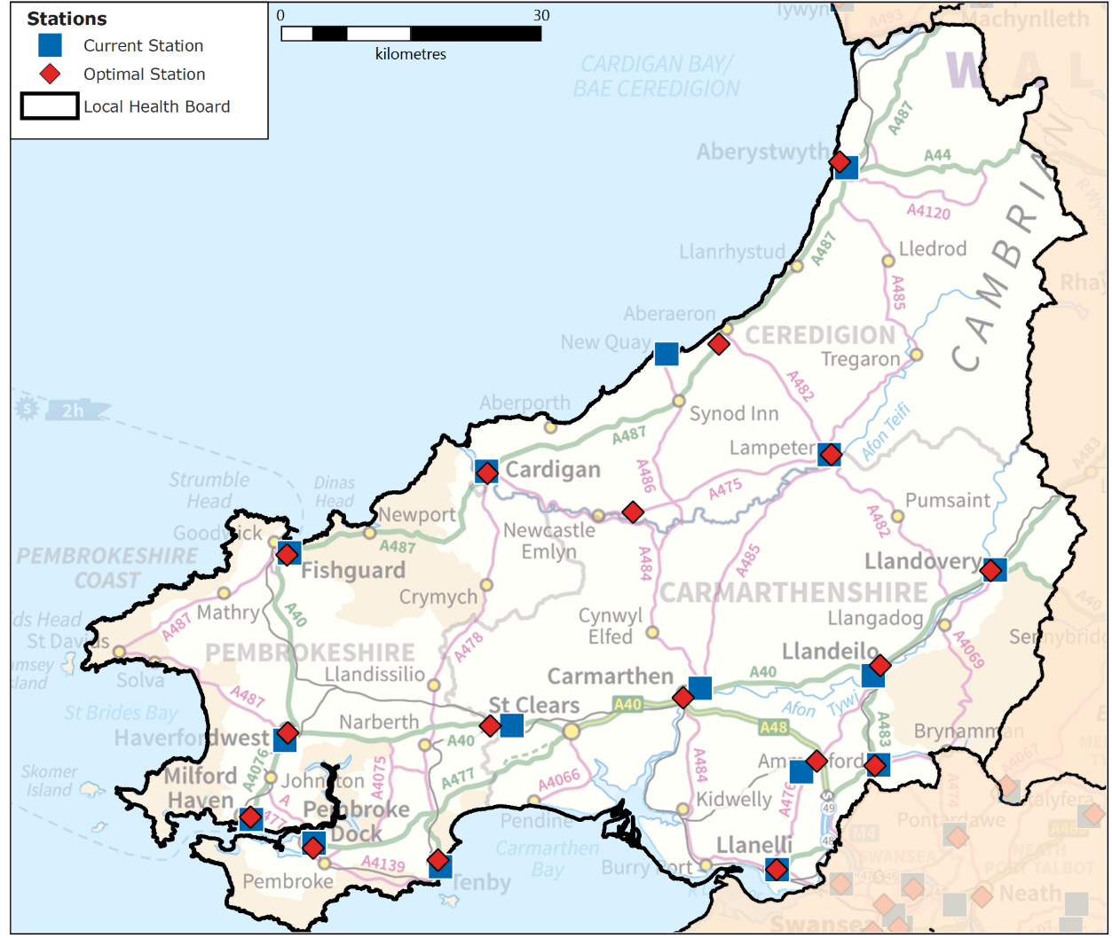
Central & West:
Hywel Dda

Slide 70
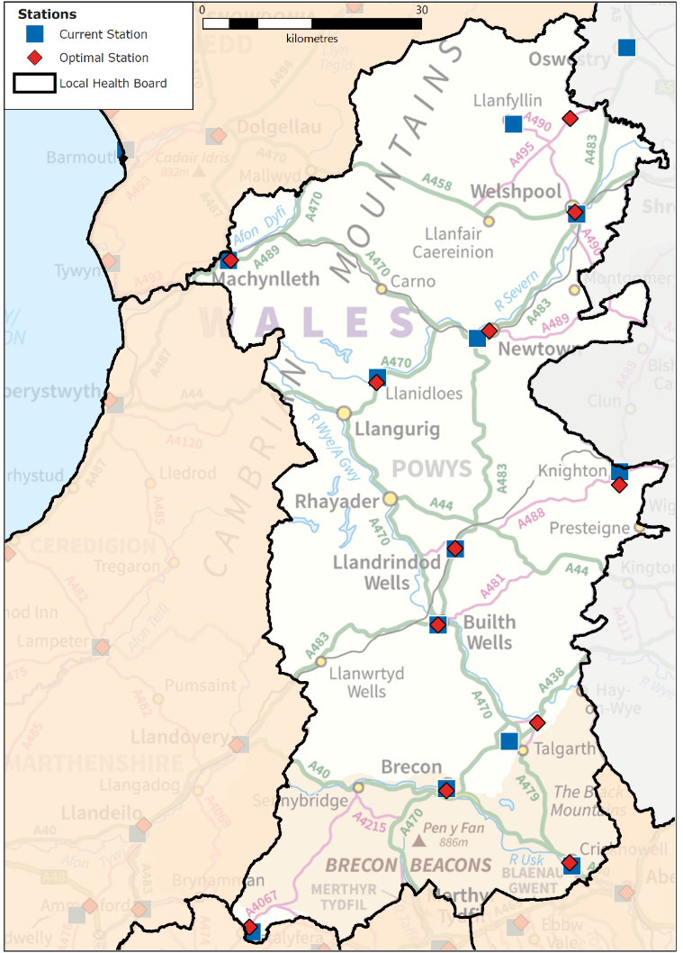
Central & West:
Powys

Slide 71
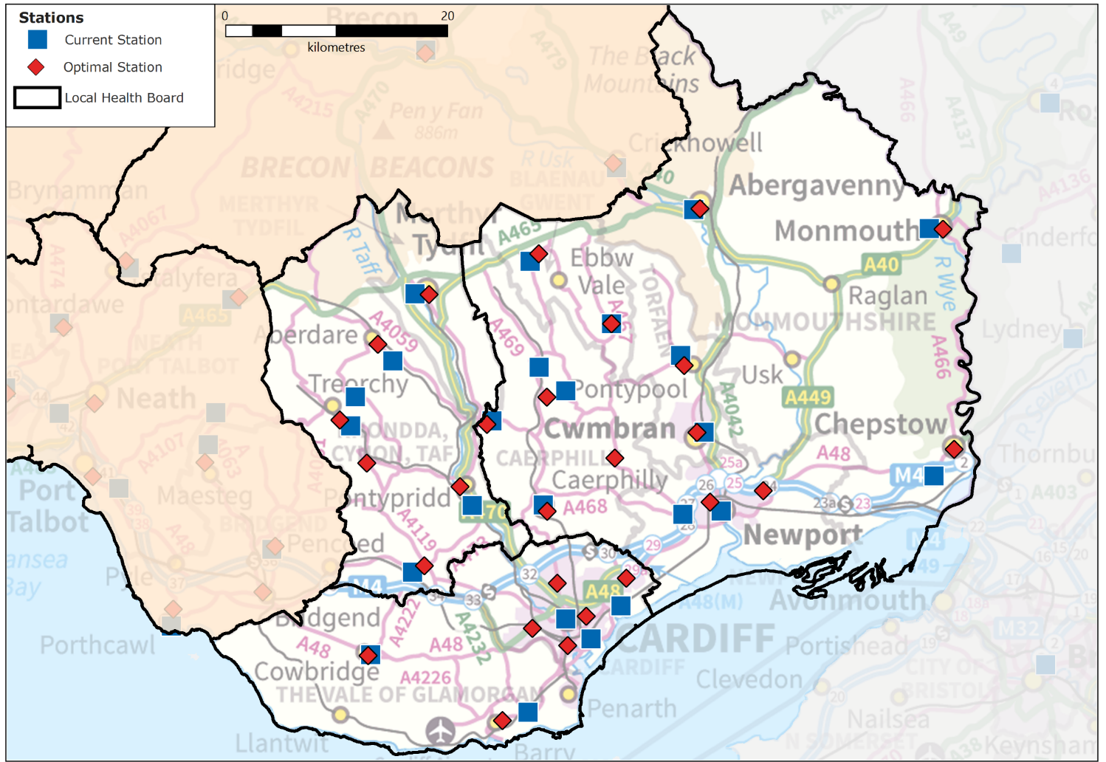
South East

Slide 72
Next Steps

Slide 73
Next Steps
Ops Modelling:
  Add staff to meet targets with current demand
  Add staff to meet targets with December 2024 demand
  Model efficiencies through increased H&T, APP, Locations
  Model trajectory from 2019/20 to 2024/25
Call Handling Modelling:
  Realign rosters to current demand
  Performance trajectory to 2025 (no additional staffing)
  Call taker requirement to meet call answer targets
CTA Modelling:
  CSD staff requirement to maximise WAST codeset
  NHSD staff requirement to maximise WAST codeset
  CSD requirement to maximise expanded codeset

Slide 74
Discussion

