Slide 1

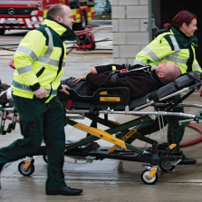

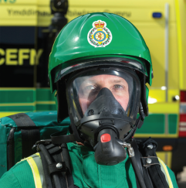




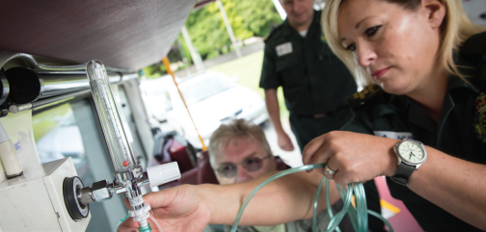



Welsh Ambulance Service NHS Trust:
Red Improvement
10th September 2019 EASC
welshambulanceservice
@welshambulance
www.ambulance.wales.nhs.uk

Slide 2

Demand Increase
www.ambulance.wales.nhs.uk @welshambulance #TeamWAST
Notes:
Red demand has increased by 6.7% overall year on year, and in every Heath Board area, breathing problems continues to be the most frequent reason for red calls. Overall increased verified demand is reported in almost every MPDS code, but the biggest volume increases are seen in falls. Increases likely to be therefore genuine and due to increasing age / morbidity in general population. Verified Amber demand has remained stable, with only a 1.0% decrease year on year.

Slide 3
Demand Analysis
Exploring Increasing Red Demand (extract from JET slides to WG)
Year on year (2017 v 2018) comparison of increase in Red demand.
Red demand increased by 13% overall, and in every Heath Board area.
Increased demand seen in almost every MPDS code, but biggest volume increases seen in breathing problems (up by 36%).
Increases likely to be therefore genuine and due to increasing age / morbidity in general population.
Increases in Pregnancy/Childbirth/Miscarriage seen in HD and Powys.
www.ambulance.wales.nhs.uk

Slide 4
Emergency Ambulance Production
www.ambulance.wales.nhs.uk @welshambulance #TeamWAST
Notes:
Generally 20-30% of our EA production come from overtime hours, the average over the 2 year period was 24.2%. Specifically, in July 2019, overtime contributed 24.7% to total actual hours for Emergency Ambulances.
Production July 2018 = 68,885 compared to Production July 2019 68,512. This equates to 9.5 hours less per day.

Slide 5
RRV Production
www.ambulance.wales.nhs.uk @welshambulance #TeamWAST
Notes:
Overtime contributes slightly less to RRV production compared to EAs. Generally RRVs contribute between 10-20% to RRV actual hours, the actual average over the 2 years was 15.3%.
Specifically, in July 19 overtime contributed 14.26% to total actual hours. This varies considerably between Health Boards, Powys and Hywel Dda on slide 6.

Slide 6
Overtime Production
www.ambulance.wales.nhs.uk @welshambulance #TeamWAST
Notes:
Pan Wales EA and RRV UHP / Actual Hours Produced (KH)
HD / P EA and RRV UHP / Actual Hours Produced (SR), this should show impact on OT.
Separate information on overtime – contribution to actual hours (SR)

Slide 7
Sickness
www.ambulance.wales.nhs.uk @welshambulance #TeamWAST
Notes:
Sickness has been on an improving trend since December 2018, being lower than the same period in the previous year. However, July 2019 position of 6.7% has increased very slightly compared to the July 2018 level of 6.62%.

Slide 8
Running Calls
www.ambulance.wales.nhs.uk @welshambulance #TeamWAST
Notes:
Red performance has been consistently above 70% for the last 12 months, with the exception of July 2019 achieving 69.3% (and now August at 69%). Despite consistently achieving the 65% target, as the graph shows, there has been a gradual decline in the monthly performance, linked in part to increasing red incident demand (up 6.9% from 2017/18 to 2018/19) and to a reduction in the number of running calls recorded (through increased consistency in the application of the standard / guidance). It is important to remember that a running call adds volume, increasing the denominator, and is a hit at the same time increasing the numerator.
Changes to the treatment and recording of running calls to provide the most accurate presentation of true response performance have been notified to the Chief Ambulance Service Commissioner in correspondence dated 16 April 2019 and 13 August 2019.
Each running call, by its nature, has a zero minute response time, and therefore as the number of running calls reduces as a proportion of the overall red demand, this will negatively affect performance.

Slide 9
EA Red Contribution
www.ambulance.wales.nhs.uk @welshambulance #TeamWAST
Notes:
RRV – up to 47 pan wales
EA – up to 120 pan Wales
EAs contribute in the region of half of red performance.

Slide 10
Handover Lost Hours
www.ambulance.wales.nhs.uk @welshambulance #TeamWAST

Slide 11
Handover Lost Hours
www.ambulance.wales.nhs.uk @welshambulance #TeamWAST
Notes:
Maelor was significant contributor but well subsided
Morriston, Royal Gwent, Glan Clwyd and Princess of Wales largest contributors

Slide 12
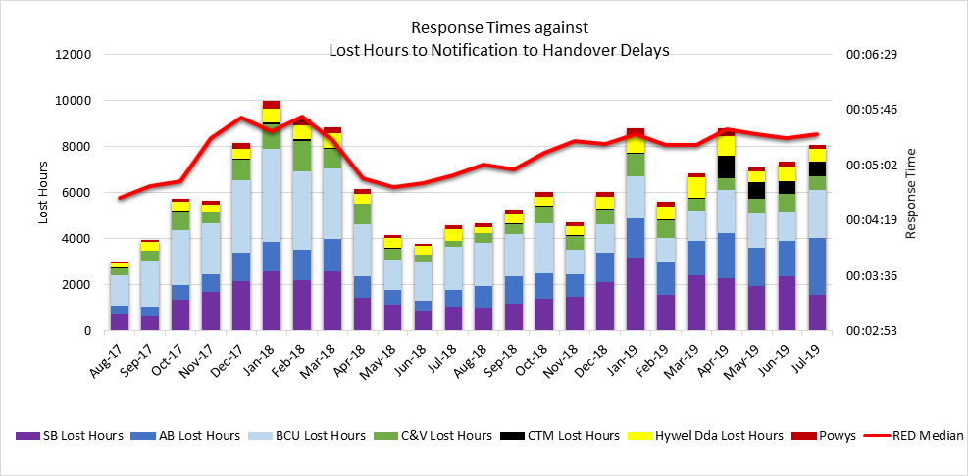
Handover & Performance
www.ambulance.wales.nhs.uk @welshambulance #TeamWAST

Slide 13
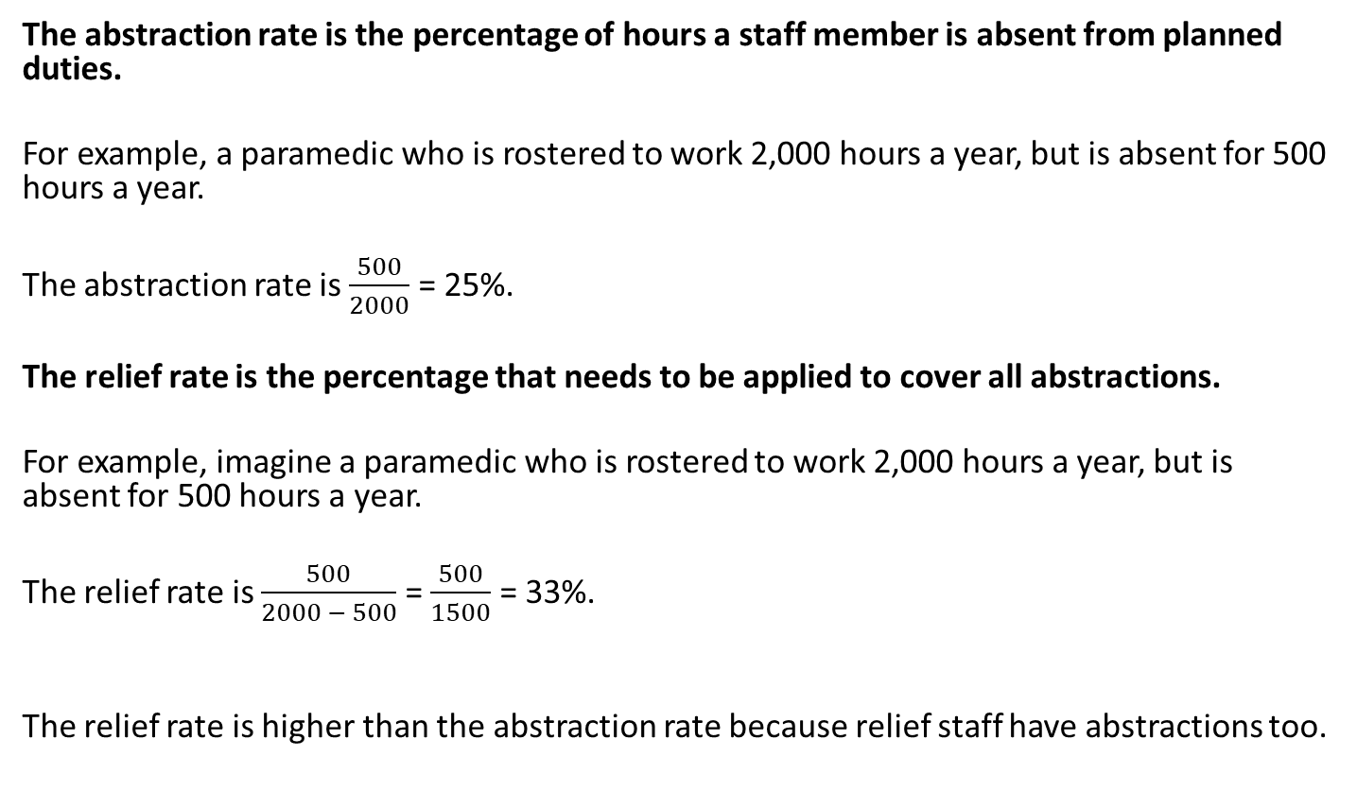
Abstractions v. Relief Rate
The abstraction rate is the percentage of hours a staff member is absent from planned duties.
For example, a paramedic who is rostered to work 2,000 hours a year, but is absent for 500 hours a year.
The abstraction rate is $\frac{500}{2000}$ = 25%.
The relief rate is the percentage that needs to be applied to cover all abstractions.
For example, imagine a paramedic who is rostered to work 2,000 hours a year, but is absent for 500 hours a year.
The relief rate is $\frac{500}{2000 − 500}$ = $\frac{500}{1500}$ = 33%.
The relief rate is higher than the abstraction rate because relief staff have abstractions too.
www.ambulance.wales.nhs.uk

Slide 14
Proposed Response Relief Rate
EMS Response Relief
www.ambulance.wales.nhs.uk
Notes:
The current planned rate of abstraction in WAST is 24% and the relief rate is 34% (this is the planned not the actual), as shown in previous slide
During the recent Aneurin Bevan and Cwm Taf roster reviews, a Roster Review Toolkit was created, which used these percentages; however, it was noted at the time that they were historic and needed to be reviewed (and increased)
Whilst WAST’s actual rate of abstraction is high (as identified by ORH), the planned abstraction (and subsequent relief rate) is considered low)
The Demand & Capacity Review has provided an opportunity to re-base the planned abstraction rate and relief rate based on current and actual need
The proposed abstraction rate is 29.91% and therefore the proposed relief rate is 42.67%. This would put WAST in the middle of ORH’s national benchmark comparators and is stretching given the current actuals (WAST’s current relief rate, based on funded establishment is c.18%)
The proposed “planned” sickness rate is 5.99% (current rate is 8.2% thus delivering a 2.3% improvement)
This rate reflects the need for training, which is an important aspect of patient safety, staff retention and clinical quality
The detailed relief rate calculation is shown on the next slide

Slide 15
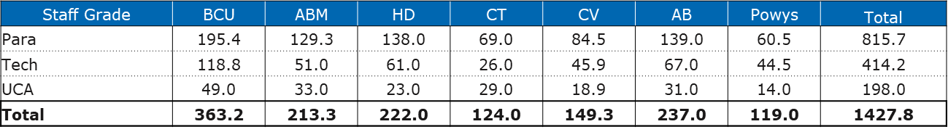
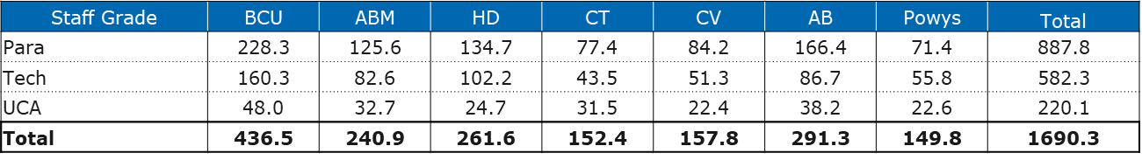
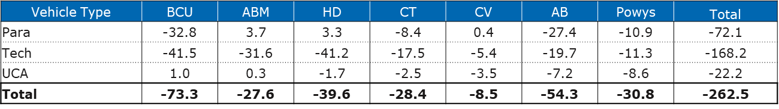
EMS Relief Gap FTEs
WAST has a difference between its funded establishment and the FTEs required to cover the core EMS rosters (RRV/EA and UCS) at the required re-based abstraction rate (and subsequent relief rate) of 29.21% and 42.67% respectively.
Funded
Required
Difference
www.ambulance.wales.nhs.uk
Notes:
This is based on EA/EMT ratio of 55/45, to avoid double crewing EMTs.
WAST will also required additional first tier front line clinical and management support for this relief gap. It is estimated that an additional 14.2 CTLs will be required (ratio of 2 to 25).

Slide 16
NQP Pipeline
www.ambulance.wales.nhs.uk
Notes:
On 1st May 2019, EMT agreed appointment of up to 97 NQPs (30 from the conversion course and 67 from the Big Bang event) in 2019/20 to backfill predicted paramedic turnover and internal movements up to the end of the financial year.
We have made a total of 30 offers for conversion NQPs (1 is still awaiting their HCPC registration before starting) and due to mop up interviews we were asked to undertake after the Big Bang event, we made a total of 74 offers to Big Bang candidates, 41 of which were from Swansea University.
7 candidates in total withdrew, none of which were from Swansea University. One offer was withdrawn due to a failure to provide placement feedback. The others from other universities withdrew for their own reasons (e.g. being offered a role elsewhere).
Therefore we currently have 67 NQPs from this year’s Big Bang event who either started their training in August/ September 2019 or are due to join us before December 2019. We also have another 3 NQP from last year’s Big Bang event (e.g. 1 deferred due to maternity leave) also due to join us before December = 70 NQPs in total
However 2 of these candidates still need to pass their driving assessments (which were delayed due to them waiting to obtain their C1).
21 of the 69 NQPs are also currently awaiting the results of their second re-sits which are due out this month. 19 of these are graduates are from Swansea University this year, 1 is from Swansea University last year and one is from an English ambulance Service.
If they fail this re-sit, the final attempt will be facilitated by an external company. We are currently waiting to find out the date. If it is after our last training course on 4th November, we would need to either keep these individuals on a reserve list until we know if they have qualified and check if the training team can run another 2 week induction course for them in the new year or we can withdraw our offers and they can re-apply at a later date.
1 x conversion NQP awaiting HCPC registration and 1 x NQP from last year’s BB event awaiting registration

Slide 17
Qliksense “Hackathon”
The Red Improvement Plan includes using more advanced performance software (Qliksense and Optima Predict). In Jun-19 WAST held a “hackathon”, using Qliksense.
The “hackathon” looked for trends over time which were close to the RED decline or followed similar patterns.
The “hackathon” identified Red incident re-categorisation as an issue a) a decline in Red downgrades and b) an increase in Red upgrades. As a result a new process was implemented in the CCC which allows the response to be faster without changing the category of the call or not downgrading.
The “hackathon” also identified RRV standby points (currently being reviewed: completed in AB, CT, HD and P) and overnight RRVs.
WAST’s Health Informatics are continuing to roll out Qliksense and as part of this adding in more information about ambulance availability (the key issue identified in the Amber Review), in particular, post production lost hours and resource information (planned ambulance hours and actual ambulance hours). This should provide a much more powerful causal analysis than we are able to provide currently.
www.ambulance.wales.nhs.uk @welshambulance #TeamWAST

Slide 18
Red Improvement Plan
Red Improvement Plan contains is comprehensive, containing 25 main actions (with supporting sub-actions). Key points from Plan as follows:-
Community First Responders
36 additional responders being trained by St John for HD and P, due to go live in Sep-19.
Further work via Optima Predict on identifying gaps in Community First Responder schemes (quarter 4, see other priorities for Optima Predict below).
Public/HCPs
PAD sites and GoodSAM information loaded into CAD to maximise contribution.
An extra 476 additional AEDs will be in circulation by 30 Sep-19.
Support from HBs on HCPs carrying AEDs would have impact.
RRVs/Status Management Plan i.e. location of RRVs to maximise speed of response
Optima Predict currently being used to review each HB.
Ability to deliver on findings significantly hindered by relief gap.
Overproducing on RRVs in HD and P to boost performance (has had impact, but difficult to sustain, particularly, during summer annual leave period.
www.ambulance.wales.nhs.uk @welshambulance #TeamWAST

Slide 19
Red Improvement Plan
CCC Clinical Review
Review of the CCC process and sub-processes (redesign where appropriate), the performance metrics underneath these and performance reporting to empower managers (to reduce time lost in CCC and reduce response times) (to complete Oct-19).
Station Mobilisation
Review of estate and highways by stations to reduce mobilisation times
Improving Resource Availability Programme (separate programme, linked to Red)
Improving attendance.
Improving recruitment timescales.
Modernising bank arrangements.
Transforming Resource Policy.
Handover to Clear (dual pin technology).
Optima Predict/Qliksense
- Improved reporting, in particular, predictive reporting (week, month, season i.e. winter)
www.ambulance.wales.nhs.uk @welshambulance #TeamWAST

Slide 20
Red Improvement Plan
Dynamic Reporting
Development of triggers to give automatic notification to managers.
Management Focus
Weekly corporate meeting on Red, led by Director of Operations.
Specific recovery plans for HD & P.
Increased focus on twice weekly UHP/planning meeting with AOMs and AD Response.
Design and implementation of on-duty management role to improve resolution of tactical issues (silver cell)
Improved daily performance briefing framework.
Handover
Availability of Patient Flow Co-ordinators for major ED sites.
Modelling via Optima Predict of impact of handover.
WAST support to NCCU on hospital handover work (linked to Amber Review).
Paper from NCCU, with WAST input, on gold call systems leadership.
Immediate Release Protocol.
Fast track opportunities to support patient handover.
Support to Delivery Unit and NCCU on gold command training / hospital capacity.
www.ambulance.wales.nhs.uk @welshambulance #TeamWAST

Slide 21
Conclusions
Red performance has previously been maintained above 70% and the 65% monthly requirement is achieved, however the pattern is inconsistent with the commissioning intention.
WAST has been reducing “running calls” from Red performance within the context of rising demand. Removing “running calls” does more accurately reflect WAST’s response performance.
There are three fundamentals affecting Red: increased demand, the relief gap and handover lost hours.
The difference between A8 and A9 indicates that if WAST can make marginal gains it can impact on Red performance, within the limits of these fundamentals.
WAST has a comprehensive Red Improvement Plan that is being delivered at pace.
As we move into winter, there needs to be a realism about the levels of performance that can be delivered, given the fundamentals and potential flu and broader winter impacts.
www.ambulance.wales.nhs.uk @welshambulance #TeamWAST

