Slide 1



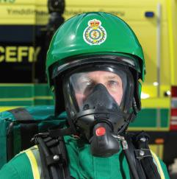



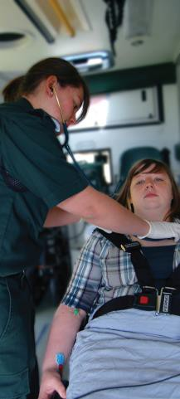


EASC – 8 September 2020
Activity and Performance Summary – August 2020
07 Sept 2020

Slide 2

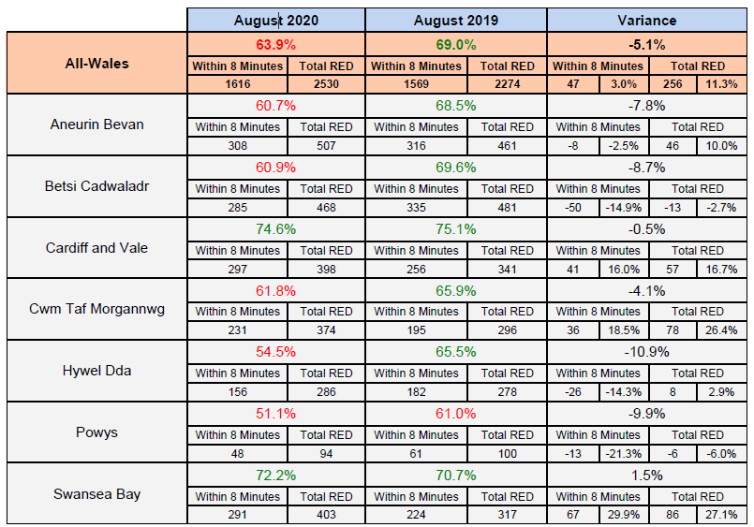
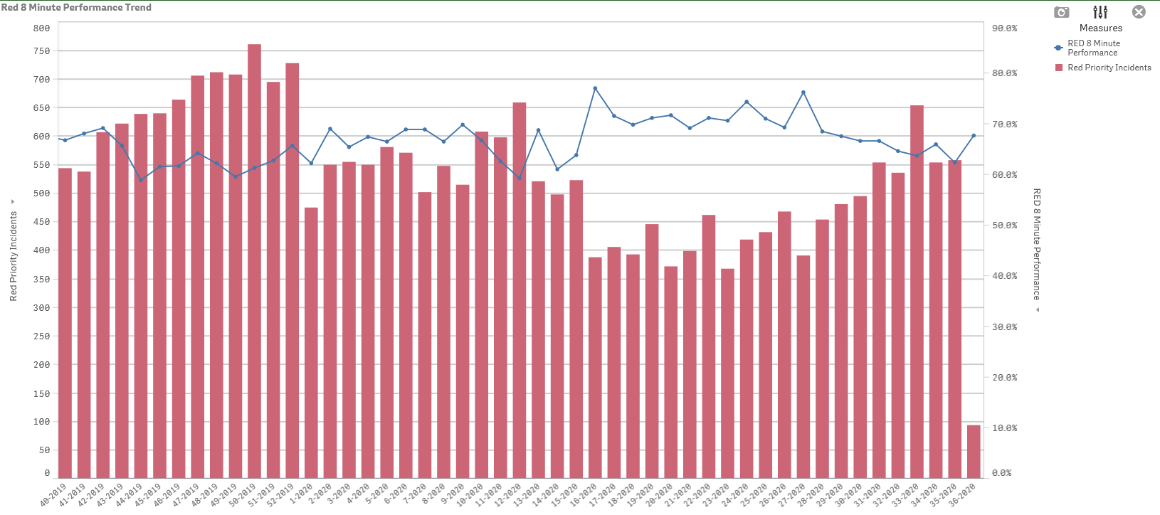
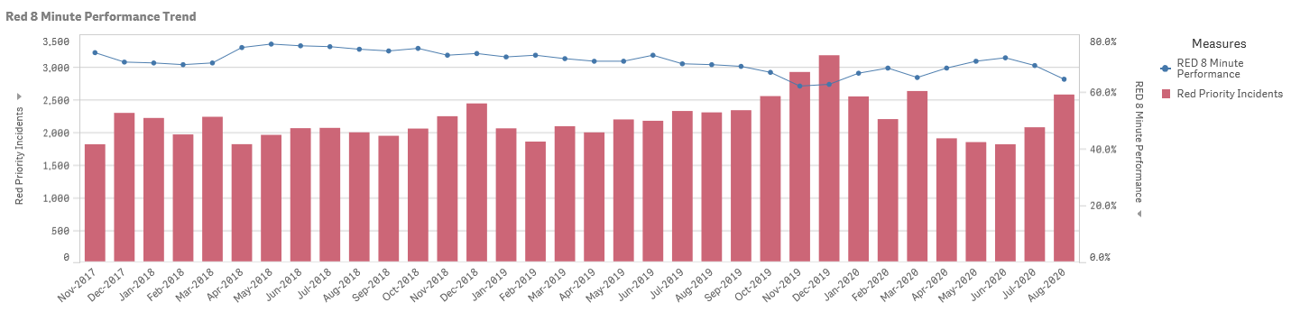
Red Position 24 August 2020

Slide 3
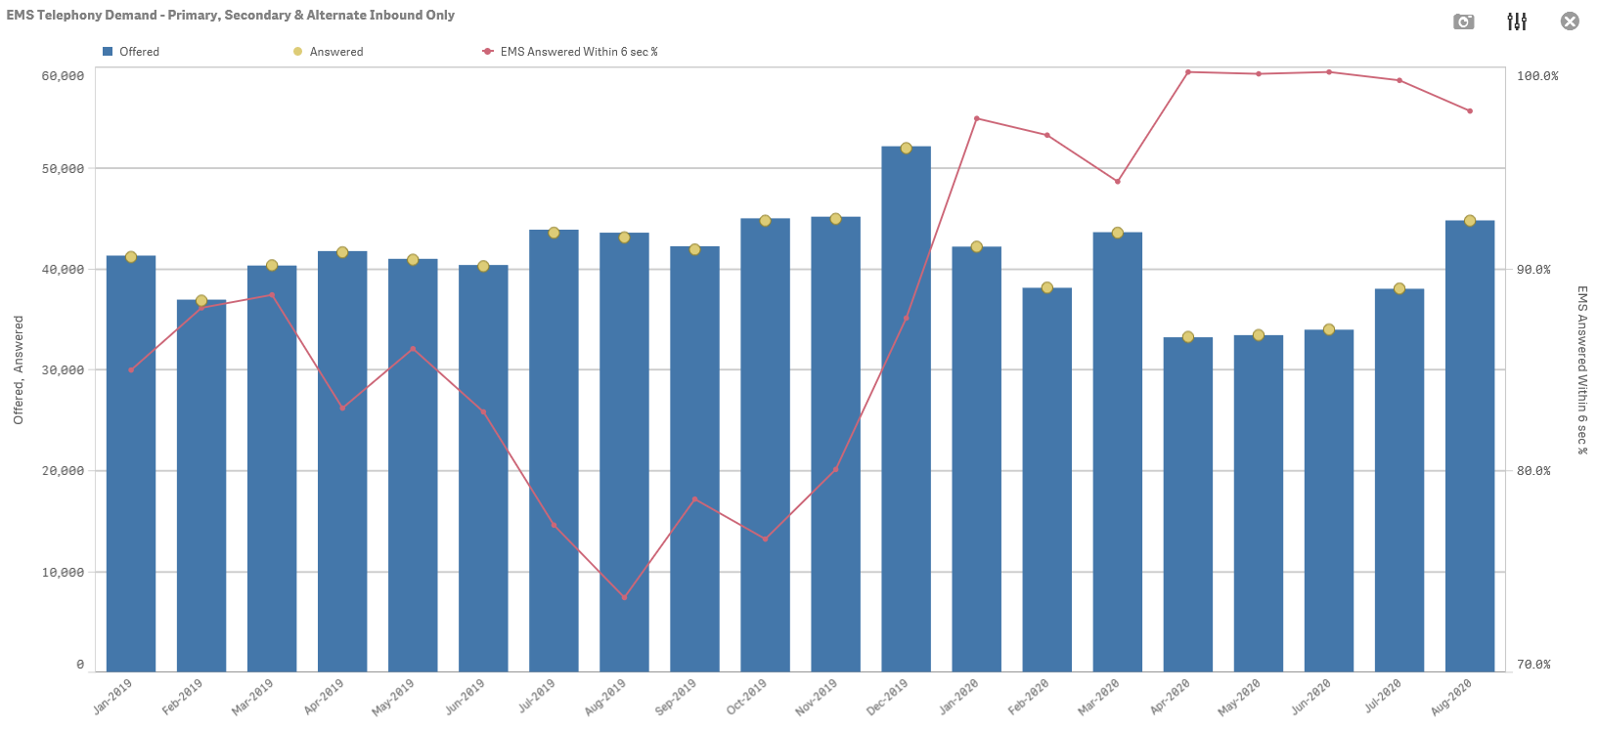
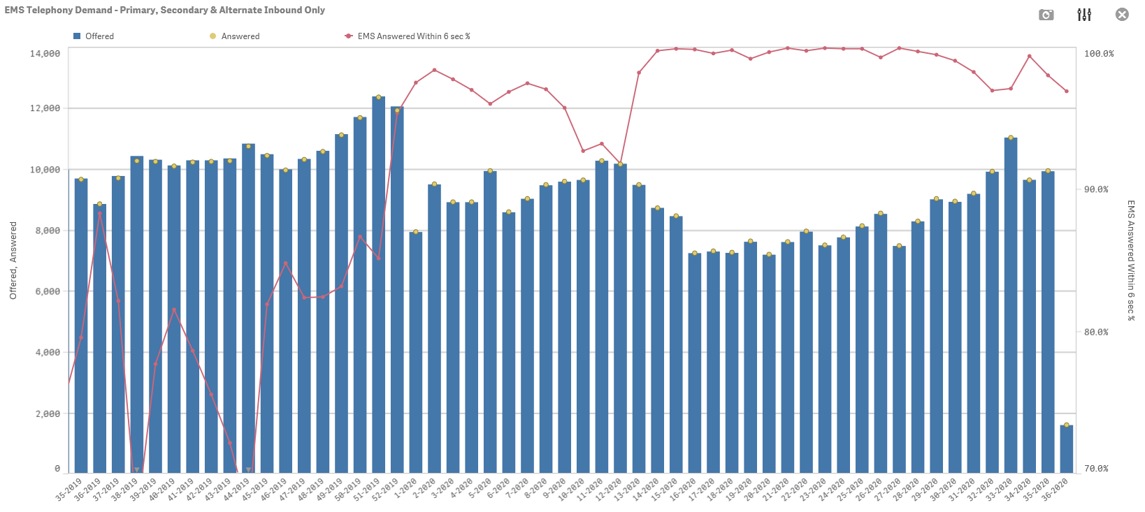
999 Handling

Slide 4
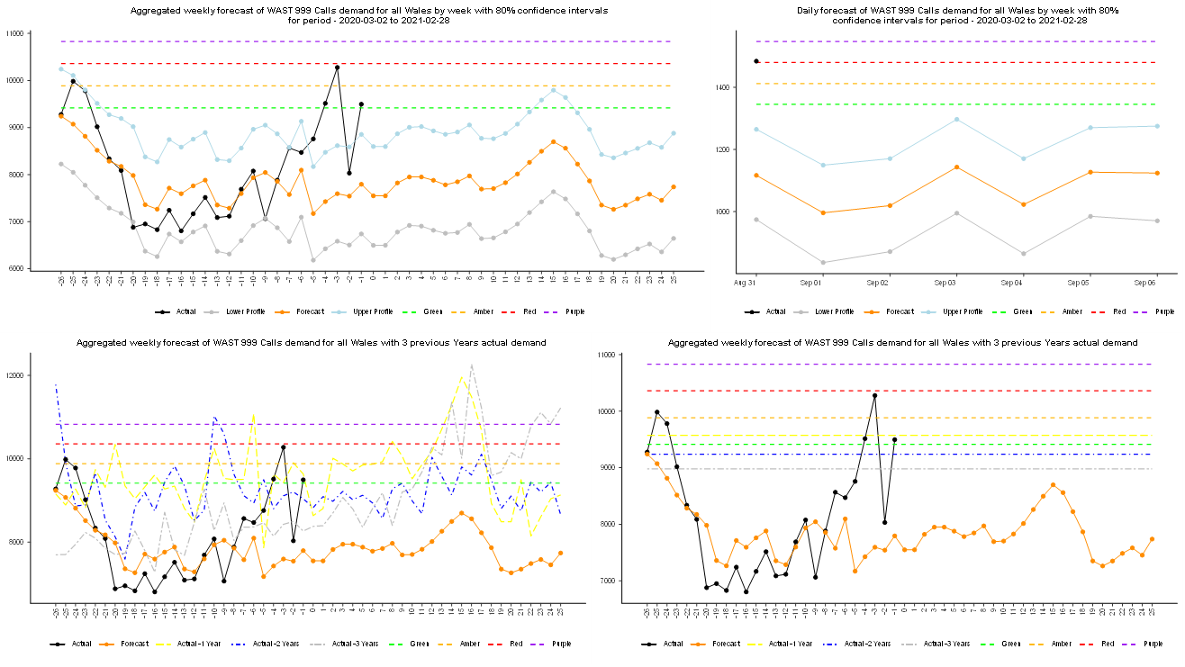
999 Calls

Slide 5
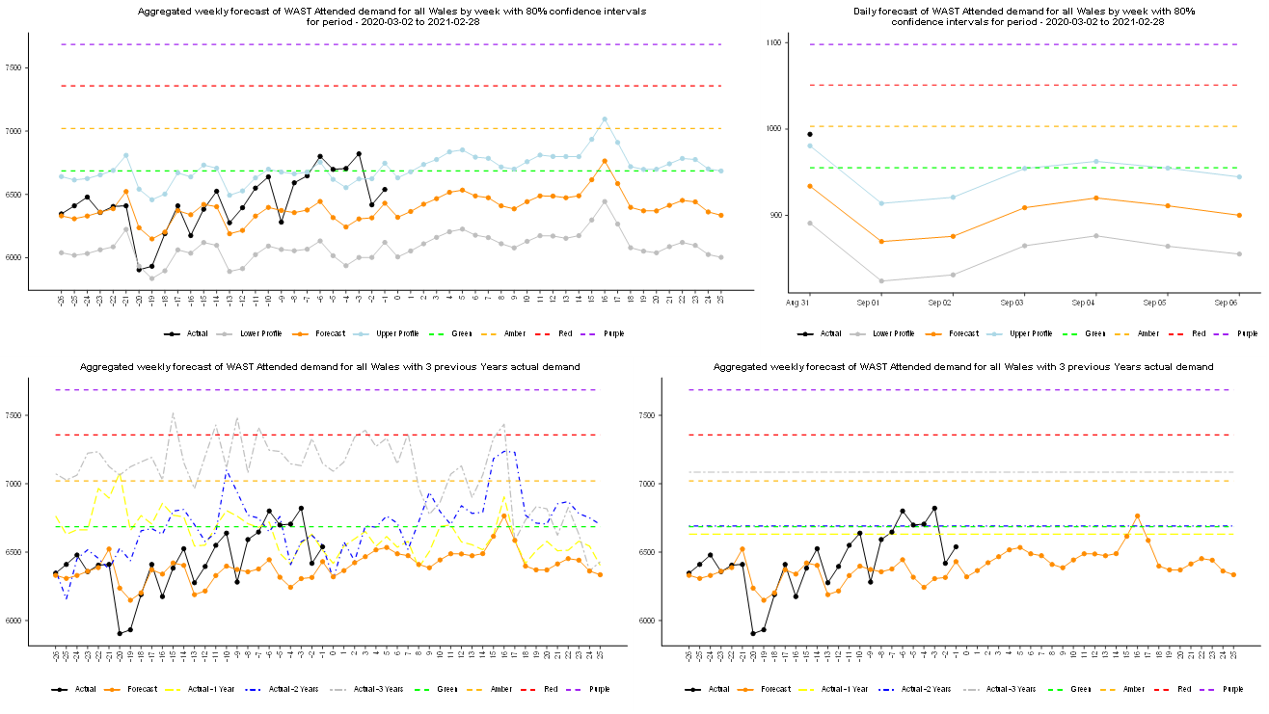
Incidents

Slide 6
Production Comparison August

Slide 7
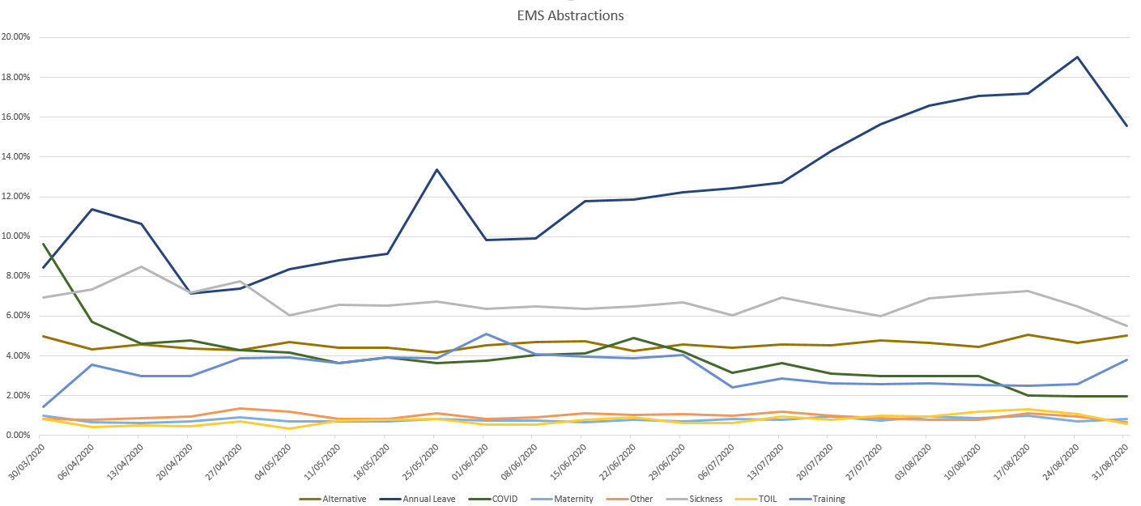
Abstractions

Slide 8
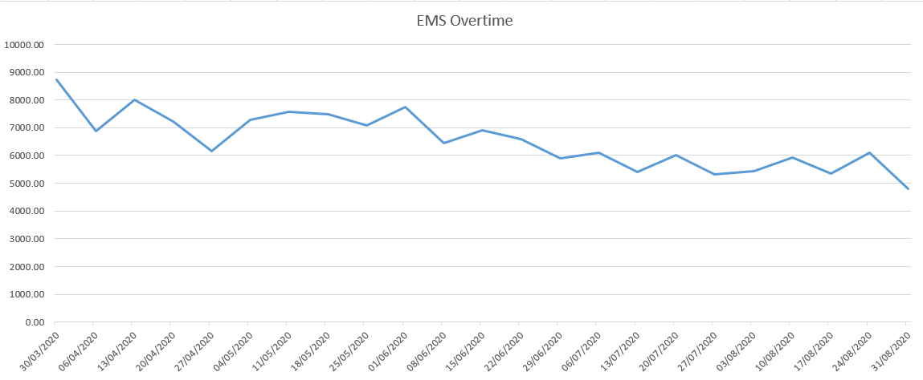
Overtime

Slide 9
Abstractions

Slide 10
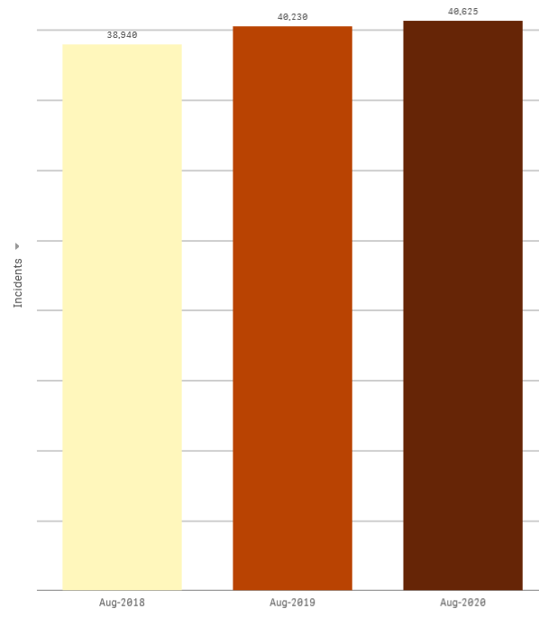
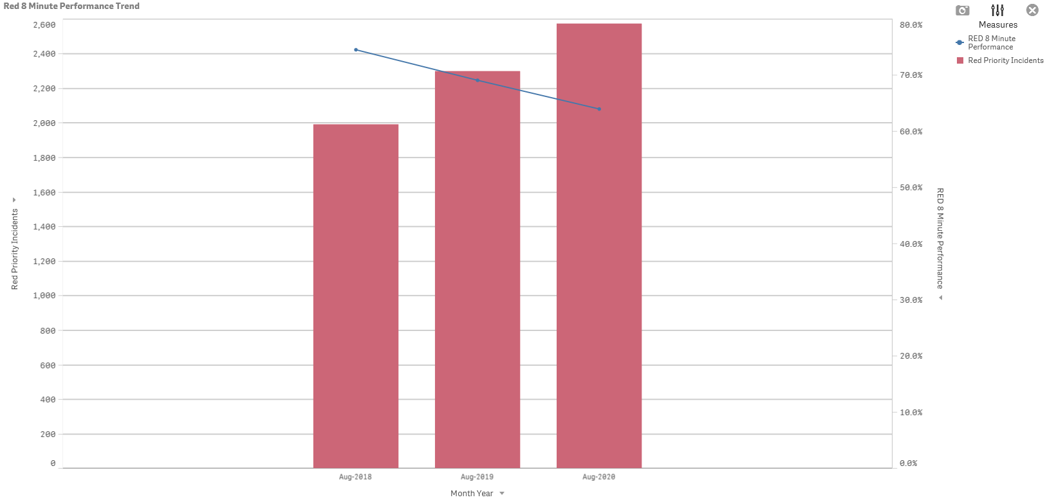
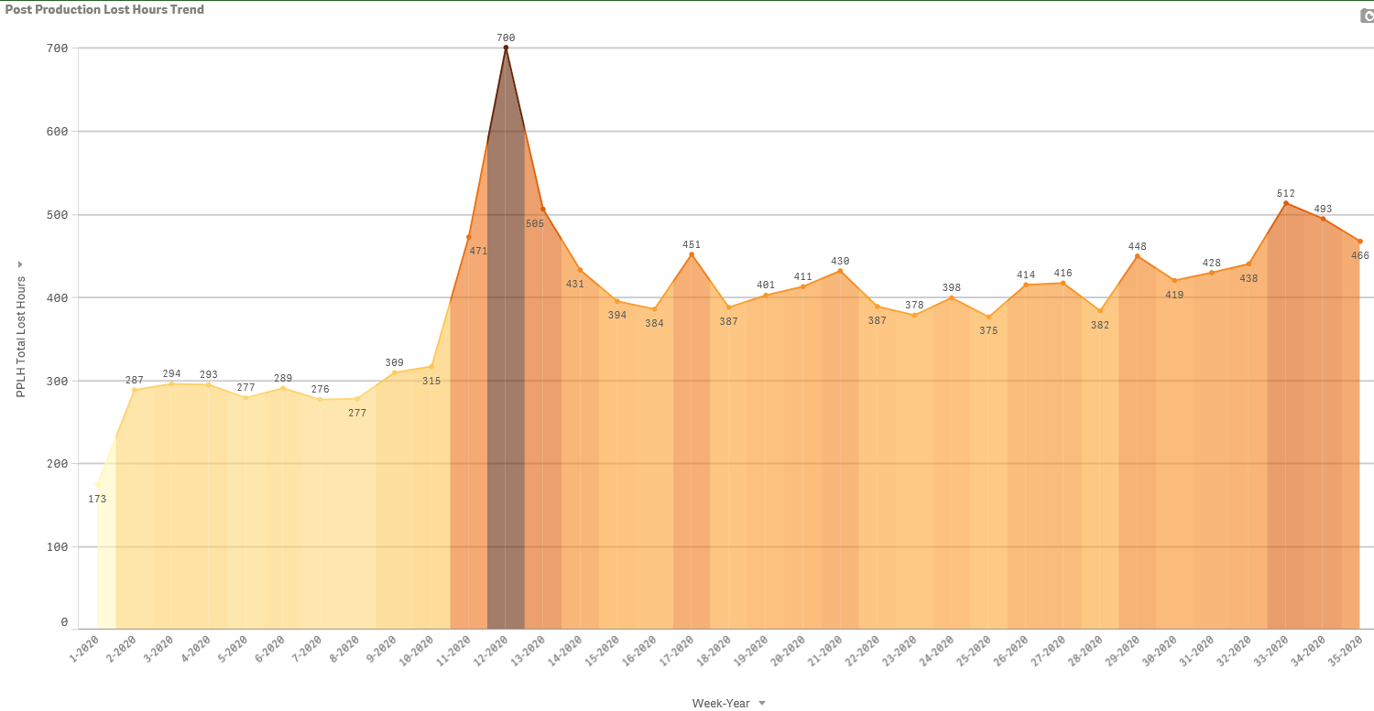
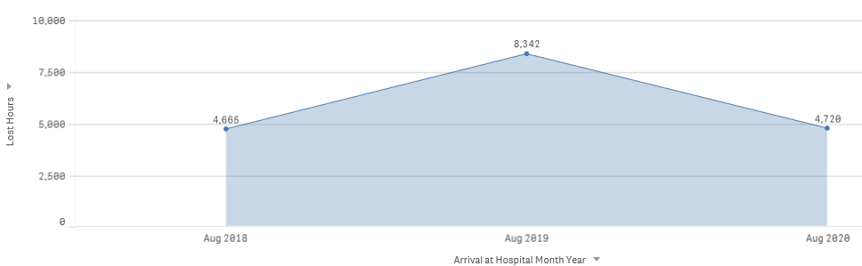
August Comparisons

Slide 11
EA Utilisation
Up to 3% to be added for rest break impacts
Utilisation beyond 60% can introduce red performance challenge
55% can be considered an industry standard

Slide 12
Staffing
 | Budgeted Establishment | SIP as at 11.08.2020 | Notes
UCS | 196.96 | 206.13 | Additional 38 commence training end of August and operational September (ready to backfill UCS vacancies created by existing UCAs transitioning to EMT)
EMT | 377 | 426.27 | 56 of these are currently in training; available to Ops in September
Para | 860.58 | 855.92 | NQP training commences end of August (first 18 due into Ops September)
We are not seeing the impact of the EMT additionality yet as they are currently in training and won’t be operational until September
Even though we have large EMT numbers in training, there is front-filling with replacement UCAs. It does however leave some gaps on the EMT line, as not all of these staff are additionality (some are filling existing EMT vacancies)
The 136 additionality is a contribution towards closing the relief gap (phase 1) not directly linked to improve red performance

Slide 13
September 2020 - Forecast
07 Sept 2020

Slide 14
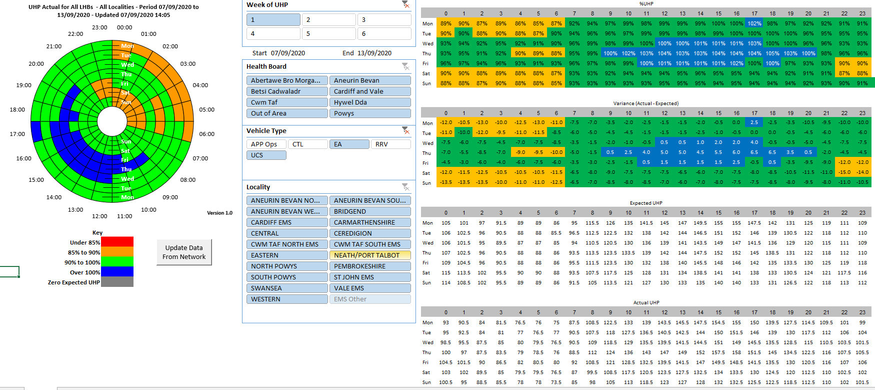
UHP – EA/UCS
Source – UHP Toolkit
14
14
Notes:
Not populated by HI

Slide 15
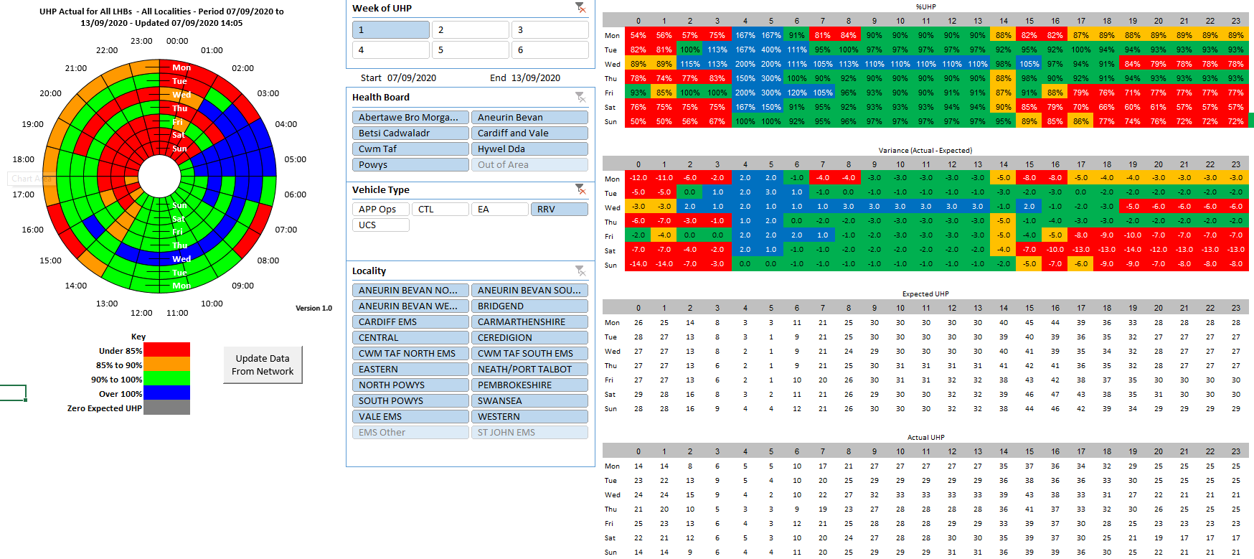
UHP – RRV
Source – UHP Toolkit
← Position on Monday
15
15
Notes:
Not populated by HI

Slide 16
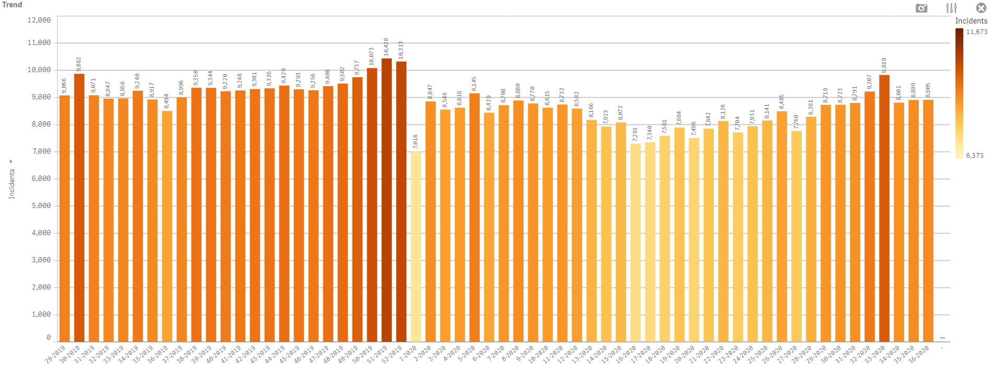
WEEKLY EMS INCIDENTS
16
Notes:
Go to Qlik app EMS OPS (AS1) FULL SLIDE 8 AND 10 (TOP GRAPH)

Slide 17
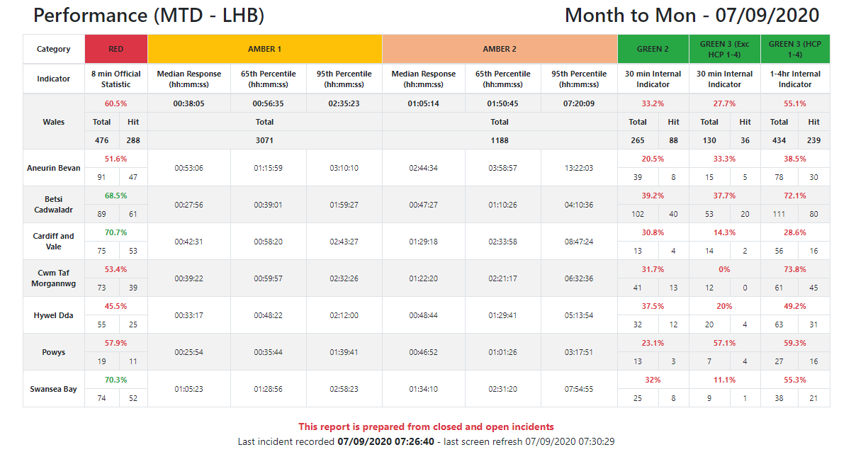
MONTH TO DATE PERFORMANCE
Source – Launchpad
17
Notes:
Source Launchpad - https://launchpad.wales.nhs.uk/Performance/MTD/Default.aspx

Slide 18
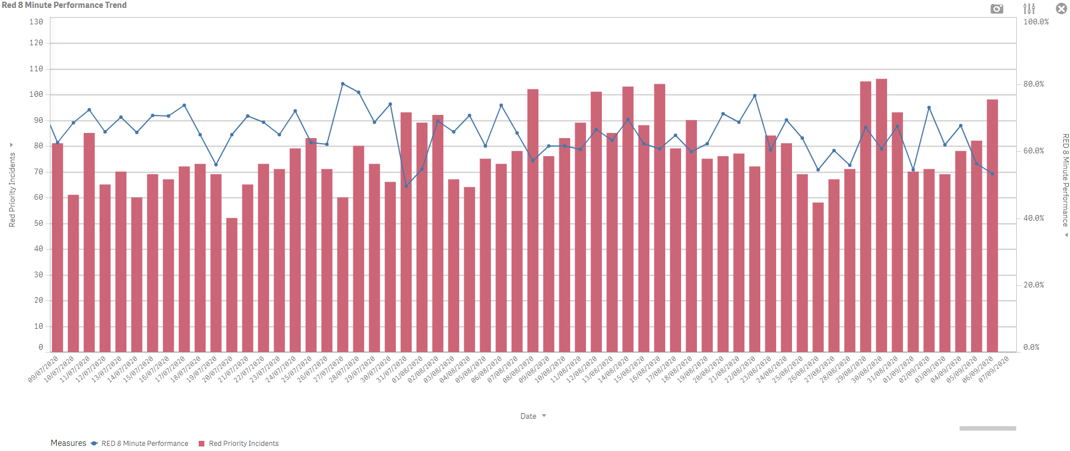
DAILY RED PERFORMANCE
18
Notes:
Go to Qlik app EMS OPS (AS1) Full SLIDE 12 13 14

Slide 19
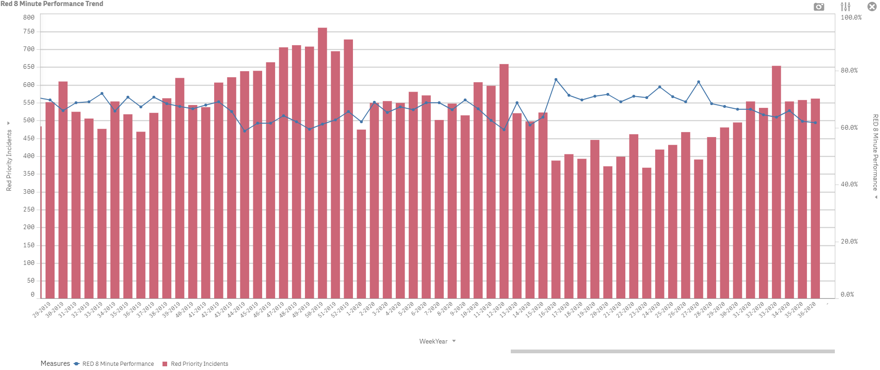
WEEKLY RED PERFORMANCE
19
Notes:
Go to Qlik app EMS OPS (AS1) Full SLIDE 12 13 14

Slide 20
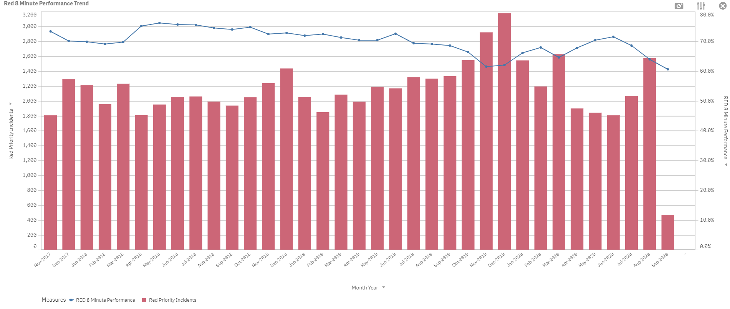
MONTHLY RED PERFORMANCE
20
Notes:
Go to Qlik app EMS OPS (AS1) Full SLIDE 12 13 14

Slide 21
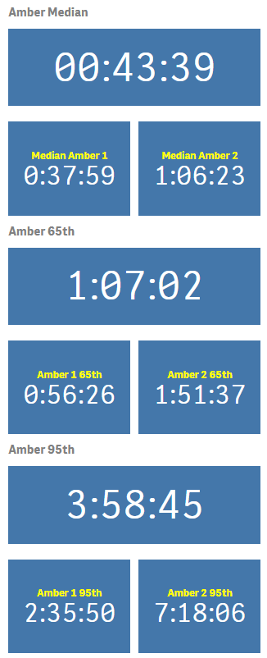
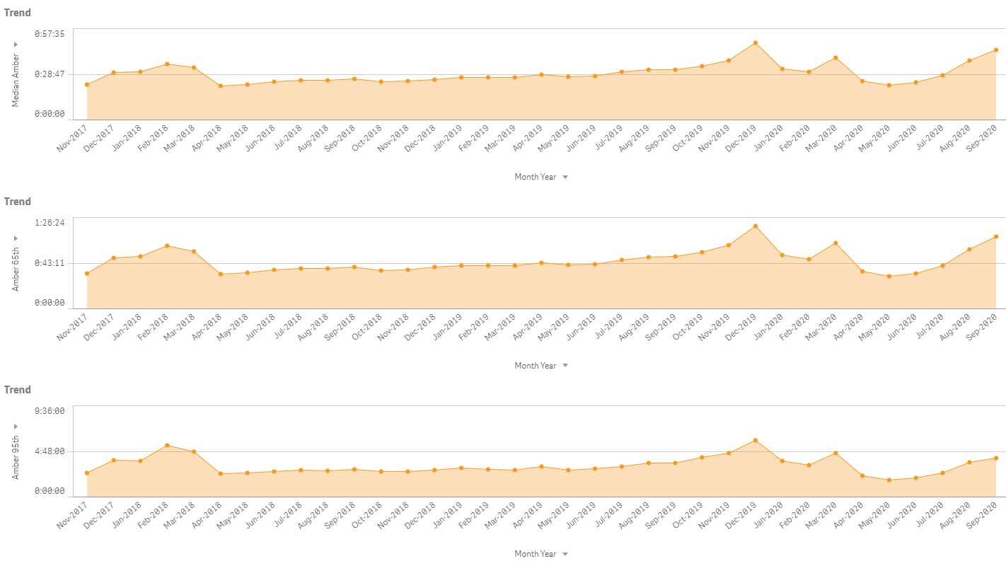
AMBER PERFORMANCE – ALL WALES
Sept MTD
Source – Qlik Sense App EMS Operations (AS1), Bookmark TPT Slide 15 - Amber Performance - All Wales
21
Notes:
Go to Qlik app EMS OPS (AS1) Full SLIDE 21 snip the area charts and select current month then snip the boxes

Slide 22
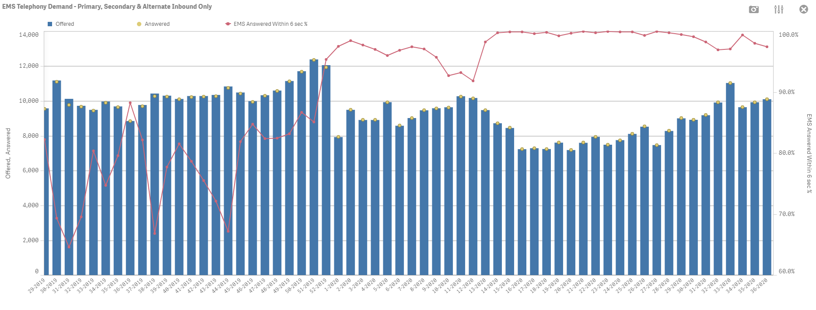
WEEKLY 999 TELEPHONY
Source – Qlik Sense App COVID-19 Executive Summary
22
Notes:
Go to Qlik app COVID EXEC APP Full SLIDE 23 24 25

Slide 23
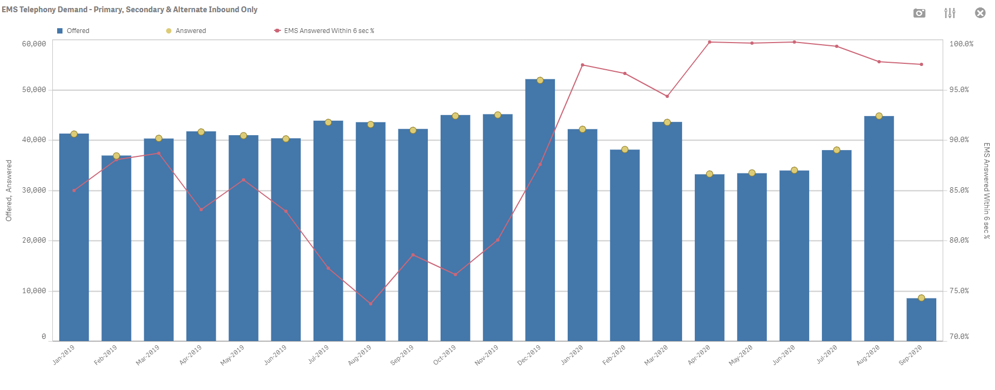
MONTHLY 999 TELEPHONY
Source – Qlik Sense App COVID-19 Executive Summary
23
Notes:
Go to Qlik app COVID EXEC APP Full SLIDE 23 24 25

Slide 24
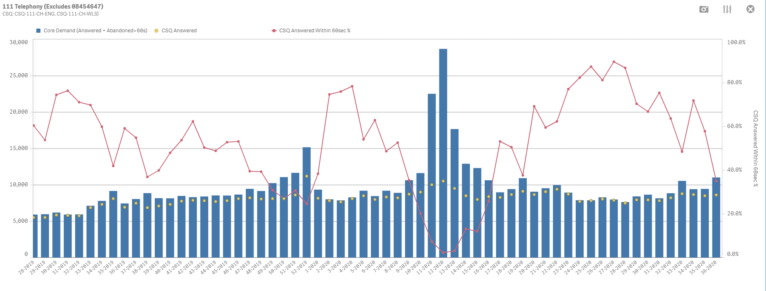
WEEKLY 111 Calls to CSQ
24
Notes:
Go to Qlik app COVID EXEC APP Full SLIDE 26 27 28

Slide 25
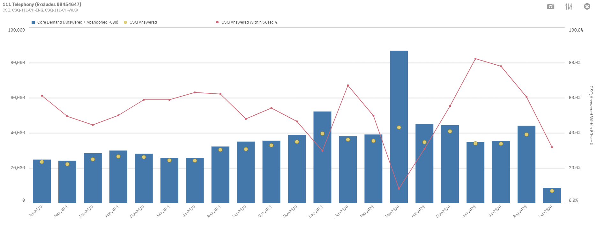
MONTHLY 111 Calls to CSQ
25
Notes:
Go to Qlik app COVID EXEC APP Full SLIDE 26 27 28

Slide 26
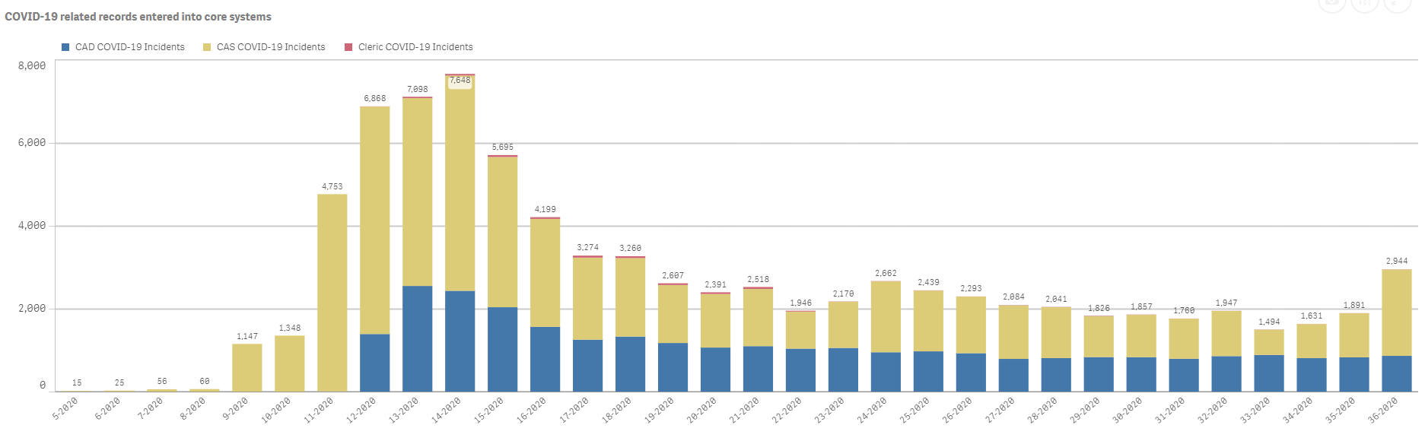
COVID SYSTEM RECORDS
26
Notes:
Go to Qlik app COVID EXEC APP Full SLIDE 29

Slide 27

PROTOCOL 36
27

Slide 28
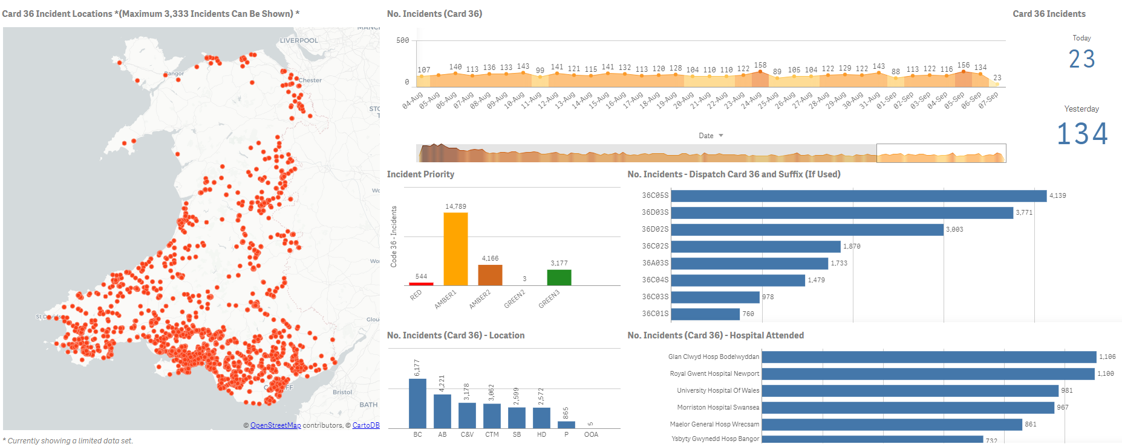
DASHBOARD SNAPSHOT AS AT HH:MM DD/MM/YYYY
Source – Qlik Sense App COVID-19 Surveillance, Bookmark TPT Slide 21 Dashboard Snapshot
28
Notes:
Go to Qlik app COVID Surveillance APP Full SLIDE 33

Slide 29
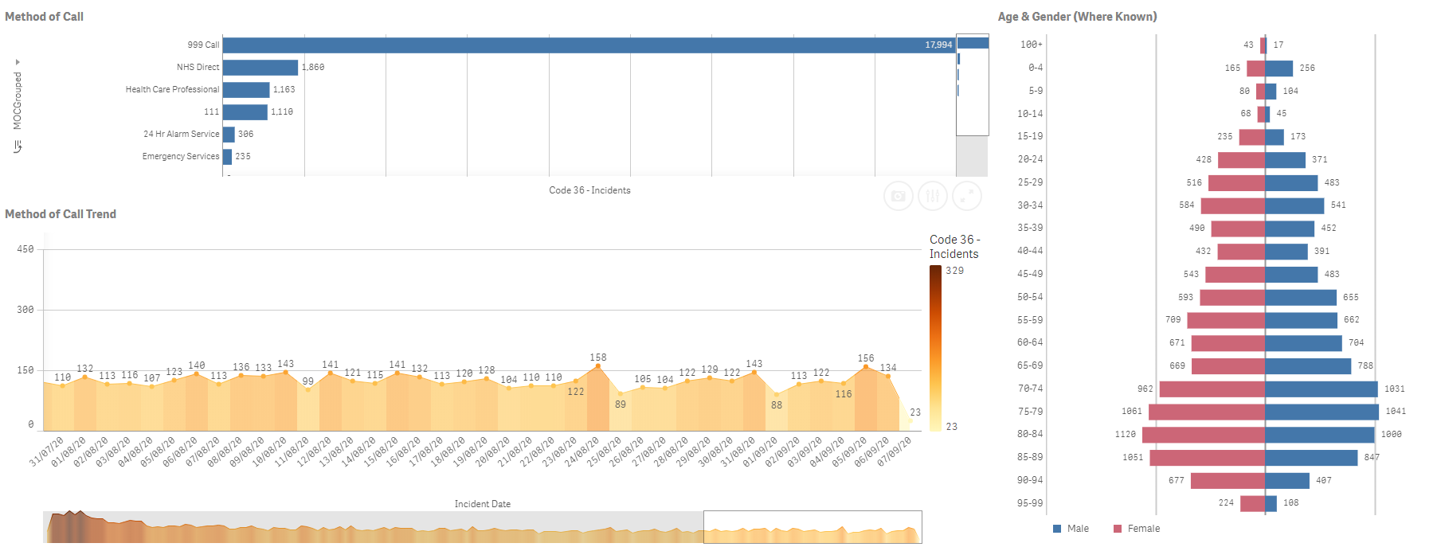
P36 PATIENT PROFILE
Source – Qlik Sense App COVID-19 Surveillance, Bookmark TPT Slide 26 – P36 Patient Profile
29
Notes:
Go to Qlik app COVID Surveillance APP Full SLIDE 40 apply code 36 in nature of inc despatch

Slide 30
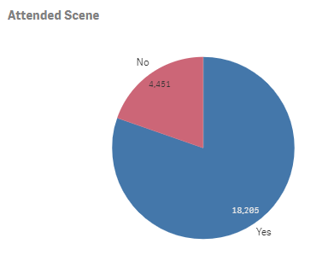
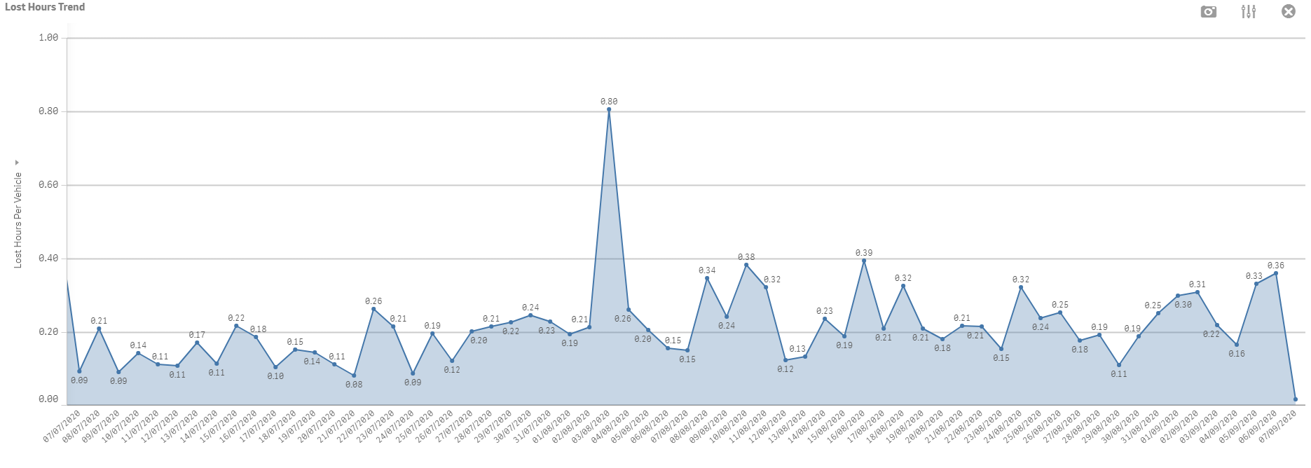
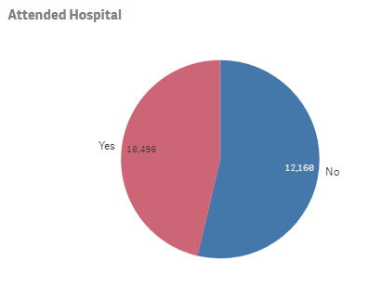
P36 OUTCOME AND LOST HOURS
Source – Qlik Sense App EMS Operations (AS1), Bookmark TPT Slide 27 – P36 Outcome and P36 Lost Hours
Lost hours per vehicle P36
80.4% of P36 we attend scene
57.7% Conveyance Rate from incidents attended scene
30
Notes:
Go to Qlik app COVID Surveillance APP Full SLIDE 41 make a selection for code 36 hover over attended scene yes segment record the % and then click yes attended scene and apply the selection then hover over attended hospital pie chart yes segment and record %

Slide 31
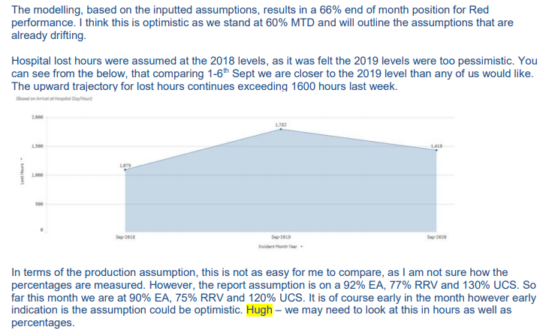
SEPTEMBER PERFORMANCE FORECAST

Slide 32
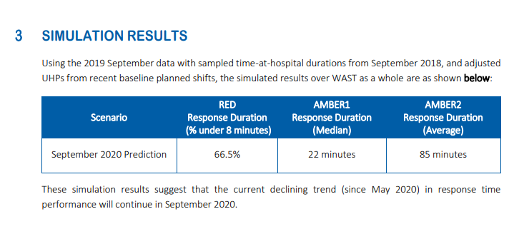
SEPTEMBER PERFORMANCE FORECAST

