Slide 1

‘Focus on’
Non-Emergency Patient Transport Services (NEPTS)
Emergency Ambulance Services Committee Meeting
8 September 2020
James Rodaway

Slide 2

NEPTS Headline Statistics
National Collaborative Commissioning unit
  In 2018/19 NEPTS completed 685,000 patient journeys to and from almost 400 different healthcare settings across Wales & England.
  The total annual distance of NEPTS journeys is almost 10 million miles.
  There are 7 different types of NEPTS patient mobility’s.
  NEPTS use more than 30 different types of resource to deliver the service.
  The NEPTS call taking team answers over 250,000 calls per year, at an average of 1000 calls per day.
Notes:
Strategic design principles to underpin and deliver the vision of USC
The strategic principles that need to be followed to deliver NPUC

Slide 3
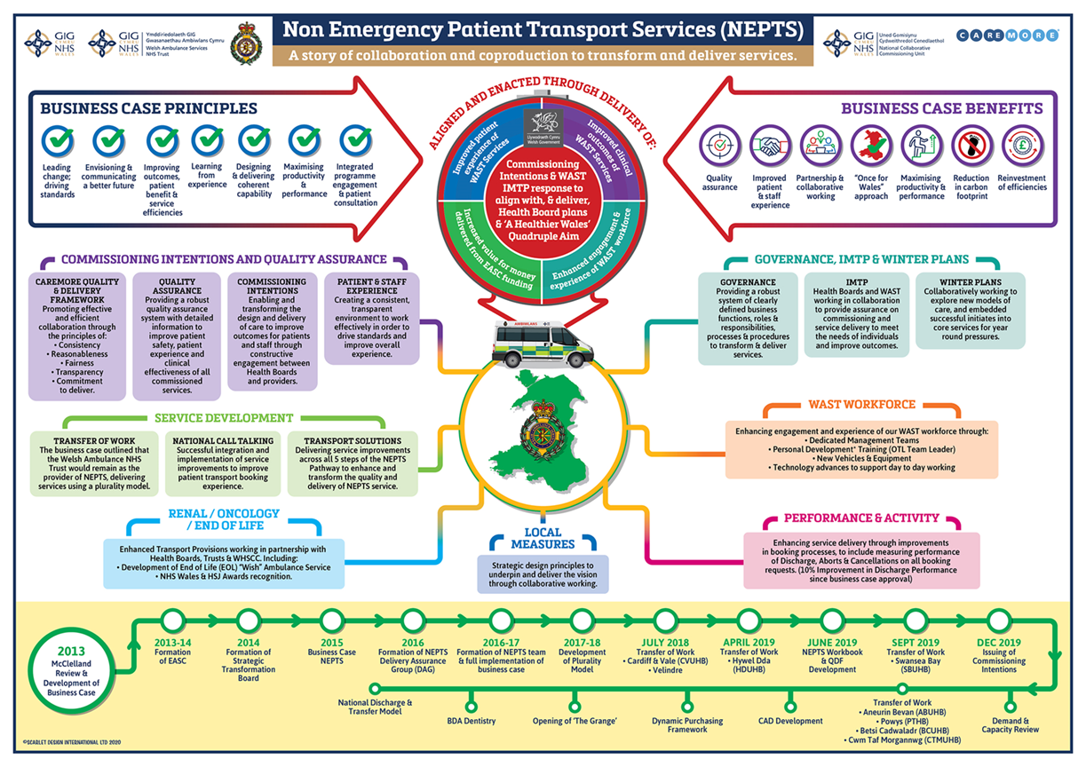
Collaborative Approach: NEPTS DAG
Consistent HB & WAST representation at NEPTS Delivery Assurance Group (DAG)
Co-production and collaborative approach
NEPTS programme of transformation
Significant progress but still work to do on NEPTS in Wales

Slide 4
Commissioning & Quality Assurance
NEPTS Collaborative Commissioning Quality & Delivery Framework signed October 2019
Commissioning Intentions developed through NEPTS DAG
Delivery of commissioning intentions monitored through NEPTS DAG
External providers are quality assured
Monitoring process for external providers
Supporting external suppliers to meet quality requirements through the transfer of work process

Slide 5
NEPTS Service Development
Transfers of Work
C&V UHB, SBUHB, HDUHB, Velindre, Renal Hub has transferred to WAST
PTHB, ABUHB, BCUHB & CTMUHB impacted by COVID but prioritised for completion
National Call Taking
Driving improved performance: reduction in call answer times
One number for NEPTS across Wales
Transport Solutions
Improvements to call booking process, ensure consistency, correct resources, enforce eligibility
Improved performance in pick up and drop off to appointment times
Reduction in aborted or on the day cancelled journeys
Meaningful measurement of patient and staff expereience

Slide 6
Enhanced Service Provision
Renal
Renal patients account for around 30% NEPTS journeys, increasing trend
Renal improvements: subgroup of NEPTS DAG
Oncology
Oncology service provision requires further work
Oncology improvements will be developed through the NEPTS DAG
End of Life
WAST End of Life Rapid Transport Service highly commended at HSJ Awards

Slide 7
Performance/Service Delivery Improvements
Discharge patients collected within 1 hr of the agreed ready time has improved by more than 25% to 87% in the last year
10%+ increase in journeys where the actual transport times were recorded.
Significant reduction in renal patients experiencing reductions or loss of treatment in treatment due to delays in Transport since the inception of the NEPTS business case
Significant delays for end of life transport provision have been eradicated
Improvements made to call answering times and abandoned call levels performance
All external provision procured now undergoes a robust Quality Assurance Process.

Slide 8
Governance & Planning
Qliksense Dashboard developed by WAST through the NEPTS DAG to drive improved performance
Tiered meeting structure developed through the NEPTS DAG to support local commissioning of NEPTS
Transfers of work align WAST & Health Board governance structures
EASC support quarterly & IMTP and planning for NEPTS across Wales
NEPTS will continue to support Winter planning with additional transfer & discharge capacity

Slide 9
NEPTS Demand & Capacity Review
The D&C review is a Commissioning Intention and a WAST IMTP priority for 2020/21
The objective of the D&C review is to re-examine the levels of capacity and efficiency required within NEPTS, to meet future forecast demand and stakeholder requirements
The D&C review will be overseen by the NEPTS D&C Steering Group, which includes membership from WAST, EASC & Health Boards
The work is scheduled to complete early November 2020
D&C review recommendations being presented to NEPTS DAG through November/December and EASC and Trust Board in early 2021
D&C implementation will follow in 2021/22

Slide 10
Impact and Learning from COVID-19
1 September 2020 NEPTS DAG workshop on impact of COVID-19
Renal journeys maintained during COVID-19
Outpatients & Oncology journeys reduced
Impact of NEPTS staff shielding
Patients per journey is reduced: for every 100 journeys we now need 83 separate runs as opposed to 47 pre-COVID-19
Volunteer car service significantly reduced due to COVID
Provision procured to support surge capacity ended mid July

Slide 11
National Collaborative Commissioning unit
Questions

