Slide 1

Transforming Urgent and Emergency (uec) Care
Interventions to reduce risk of harm, and improve experience and outcomes for winter 2020/21

Slide 2
The nhs executive board was asked to:
discuss plans to transform the UEC system to improve outcomes and experience, and mitigate the risks of harm presented by Covid-19 and winter pressures
discuss the proposed change to a quality focused measurement system for urgent and emergency care (UEC) services
consider and identify action required to enable accelerated delivery of the interventions.

Slide 3

Strategic context
A Healthier Wales commitments and design principles:
  A whole system approach where seamless support, care or treatment is provided as close to home as possible;
  Services designed around the individual, based on their unique needs and what matters to them;
  People will only go to a general hospital when it is essential, with hospital services designed to reduce the time spent in hospital;
  A shift in resources to the community that enable hospital-based care (when needed) to be accessed more quickly; and
  Using technology to support high quality services.
  Develop more meaningful measures and use feedback from patients and staff to measure what matters most to people

Slide 4
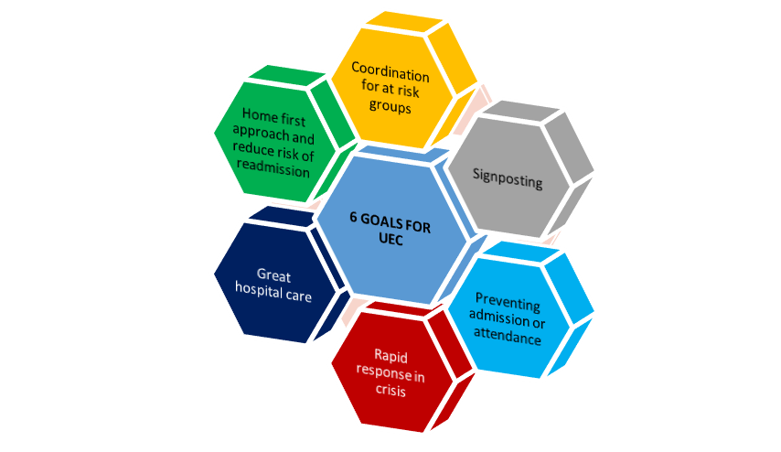
6 goals for uec

Slide 5
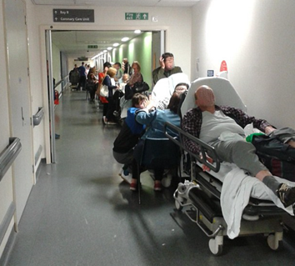
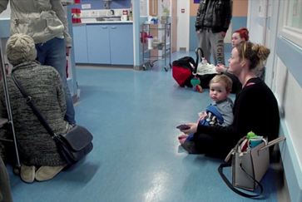
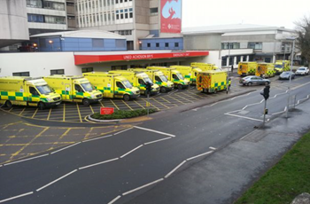
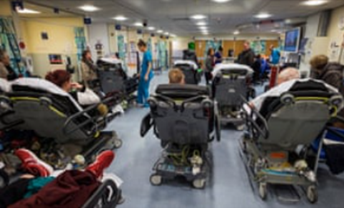
WINTER / COVID-19 CHALLENGE FOR UEC

Slide 6
WINTER / COVID-19 CHALLENGE FOR UEC
Physical capacity > Nosocomial guidance
Respiratory symptoms (influenza, coughs / colds and Covid-19)
Delayed presentations e.g. cancer
Emotional distress /anxiety/ wellbeing issues
Primary and social care activity over the festive period
Return to ‘normal range’ of activity and beyond

Slide 7
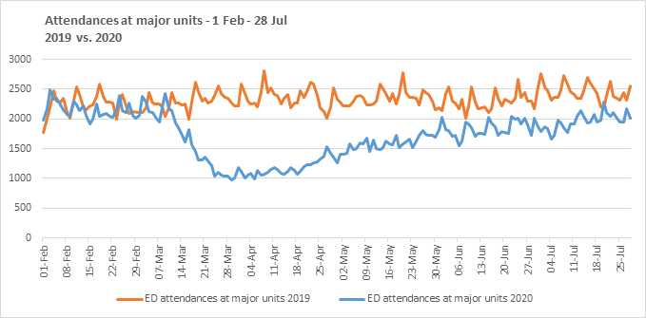
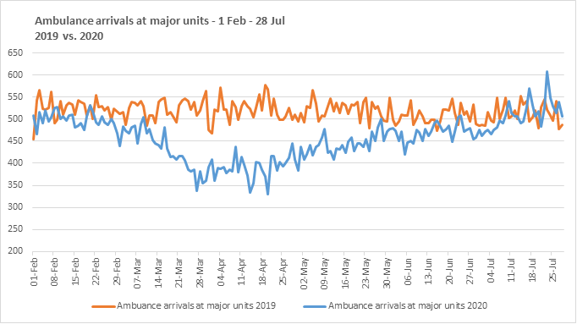
UEC activity returning to normal range

Slide 8
Uec transformation – COVID-19 + OPPORTUNITIES
A real opportunity to use Covid-19 and the winter to accelerate transformation in UEC, reduce risk, improve outcomes and achieve related aHW commitments
The pandemic has shown we can do this at pace, if we are focussed on the key issues and with resources
There is a real appetite for change among key stakeholder groups, Health Boards and NHS Trusts and Once for Wales buy in for transformation from all organisations
Integrated response essential – social services buy-in for transformation in UEC
Need progress across all Health Boards and NHS Trusts
Communications and engagement is really important

Slide 9
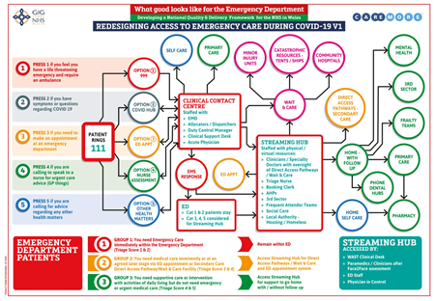
Transforming the uec model – The Emerging model

Slide 10
New UEC model – the key elements Phase 1
New ‘Phone / Contact First’ model (once for Wales)
Stream 999 and 111/GPOOH’s
999:
  Five step clinical model
  Shift left
  Demand and Capacity review and Ministerial Taskforce
111/GPOOH’s:
  Clinical Contact Centre
  Streaming Hub / Flow Centre
  Booked Appointments

Slide 11
New model for uec – KEY pre-requisites and enablers
The model works best if all health boards and trusts are taking it forward and with an integrated health and social services response
Agree the scope for phase 1 ie winter 2020 and implement at pace
A collaborative approach is essential with a balance between national co-ordination support and direction and the need for local implementation to reflect local circumstances
Effective and comprehensive communications and engagement – link to winter protection plan communications, patient survey, a balance between national and local communications with consistent messages, pro-active public and professional engagement
Workforce is a key enabler – close working with HEIW
Information and data is a key enabler – integrated data, appropriate whole system measures, real time data for operational support (dashboard)
National bodies to work together and learning from others

Slide 12
Reviewing uec + measures together
Measures Advisory Group established on request of Minister
National clinical engagement events
What matters to patients and staff - Co-production network
CEs / MDs / NDs / COOs / DoFs / DoPs consulted
Interviews with key stakeholders from across the UEC system
Focus groups on ‘what matters’ (HB and national)

Slide 13
Findings + What matters?
Current ‘silo’ approach to UEC measurement does not drive whole system accountability /improvement for patients
>4 hour target a blunt measure, not person centred, drives perverse behaviours
Quality of care, experience and frequency of communication matters most to patients when accessing care in ED
Whole system measurement and fresh approach to measuring UEC pathway matters to staff
RCEM: “Now is the time to bite the bullet and change the way we measure emergency care. We need to try a new performance framework unencumbered by the four-hour standard if we are to improve care for our patients.” (July 2020)

Slide 14
proposal
Limitations > unable to link patient level data across the system…yet
Whole system approach to drive different focus, behaviours and accountability to achieve improvement for patients
No longer use >4 hour target in ED
Three new ED KPIs + experience information + upstream and downstream measures:
    Preventing transport and admission for specific conditions / complaints
    Timeliness, quality and frequency of assessment in ED
    Improving flow of patients through hospital to reduce risk of harm
    Focusing on timely transfer home to reduce risk of harm and improve outcome
Not perfect and need for greater focus on connecting systems to enable data linkage…however, provides greater context on quality, experience, harm, outcomes

Slide 15
Next steps
Final ‘lap’ of engagement on the options - August and September.
A further ‘what matters to me’ perception survey at Emergency Departments in August and September.
Final recommendations will be set out in a report for and subsequently the Minister for Health and Social Services to include targets or standards for delivery where appropriate – October
Subject to approval, the proposed new measures will be launched over the winter period - December

Slide 16
New UEC model – interventions ahead of winter
New ‘Phone / Contact First’ model (once for Wales):
  signpost people to the right place or clinician, first time.
  People with non-life threatening conditions will be able to access clear, professional advice on which service is best suited to meet their needs.
  Remote assessment by a suitably qualified doctor or a nurse and, depending on the severity of the condition, they may be:
      encouraged to self-care;
      signposted to a more appropriate service in their local community; or
      directly booked in to an appointment in an Emergency Department if they need further assessment and treatment.
  All UK nations committed to delivering this model.

Slide 17
New model for uec – interventions ahead of winter
The NHS Wales 111 online symptom checker tool and bespoke apps
WAST / 111 call handling and telephone advice offer(hear and treat)
Health Board - flow centres and hubs
Agree priorities for advice and hubs – minor illness, respiratory, mental health, falls and urgent dental
‘Consultant Connect’ to provide remote /virtual advice to GPs on patients who may previously have automatically been referred to the Emergency Department
Discharge to recover and assess pathways and right sizing community capacity
Care home support with access to clinicians in a ‘flow hub’, Consultant Connect or ‘Attend Anywhere’
Demand and Capacity – how are we going to use additional capacity to support UEC this winter

Slide 18
summary
Successful delivery of the six goals approach, transformational interventions and their underpinning operational plans will change the ways that patients access UEC.
This should result in both an improved experience and outcome for patients and reduced risk of nosocomial transmission.
Greater efficiency and clinical effectiveness through treating patients at the most appropriate care setting for them.
Currently no additional funding / resources to support operational implementation at national or local level. £450m allocated to UK Government for UEC capital improvements in England.
Additional resource would enable accelerated delivery.

Slide 19
The nhs executive board was asked to:
discuss plans to transform the UEC system to improve outcomes and experience, and mitigate the risks of harm presented by Covid-19 and winter pressures
discuss the proposed change to a quality focused measurement system for urgent and emergency care (UEC) services
consider and identify action required to enable accelerated delivery of the interventions.

Slide 20
Reference material
Welsh Access Model
Delivery Unit – Right Sizing in the Community
Benchmarking Audits – Emergency Departments and Intermediate Care
Maturity Matrix – Phone First Maturity Matrix
CAV 24-7 presentation
National programme for Primary Care – 24/7 workstream
National Unscheduled Care Programme - EDQDF
Winter Plan – Respiratory Health Implementation Group
Urgent and Unscheduled care data flow and linkage

