Slide 1



Variables Affecting RED Performance
08 July 2022
Tef Jansma
Lead Analyst EMEA

Slide 2
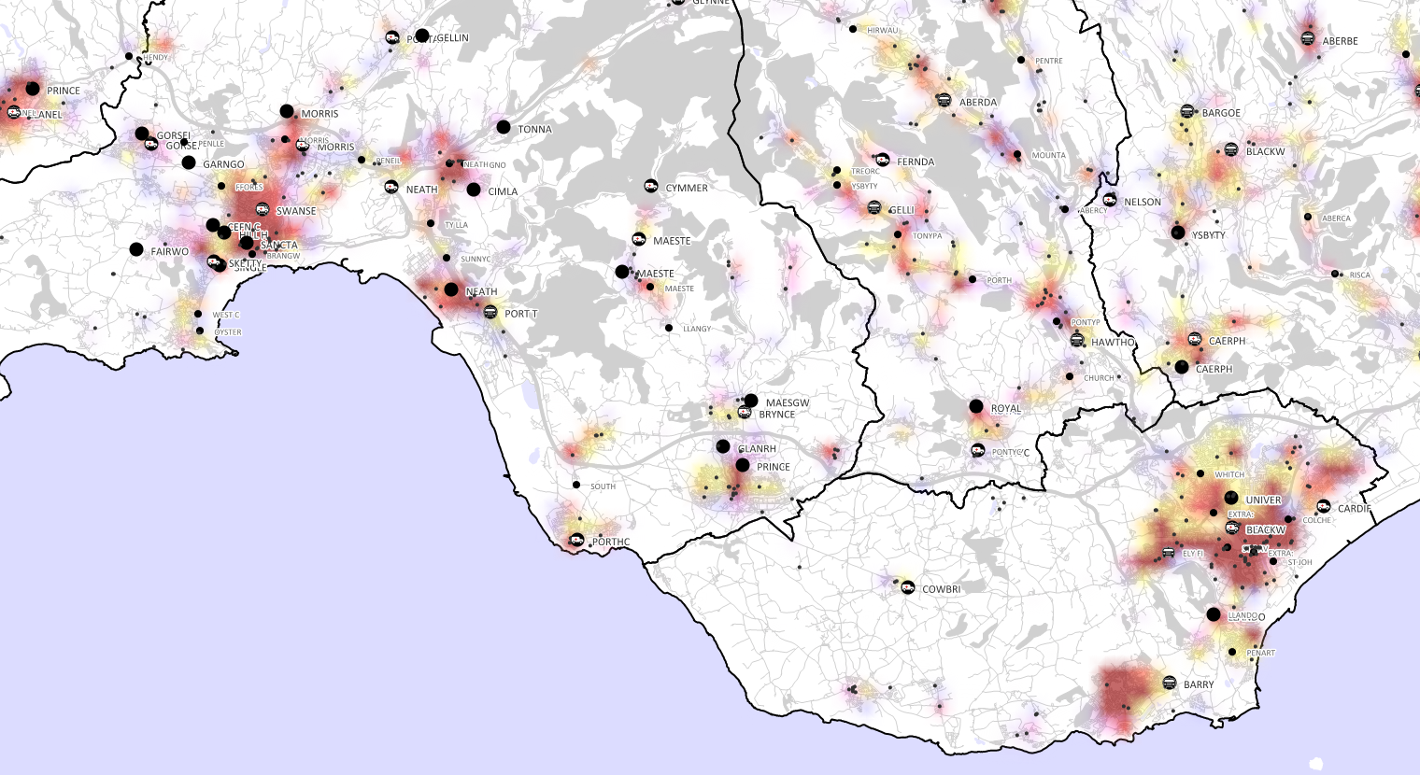
RED Performance correlations
Which factors influence RED performance?

Slide 3
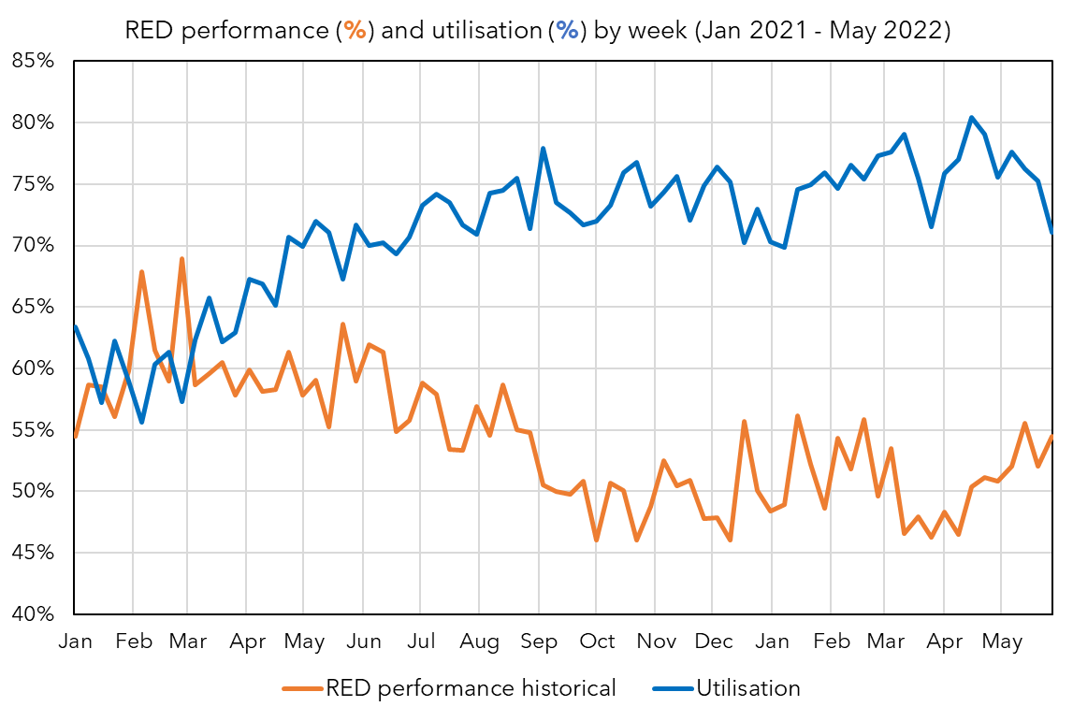
RED performance & vehicle utilisation
The overall average utilisation (= the percentage of the time a vehicle is busy with a call) has increased from ~60% to ~75 over the past 18 months.
This is the average per week, over all vehicles (EA, RRV, UCS). For ambulances (EA) it is even higher (>80%).
There is a clear inverse relationship with the RED performance (%).
A high utilisation makes it impossible to achieve a high RED performance. A certain amount of excess vehicle availability is required.

Slide 4
RED performance & vehicle utilisation
This analysis can be taken a step further by calculating correlations (%). A correlation says how one variable (for example, RED performance) is affected by another variable (B).
Correlation of 60% = 60% of the increase in RED performance can be explained by increase of B.
Correlation of -50% = 50% of the increase in RED performance can be explained by decrease of B.
Correlation of 10% = only 10% of the increase in RED performance can be explained by increase of B.

Slide 5
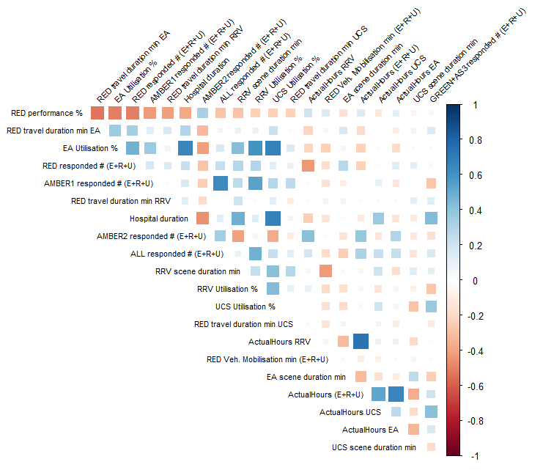
RED (%) correlogram (Jan + Feb 2021)
RED performance top correlations (top row):
-53% RED Travel Durations of EA vehicles
-50% EA Utilisation
-50% Number of RED calls responded to
-43% Number of AMBER1 calls responded to
-42% RED Travel Durations of RRV vehicles
-32% Duration spent at hospital
+32% Number of AMBER2 calls responded to
RED performance in Jan + Feb 2021 was driven by many factors: travel durations, utilisation, demand, time spent at hospital, etc.

Slide 6
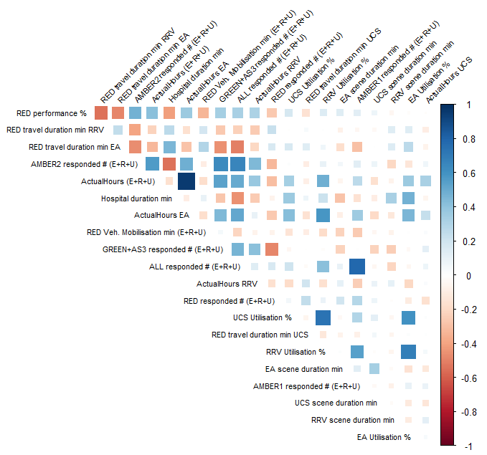
RED (%) correlogram (Jan + Feb 2022)
RED performance top correlations (top row):
-55% RED Travel Durations of RRV vehicles
-48% RED Travel Durations of EA vehicles
+48% Number of AMBER2 calls responded to
+41% Actual Hours of EA + RRV + UCS
-41% Duration spent at hospital
+36% Actual Hours of EA
-34% RED Vehicle Mobilisation Duration
Compared to Jan + Feb 2021, the RED performance in Jan + Feb 2022 was more driven by travel durations, lower AMBER2 responded demand (=Clinical Safety Plan) and slow hospital handover durations.

Slide 7
Key insights
Some key insights from this analysis:
There is not a single variable (among the dozen of chosen ones) that has a much higher correlation than others. So it's not a matter of "fix one thing and it will fix RED performance".
None of the correlations is particularly high: the highest is 55%. If you were to do this analysis on AMBER1 or AMBER2 response durations, you would probably find a few variables with a correlation between 70% - 80%. This again confirms that RED performance is more difficult to influence than for example AMBER1 or AMBER2 response durations.
There are a lot of variables that have similar correlations (half a dozen are between 40% to 55% correlation). This suggests that either a lot of things independently need to be improved to improve RED performance, AND/OR that there is a common variable (which may or may not be among the chosen ones in this analysis) that is influencing all of these variables together.

Slide 8
Thank you for your attention!
You can also email questions to
tef.jansma@csamhealth.com

